Slide 1
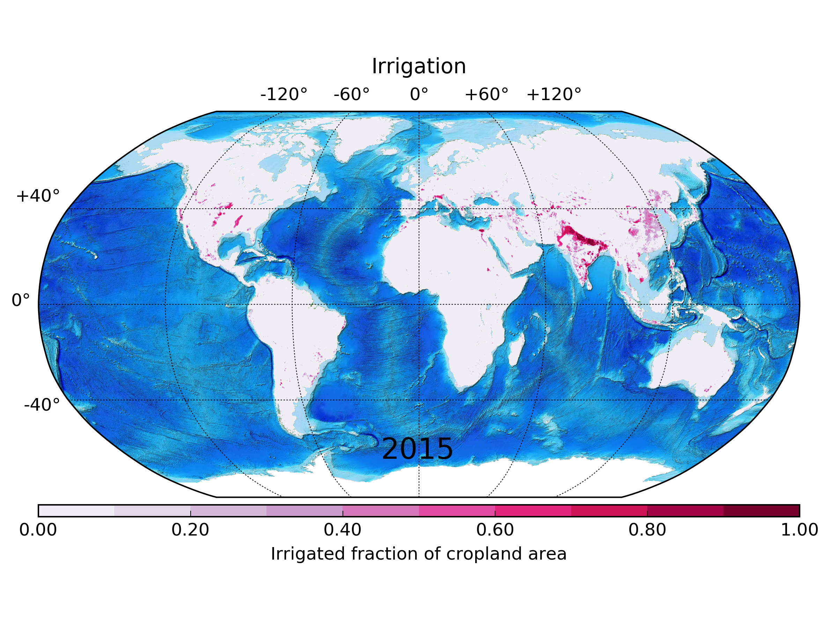
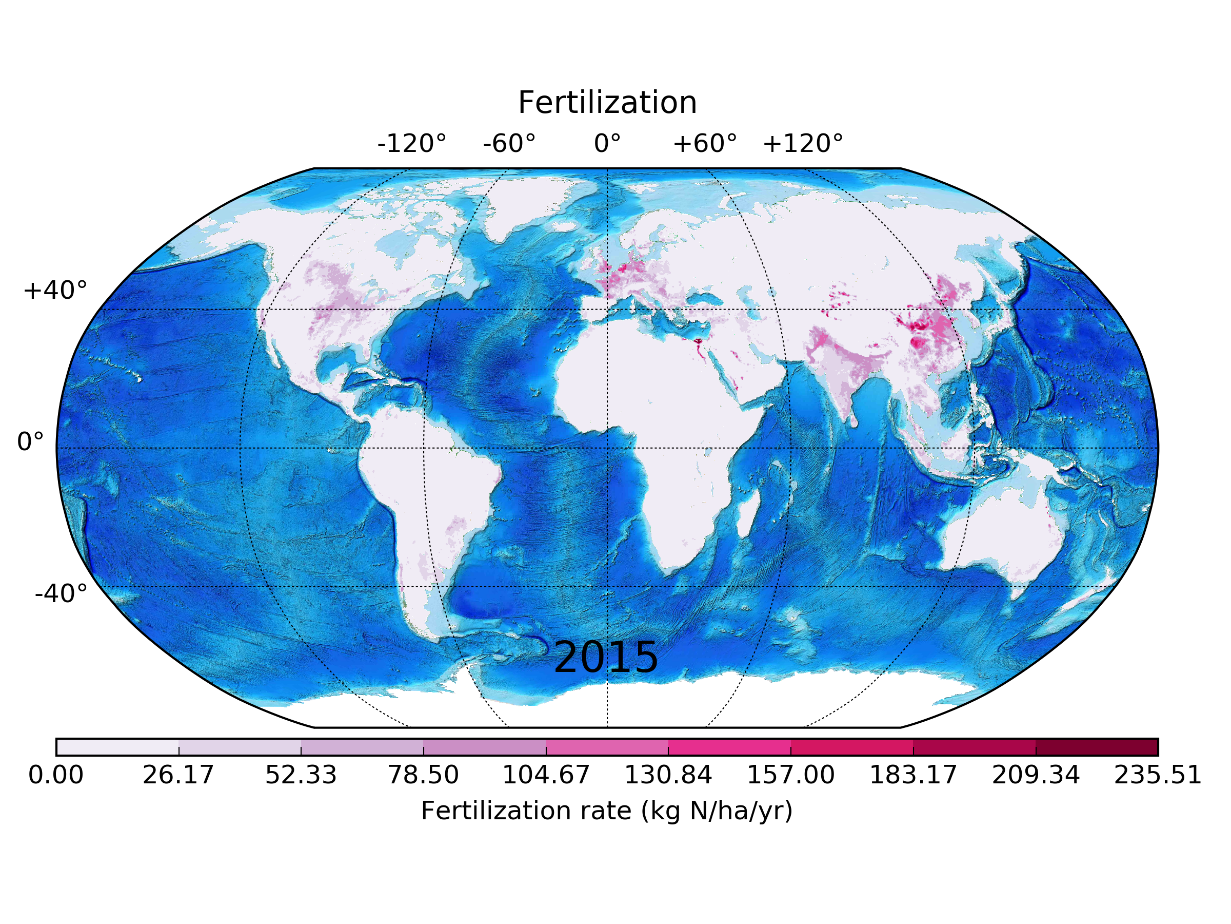
P:
Land-Use Change in ACME
George Hurtt¹, Louise Chini¹, Ritvik Sahajpal¹, Peter Thornton²
¹ Department of Geographical Sciences, University of Maryland-College Park
² Climate Change Science Institute/Environmental Sciences Division, Oak Ridge National Laboratory
B
A
Issue: Uncertainty in land-use effects on climate
Human land-use activities have significantly altered
biogeochemical and biogeophysical properties at local to
planetary scales, and these alterations have influenced the
environment including the Earth’s climate system. Yet the
precise magnitude and character of land-use effects on
climate remain uncertain, and this uncertainty in turn limits
the accuracy of future projections. The overall goal of this
contribution is to develop an expanded and fully consistent
treatment of land-use of in ACME.
C
A. Time-series of global land area occupied
by each land-use state from 850AD to 2015AD
B. Global irrigated fraction of cropland area
C. Global industrial fertilization rate
Solutions: Expanded and fully consistent treatment of land-use in ACME
Solution 1 (LG-144): Establish use of the new expanded land-use harmonization dataset in ACME.
For CMIP6, the new required land-use harmonization dataset is updated and contains ~50x the information used in CMIP5. This new information
is at higher resolution over longer time domain, and includes additional new land-use transitions, crop types, and agriculture management
information not previously available. We will develop new algorithms and code to include these new data into ACME.
Solution 2 (LG-145): Develop and implement fully consistent (1 carbon cycle) historical land-use treatment for ACME.
Global land-use history datasets are traditionally developed independently offline using best available historical information, and then used as
input to global models. While efficient, this separation leads to inconsistencies, as past land-use activities may be prescribed in areas inconsistent
with modeled climate and vegetation. These inconsistencies in turn lead to model errors. We will integrate the ACME land model with
our land-use harmonization product to reduce these errors, thereby eliminating major sources of within model error/uncertainty.
For additional information, contact:
George Hurtt
Professor & Research Director
University of Maryland, College Park
(301) 405-8541
gchurtt@umd.edu
climatemodeling.science.energy.gov/acme

