Slide 1
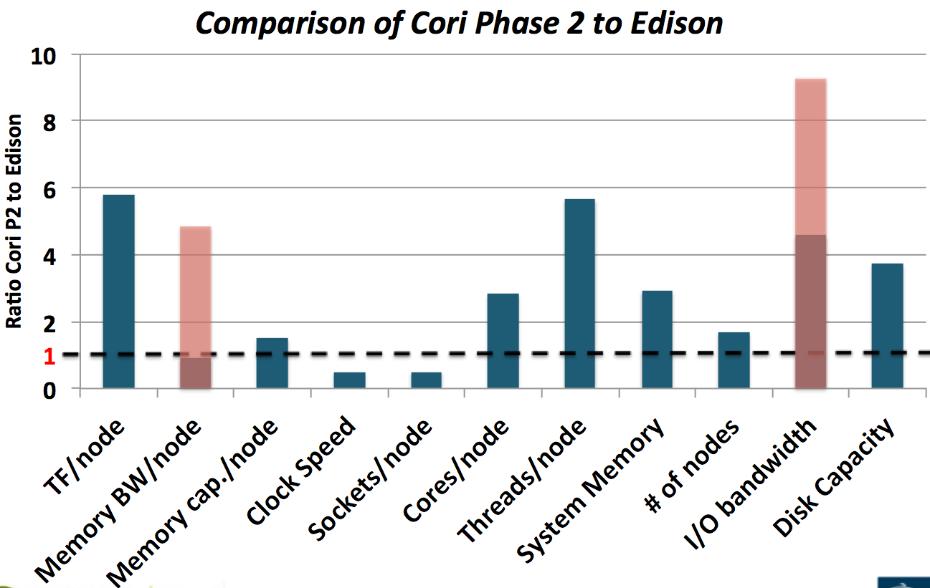
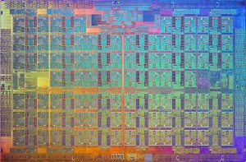
NERSC Exascale Science
Application Program (NESAP)
Doug Jacobsen, Hans Johansen, Noel Keen, Mark Taylor
Hypothesis
ACME will run on Cori “Phase 2” but … code changes will be needed!
Cori Phase 2 will have ~9300 Intel Knights Landing (KNL) nodes with
3+ TFLOPS (double precision) each.
KNL processors have up to 72 cores, eich with 4 threads and 2 vector processing units (VPU) that each support 8 double-precision vector lengths (so 16 DP per / core). Each node comes with up to 16GB of on-package memory (MCDRAM) that provides ~400 GB/s of bandwidth.
In addition, Cori’s NVRAM “Burst Buffer” can provide 750 GB/second of peak I/O performance.
From: “What public disclosures has Intel made about Knights Landing?”, Intel Developer Zone site, 6/3/2016
Cori’s Intel KNL nodes have ~6x FLOPS (30 PFLOPS!) and will have greatly improved memory, as well as I/O bandwidth due to Cray’s Burst Buffer design. KNL will likely have a much slower clock speed, so performance gains are from thread parallelism and vectorization, which require effective use of memory.
Developments Required
Expected Impact
ACME code changes will need to be prioritized based on our early access through the NESAP program (both ACME and MPAS-O).
Vectorization:
Loops will perform best with unit stride, 512-bit (8 doubles) aligned memory on inner loops. Iterations that have non-unit stride or indirect indexing (“pointer chasing”) will be slower.
Code may be more efficient working on unit-stride “chunks” of columns, where odd-sized (non-multiple of 8) can be vectorized in horizontal dimensions first.
If inner loops have conditionals (max) or branching (if / else) statements, they may need to be re-written to help the compiler do efficient vectorization.
Threading:
OpenMP will have to be “tiled” so that threads cooperate on the 1 MB L2 cache (shared between 2 cores), and take advantage of high b/w streams from the MCDRAM.
Careful placement of threads vs. allocated memory will be needed to avoid cache misses.
Serial code that is not thread safe will suffer from both wait barriers and memory issues.
These may require pervasive code refactoring, and may change interfaces for performance!
Refactoring ACME code to perform better needs agility:
Science, software, and performance teams need to work together on:
Small tests and kernels that can identify (safe) optimizations quickly.
Ability to refactor data structures for potential 16x vectorization gains.
Identifying critical code regions that are not threading or vectorizing well.
Going forward, if we do not address these lost opportunities with ACME v1, this will be a detriment on future Intel-based systems, such as ALCF’s Aurora (180-450 petaFLOP/s, approximately 50,000 nodes, featuring the next-generation Intel Knights Hill processor), and potentially other DOE leadership-class machines.
MPAS-O MPI vs. OpenMP performance study showing 6x performance improvement on Cori Phase 1 (Haswell).
From: CUG 2016 paper “Exploiting Thread Parallelism for Ocean Modeling on Cray XC Supercomputers”, A. Sarje,
D. Jacobsen, S. Williams, T. Ringler, L. Oliker
For additional information, contact:
Hans Johansen (LBNL, ACME)
Doug Jacobsen (LANL, MPAS-O)
hjohansen@lbl.gov
douglasj@lanl.gov
climatemodeling.science.energy.gov/acme

