Slide 1
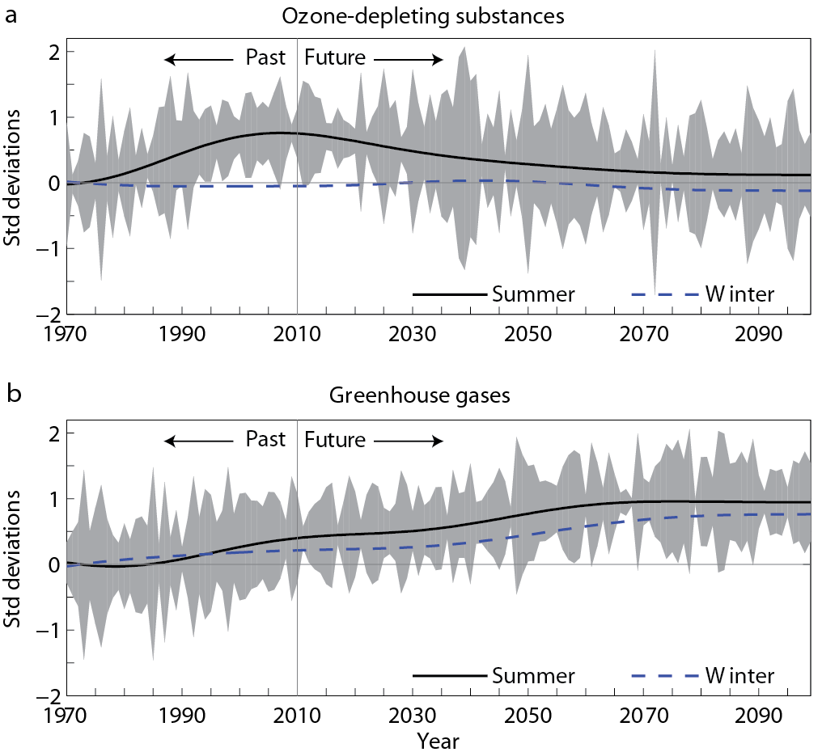
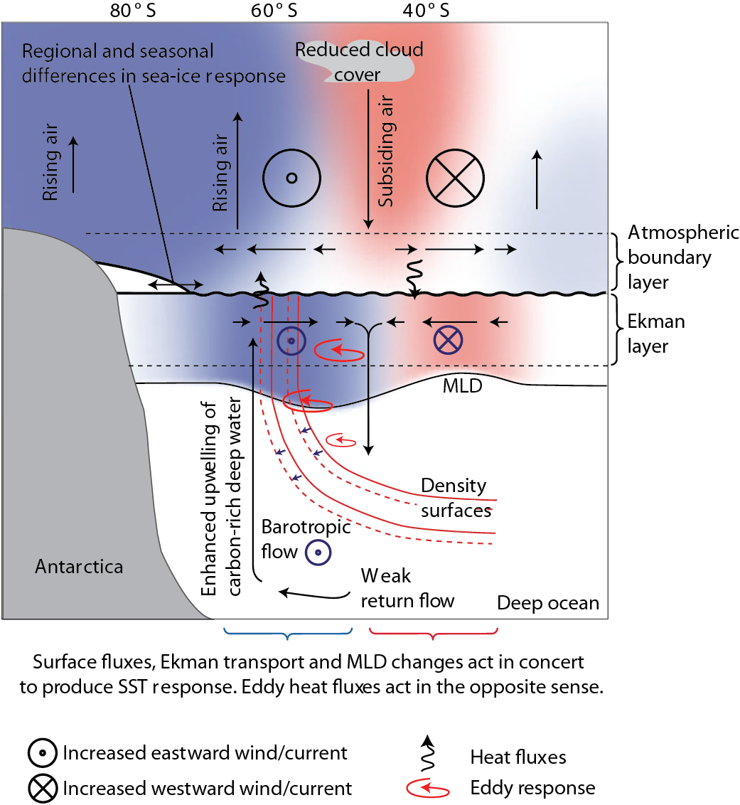
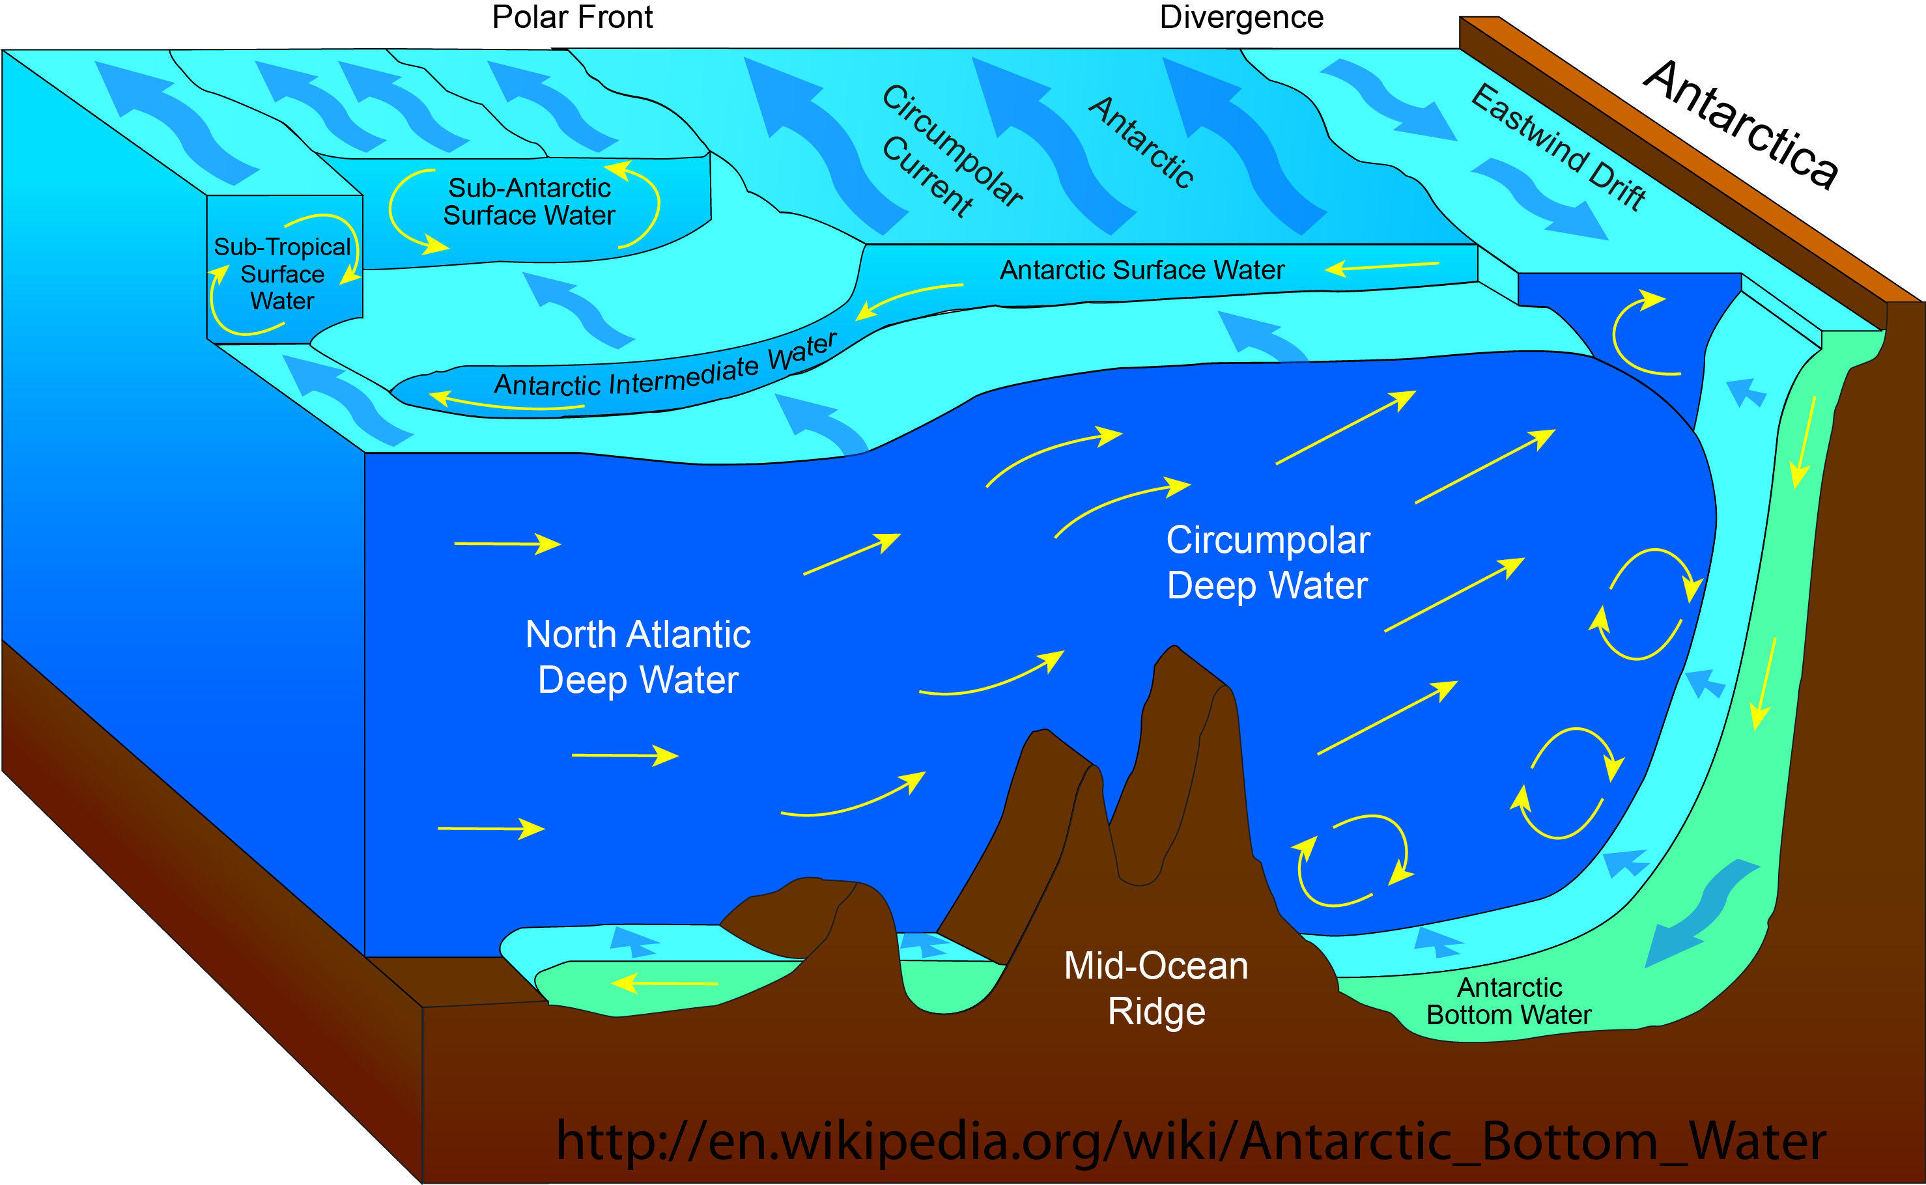
Atmospheric Chemistry in ACME
Philip Cameron-Smith (LLNL), Susannah Burrows (PNNL), Scott Elliott (LANL)
Ozone Hole [Cryosphere v1]
Methane [BGC v2]
Antarctic ozone-hole affects ice-sheets.
Ozone hole → surface winds (SAM) → ocean upwelling → ice-sheet melting.
Interannual variability of ozone hole may affect ice-sheet melting.
Implement in ACME-atm using Linoz (1 tracer),
~1% computational cost.
Methane is 2nd most important greenhouse gas.
Emissions → atmospheric chemistry → concentrations
Highly non-linear function of: clouds, water vapor, temperature, other chemicals.
Implement with chemical solver and ~30 tracers.
Dependent on:
Methane module in land BGC group,
Model top and vertical grid.
Response to Positive SAM index [Thompson, et al., Nature Geo, 2011]
Sulfur Cycle [Hydro, BGC, Cryo, v2]
Natural sulfur emissions are top uncertainty in 20th-Century forcing, & therefore climate sensitivity [Carslaw, Nature 2013].
Dimethyl sulfide (DMS) affects climate:
Ocean ecosys. → DMS emiss. → atm chem → sulfate aerosol → clouds → climate
Major aerosol source in pre-industrial and in future.
4-6 W/m² global-mean in CESM1.2.2.
In 2100-RCP8.5, DMS is the diff between 50% and 0% Arctic sea-ice.
For additional information, contact:
Philip Cameron-Smith
Task Leader: Atmospheric Chemistry
Lawrence Livermore National Lab.
(925) 423-6634, pjc@llnl.gov
climatemodeling.science.energy.gov/acme
This work was performed under the auspices of the U.S. Department of Energy by Lawrence Livermore National Laboratory under Contract DE-AC52-07NA27344. LLNL-POST-

