Slide 1



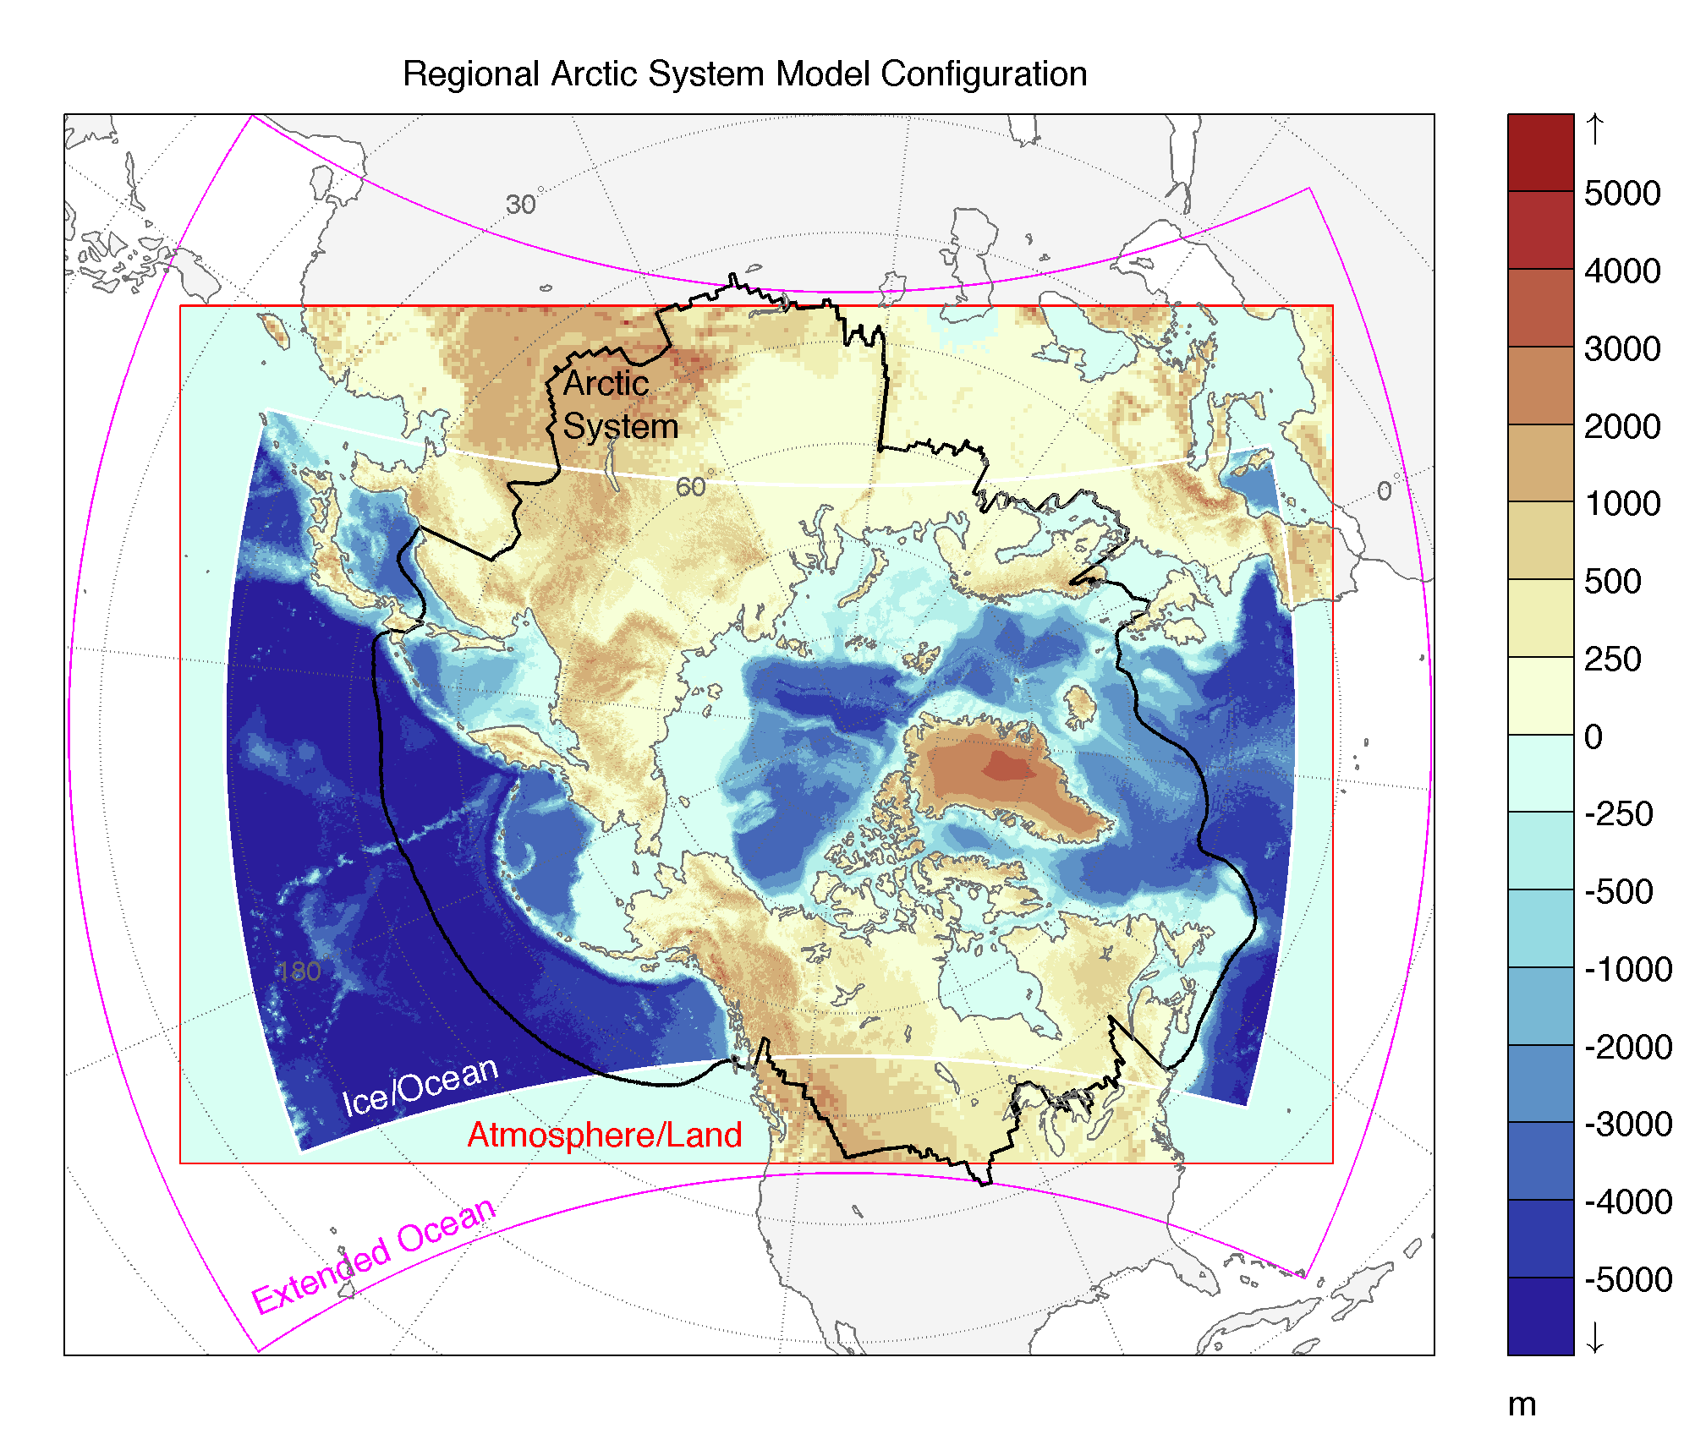
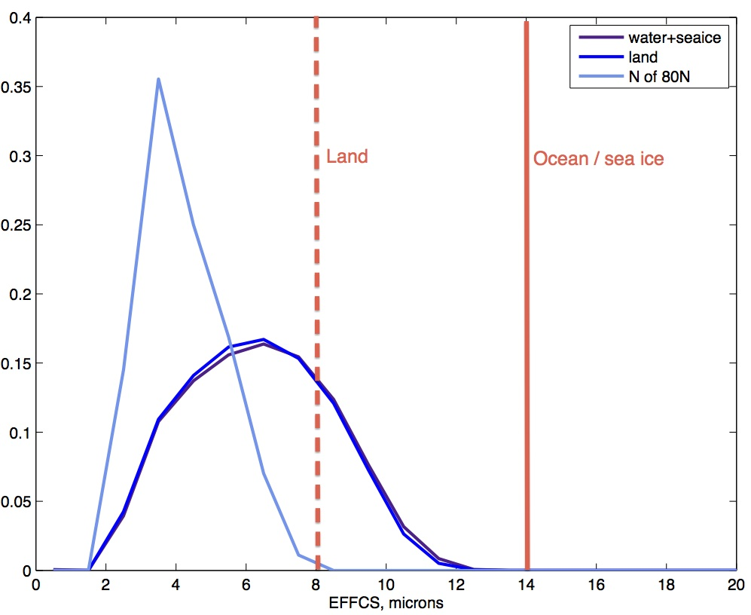
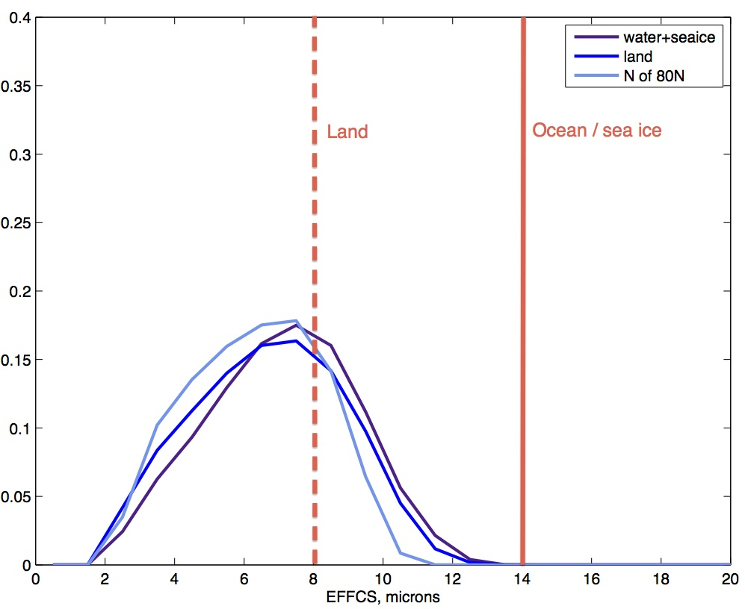
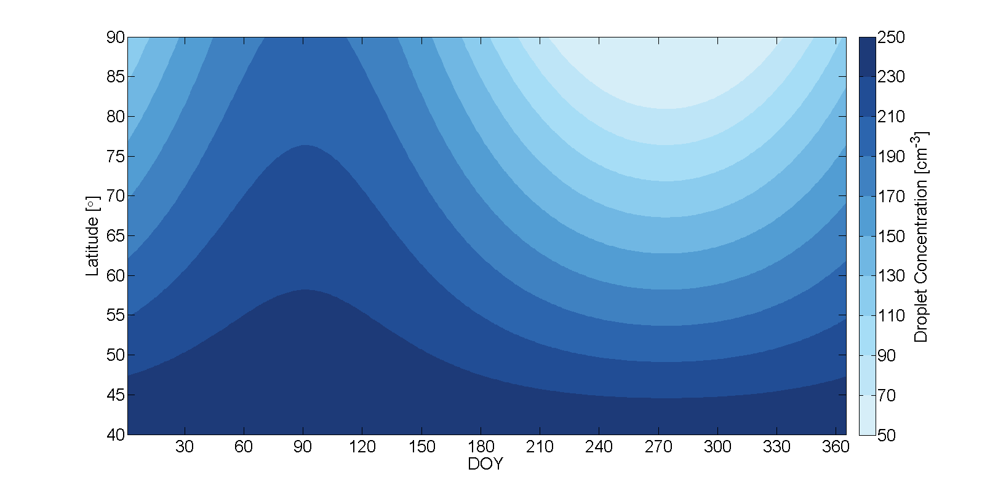
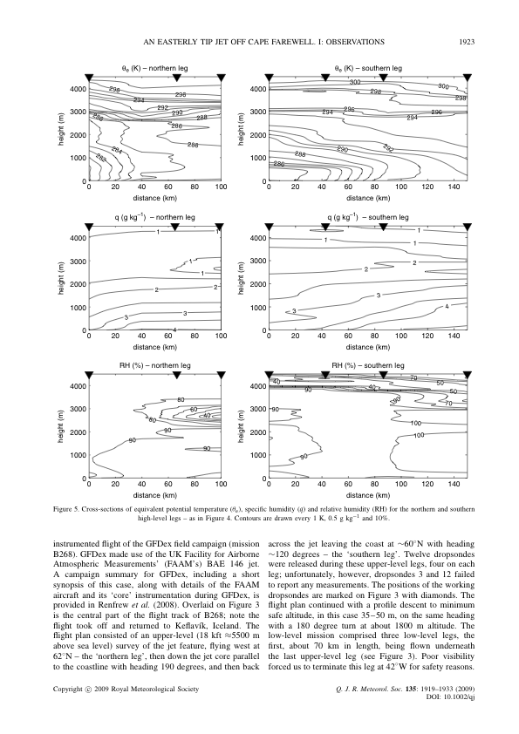
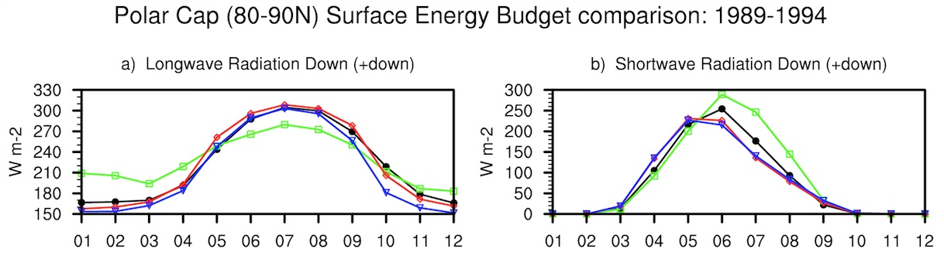
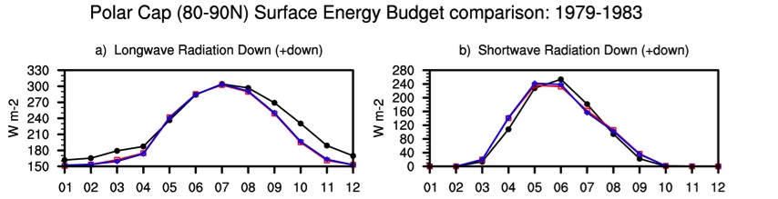
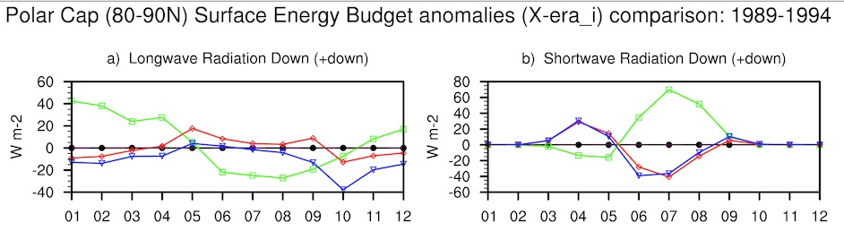
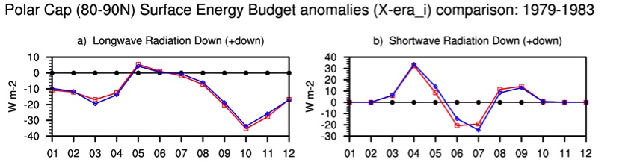
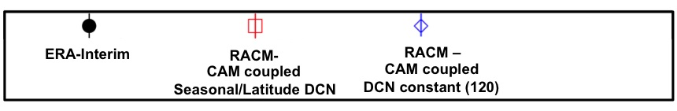
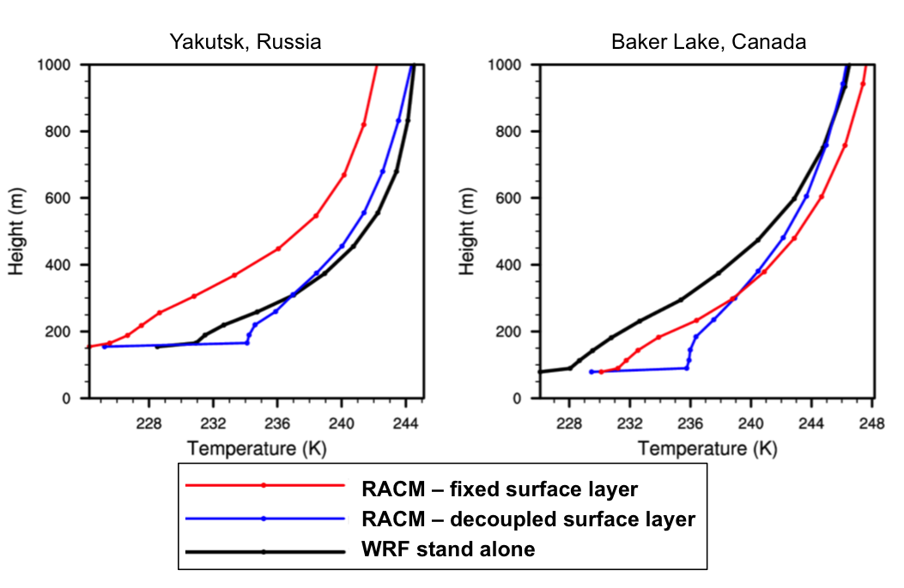
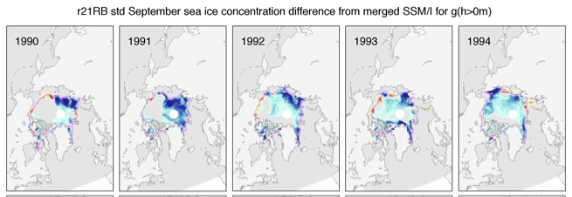
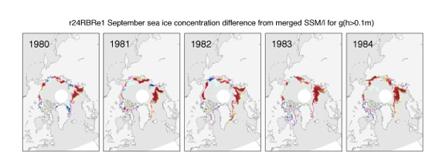
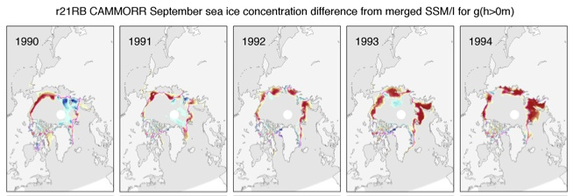
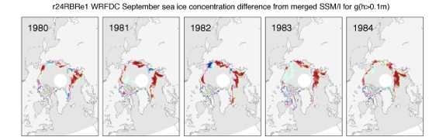

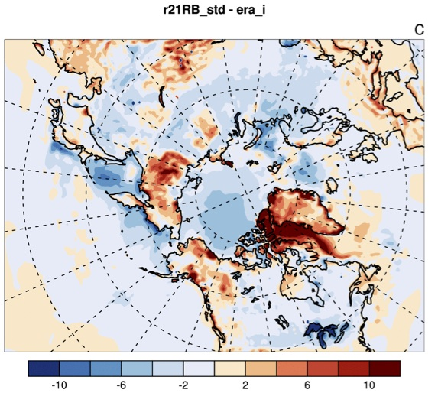
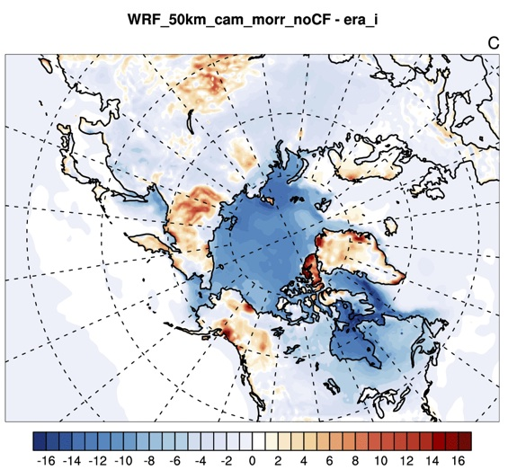
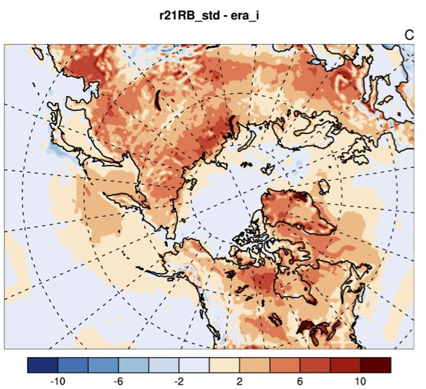
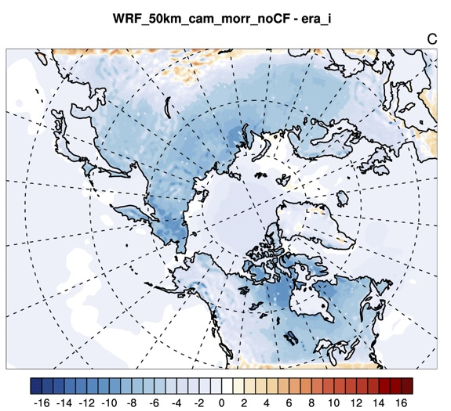
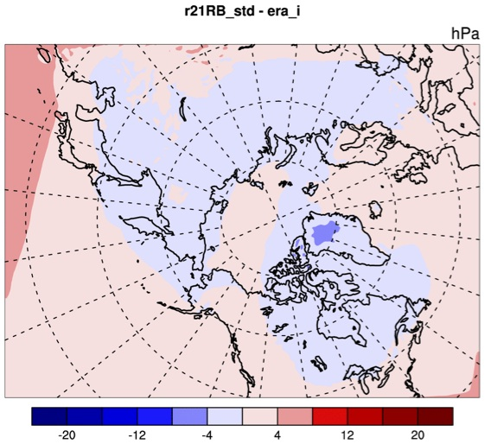
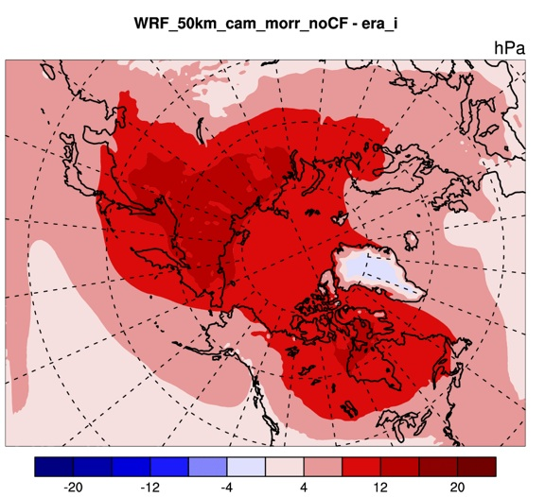
Simulation of Arctic climate with the Regional Arctic System Model (RASM): Sensitivity to atmospheric processes
John Cassano¹, Alice DuVivier¹, Mimi Hughes¹, Andrew Roberts², Michael Brunke³, Anthony Craig⁴, Brandon Fisel⁵, William Gutowski⁵, Wieslaw Maslowski², Bart Nijssen⁶, Robert Osinski⁷, Xubin Zeng³ Corresponding author: John J. Cassano, john.cassano@colorado.edu
¹ Cooperative Institute for Research in Environmental Sciences and Department of Atmospheric and Oceanic Sciences, University of Colorado, Boulder, CO
² Naval Postgraduate School, Monterey, CA ³University of Arizona, Tucson, AZ ⁴ National Center for Atmospheric Research, Boulder, CO
⁵ Iowa State University, Ames, IA ⁶ University of Washington, Seattle, W ⁷ Institute of Oceanology, Sopot, Poland
1. Regional Arctic System Model (RASM)
The Regional Arctic System Model (RASM)
Is a fully coupled regional climate system
model that includes atmosphere (WRF),
ocean (POP), sea ice (CICE), and land (VIC)
component models. These component
models are coupled using the NCAR CESM
CPL7 coupler.
RASM is configured to run on a large
pan-Arctic domain that covers all sea ice
covered ocean areas in the Northern
Hemisphere and all Arctic Ocean draining
watersheds (Figure 1).
During the development of RASM several issues related to atmosphere – surface coupling were identified as critical for realistic simulation of Arctic climate. Some of these issues will be highlighted on this poster.
2. WRF Radiation and Microphysics Impacts on Sea Ice
Coupled versus uncoupled radiation and microphysics
Microphysics droplet concentration
In the standard version of WRF the radiation parameterization calculates the radiative impact of clouds based on the mixing ratio of cloud species (liquid droplets, ice crystals, rain, and snow) forecast by the microphysics parameterization. The radiation parameterization assumes a fixed effective radius of 14 μm (8 μm) for liquid cloud droplets over ocean / sea ice (land) in these calculations.
A modified version of WRF (developed at NOAA) allows the WRF Morrison microphysics parameterization to pass information on both cloud species mixing ratio and particle effective radius to the radiation code. This is referred to as coupled radiation-microphysics and this version of the model simulates much smaller effective radii than the standard version of WRF (Figure 2).
This change in effective radius results in decreased downward longwave radiation at the surface throughout the year with only a minimal impact on downward shortwave radiation (Figure 3).
These radiative differences result in significantly more sea ice (which is closer to observed values) in the coupled radiation-microphysics simulation (Figure 4).
In the coupled radiation-microphysics version of RASM sensitivity studies were conducted that varied the microphysics droplet concentration, which leads to changes in the cloud particle size passed to the radiation parameterization. These sensitivity simulations revealed a large sea ice sensitivity to the droplet concentration.
The initial version of the coupled radiation-microphysics parameterizations used in RASM assumed a constant droplet concentration of 120 cm⁻³ and produced the droplet size distributions shown in Figure 2. Observations suggest that the droplet concentration varies seasonally in the Arctic and that the value of 120 cm⁻³ was not optimal. To better replicate the observed droplet concentration in the Arctic a seasonally and spatially varying droplet concentration was implemented in RASM (Figure 5).
The use of either fixed or spatially and temporally varying droplet concentration alters both the downward longwave and shortwave radiation at the surface with seasonally varying differences between the two experiments. The simulation with time and space varying droplet concentration simulates less downwelling shortwave radiation from late spring until early summer (May and June) and less downwelling longwave radiation from mid-summer through autumn (July through November) (Figure 6).
The use of spatially and temporally varying droplet concentration causes a slight increase in sea ice concentration compared to RASM simulations with fixed droplet concentration. (Figure 7).
Figure 2. Probability density function of liquid cloud droplet effective radius for January (left) and July (right). Red solid (dashed) lines show the effective radius of liquid cloud droplets over ocean / sea ice (land) used in the standard version of WRF.
Figure 5. Specified droplet concentration in the WRF Morrison microphysics parameterization as a function of day of year (DOY) and latitude.
Figure 1. RASM domain
3. Atmosphere – Surface Coupling
Earlier versions of RASM exhibited significant atmosphere – land decoupling during the winter (Figure 8, blue lines). This behavior was inconsistent with results from stand-alone WRF simulations (Figure 8, black line) and available observations. The problem was traced to the stability function
used to calculate turbulent fluxes in VIC.
This problem had not been previously
identified in VIC simulations since it is
amplified due to feedbacks between
the atmosphere and land not present
in the typical stand-alone configuration
used with VIC prior to the RASM
project. Improvements to the
treatment of the stability function
resulted in more realistic near surface
temperature profiles in later versions
of RASM (Figure 8, red line).
Figure 3. Downward longwave (left) and shortwave (right) radiation from ERA-Interim (black), CORE2 (green), RASM with uncoupled radiation-microphysics (red), and RASM with coupled radiation-microphysics (blue). Differences between CORE2 or RASM simulations and ERA-Interim are shown in the bottom panel.
Figure 6. Downward longwave (left) and shortwave (right) radiation from ERA-Interim (black), RASM with coupled radiation-microphysics with fixed droplet concentration of 120 cm⁻³ (blue), and RASM with coupled radiation-microphysics with spatially and temporally varying droplet concentration (red). Differences between the RASM simulations and ERA-Interim are shown in the bottom panel.
RACM-CAM coupled with Seasonal/Latitude DCN
September sea ice concentration difference from passive microwave for g(h>0, 1m)
RACM-CAM coupled with DCN constant (120)
September sea ice concentration difference from passive microwave for g(h>0, 1m)
Figure 8. Winter boundary layer temperature profiles in two versions of RASM (red and blue lines) and a stand-alone version of WRF (black line).
Figure 4. Differences between RASM and satellite observed sea ice concentrations for September for RASM with uncoupled radiation-microphysics (top) and coupled radiation-microphysics (bottom).
Figure 7. Differences between RASM and satellite observed sea ice concentrations for September for RASM with coupled radiation-microphysics with spatially and temporally varying droplet concentration (top), and RASM with coupled radiation-microphysics with fixed droplet concentration of 120 cm⁻³ (bottom).
4. Comparison of Coupled vs. Uncoupled Atmosphere Simulations
5. Conclusions
The sea ice state simulated in RASM is sensitive to the details of the WRF radiation and microphysics treatment, with coupling between the radiation and microphysics parameterization resulting in improved sea ice simulation (Figure 4).
Early versions of RASM identified a feedback between land and atmosphere processes related to surface stability and turbulent fluxes that resulted in unrealistic decoupling of the atmosphere and the surface (Figure 8). This highlights the need for care when coupling model components that had previously only been used in a stand-alone mode.
Realistic representation of the surface (land, sea ice, and ocean) state is critical for accurate atmospheric simulation. Realistic time evolving sea ice thickness in RASM results in significant improvements in near surface winter temperatures over the Arctic Ocean in RASM compared to stand-alone WRF (Figure 9). Cold biases over land areas in summer in stand-alone WRF (Figure 10) drive significant pressure and circulation biases not evident in the fully coupled RASM (Figure 11).
Feedbacks between the atmosphere and surface are critical in the climate system. Part of the motivation for developing RASM was to more accurately capture these feedbacks in a high resolution regional model of the Arctic climate system.
In RASM sea ice evolves in a realistic manner with multiple ice thickness categories present in each grid cell. In stand-alone WRF sea ice has a specified fixed thickness. Changes in sea ice thickness are critical in winter since thick sea ice acts to insulate the atmosphere from the warmer ocean. RASM simulations show more realistic surface air temperatures in winter compared to stand-alone WRF due to the more realistic coupling between ocean, ice, and atmosphere processes in RASM (Figure 9).
Surface air temperature over land in summer is much warmer in RASM than in stand-alone WRF (Figure 10). These differences are likely due to coupled versus uncoupled processes as well as to the use of different land models (RASM uses VIC and stand-alone WRF uses Noah).
The land cold bias present in stand-alone WRF results in a significant bias in sea level pressure and near surface circulation that is not evident in the coupled RASM simulation (Figure 11). This behavior of biases in one aspect of the model simulation impacting other aspects of the model climate highlights the need for accurate simulation across all components of the coupled climate system.
Figure 9. Winter (DJF) mean differences between RASM and ERA-Interim (left) and stand-alone WRF and ERA-Interim (right)
2 m air temperature.
Figure 10. Summer (JJA) mean differences between RASM and ERA-Interim (left) and stand-alone WRF and ERA-Interim (right)
2 m air temperature.
Figure 11. Summer (JJA) mean differences between RASM and ERA-Interim (left) and stand-alone WRF and ERA-Interim (right) sea level pressure.
Acknowledgements: This research was funded by the U.S. Department of Energy EaSM program. Computing resources were provided via a Challenge Grant from the U.S. Department of Defense High Performance Computing Modernization Program.

