Slide 1
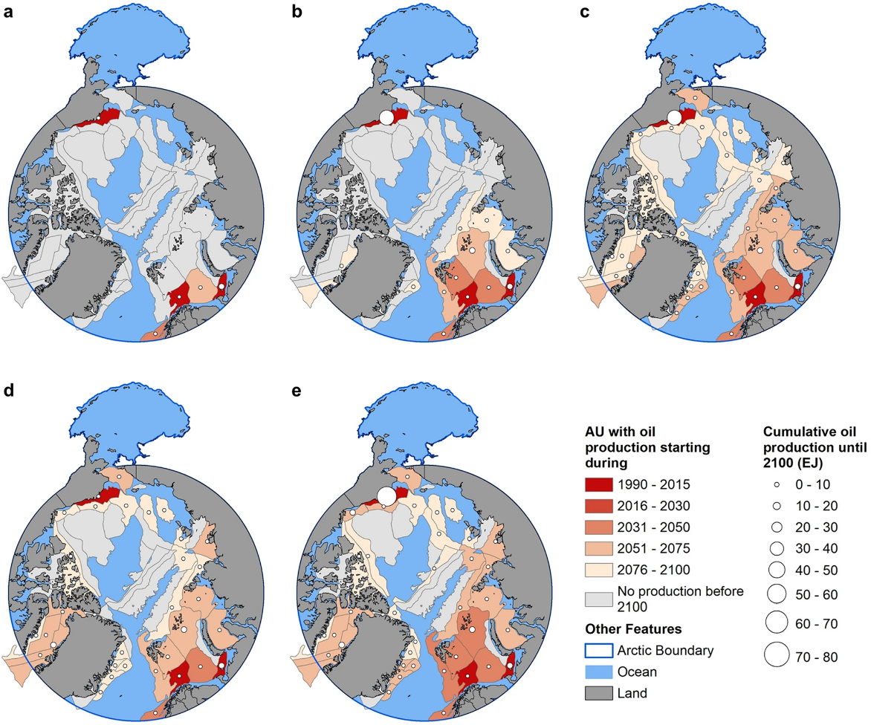
Arctic Offshore Oil and Gas Production in a Changing Climate
Objective
Explore the potential increase in Arctic offshore oil and gas production due to climate change-induced sea ice thinning and its impact on global energy markets, for both “business-as-usual” and low-carbon energy transition scenarios.
Approach
Modify the Global Change Analysis Model (GCAM), a multi-sector dynamics, human-Earth system model, to simulate the interactions between Arctic offshore oil and gas production and global energy markets under various climate and socioeconomic scenarios.
Incorporate spatial-temporal patterns of sea-ice loss projections from selected CMIP6 climate models into GCAM, enabling the assessment of technical and economic viability for Arctic offshore resource extraction across different climate-induced sea-ice conditions.
Impact
Projected Arctic sea-ice loss may lead to relatively large increases in offshore oil production in the Arctic, particularly along the Alaskan Platform in the USA, but minimal impact on global oil and gas markets.
The study indicates that by 2100, assuming a future with a heavy dependency on fossil fuels (SSP5), Arctic offshore oil and gas extraction could add 0.8–2.6 EJ/year to oil and gas markets, which is a small fraction of total global production.
Under a low-carbon future scenario, Arctic offshore oil production increases to replace emission-intensive unconventional oil production to meet the overall oil demand.
This figure illustrates Arctic offshore oil production at the Assessment Unit (AU) level under (a) Ref, (b) RCP2.6, (c) RCP8.5, (d) LowC, and (e) LowC|2.6. For scenarios with multiple ensembles, the production is shown using ensemble mean. The color shows when the production first started or is projected to start. The size of the circle shows all-time cumulative offshore oil production until 2100 in that AU. The exajoule (EJ) is equal to 10¹⁸ J and approximately 0.2 billion barrels of oil equivalent (BBOE).
Zhang, Y., S. Msangi, J. Edmonds, and S. Waldhoff. 2024. “Limited increases in Arctic offshore oil and gas production with climate change and the implications for energy markets,” Scientific Reports, 14, 6699. DOI: 10.1038/s41598-024-54007-x

