Slide 1
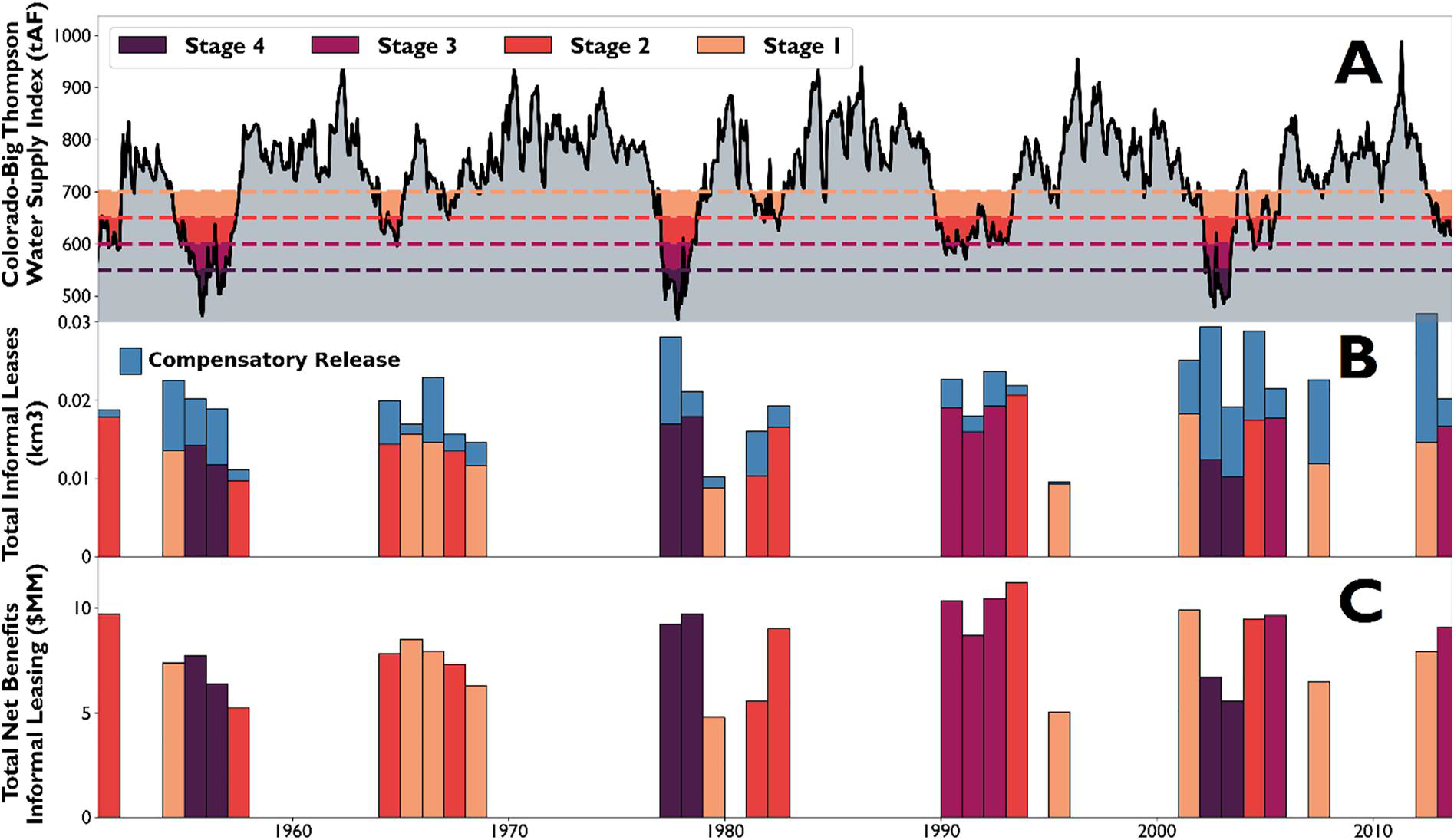
Innovative Water Leasing to Combat Western U.S. Drought Challenges
Objective
Propose a mechanism to reduce transaction costs by adapting informal leases to facilitate quicker and less expensive water transfers among market participants in the Western United States.
Approach
Develop a framework using index-based option contracts to coordinate informal leasing agreements, which include compensatory releases to mitigate impacts on instream flows and third parties.
Implement simulations using the StateMod water allocation model to identify potential lease sellers and facilitators based on water rights seniority, demand patterns, and hydrologic conditions in the Upper Colorado River Basin.
Calculate compensatory releases and option payments to ensure no injury to third parties, using historical data to evaluate the impact of informal leases on water allocations and transaction costs.
Impact
This figure illustrates the C-BT water supply index (CBI) and its relation to drought stages and water leasing. (A) Shows the CBI calculated monthly from 1950 to 2013, with four thresholds marking different stages of drought when water leases are purchased. (B) Displays the total informal water leases delivered each year, considering additional water releases. (C) Shows the annual financial benefits gained from reallocating water. The years are color-coded based on the drought stage (1–4) in which water leases were purchased.
Informal leases enable rapid short-term water reallocation during drought while significantly reducing transaction costs compared to formal leasing processes.
The State of Colorado could have accrued $222 million in benefits using informal leases to reallocate water from irrigators to urban users during the historical period 1950–2013.
Compensatory releases and option contracts effectively manage potential third-party impacts, aligning incentives for cooperation and reducing reliance on costly legal processes.
Zeff, Harrison, Antonia Hadjimichael, Patrick M. Reed, and Gregory W. Characklis. 2024. Using Financial Contracts to Facilitate Informal Leases within a Western United States Water Market Based on Prior Appropriation. Earth's Future 12 (5): e2023EF003739. https://doi.org/10.1029/2023EF003739.
First draft generated using PAIGE, the Pnnl AI assistant for GEnerating publication highlights

