Slide 1
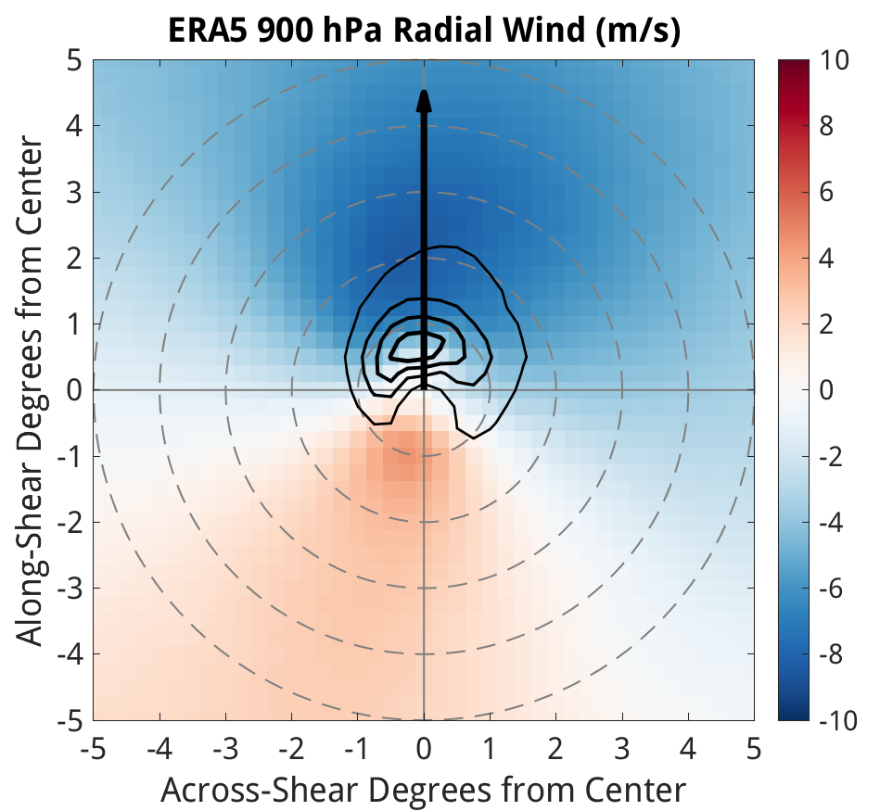
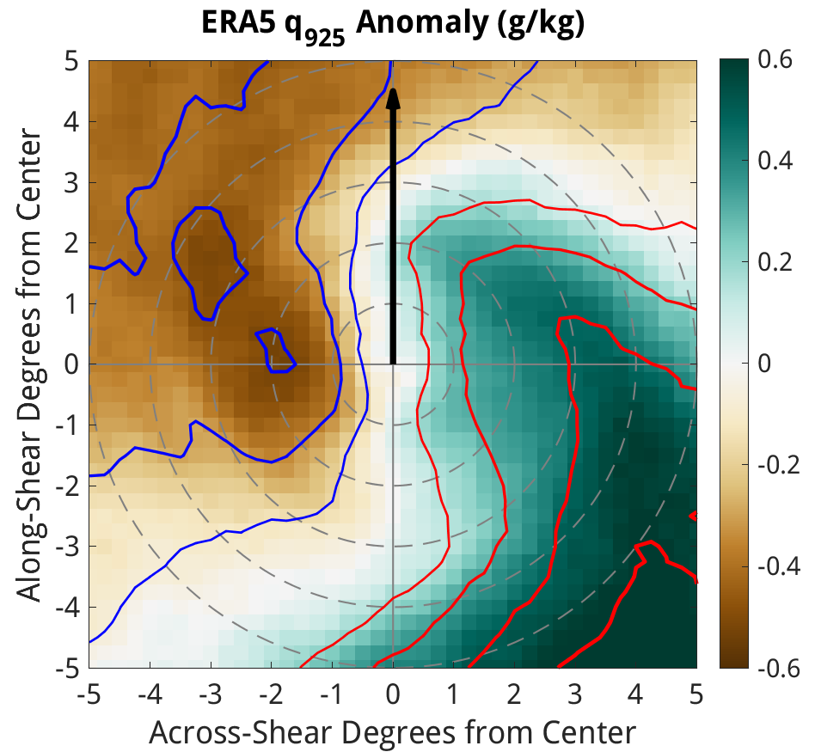
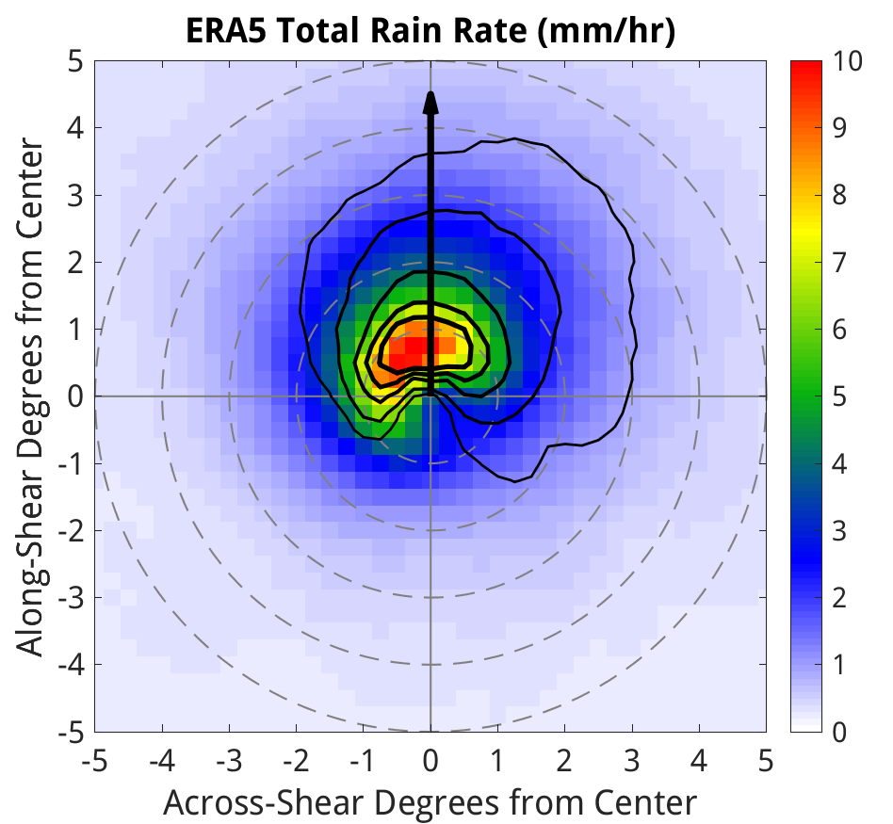
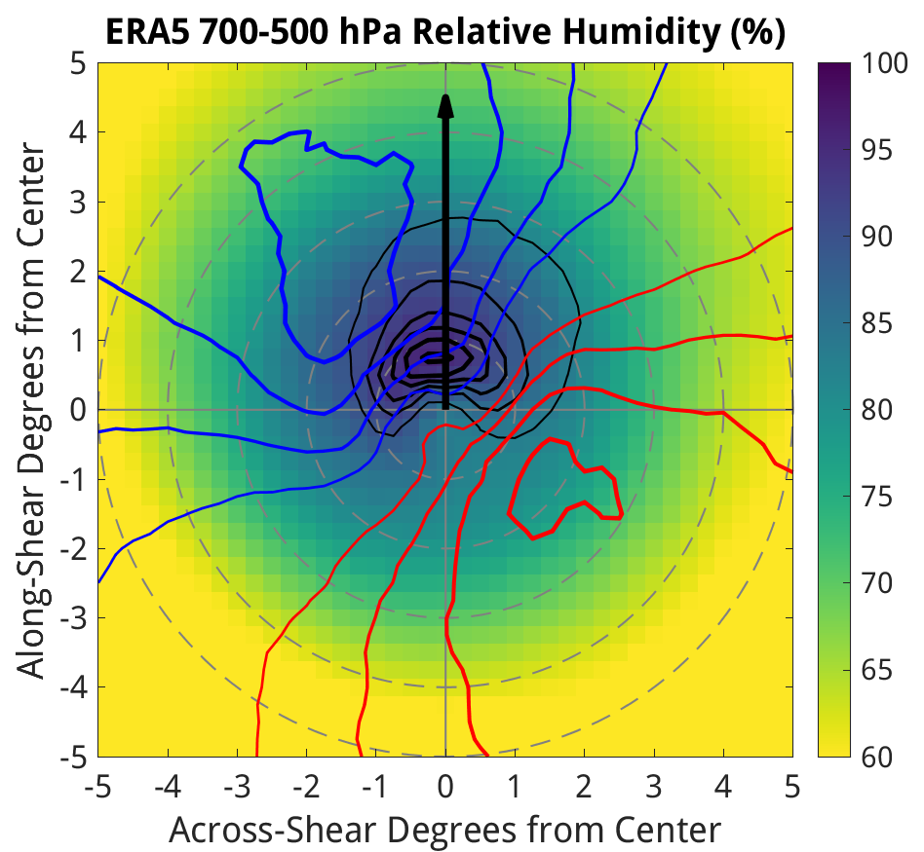
Tropical Cyclone Wind Shear-Relative Asymmetry in Reanalyses
Science Question
Tropical cyclones (TCs) are often quite asymmetric. We have not studied how climate models capture these asymmetries and the processes causing them.
Approach
Track TCs in the ERA5 and CFSR reanalyses with TempestExtremes
Rotate individual TC snapshots with the vertical wind shear, and develop composites of wind, precipitation, and thermodynamic fields based on TC intensity and wind shear magnitude
Results and Significance
Reanalyses exhibit wavenumber-one asymmetry that amplifies under stronger shear and weaker TCs
They also show a realistic cycle of convective growth and decay
Our findings suggest that process-oriented studies of TC asymmetry in a warming climate are viable using GCMs
(a)
(b)
(c)
(d)
Figure: Examples of tropical cyclone asymmetry in the ERA5 reanalysis, averaged across a composite of TCs with minimum pressure between 975-990 hPa, under vertical wind shear of 5-10 m/s. (a) Radial wind at 900 hPa, with contours showing ascent at 850 hPa. (b) Azimuthal anomaly of 925 hPa specific humidity, with contours showing anomalies in 925 hPa equivalent potential temperature. (c) Rain rate, with contours showing ascent at 600 hPa. (d) Mid-level relative humidity, with contours showing anomalies in 600 hPa potential temperature.
Carstens, J. D., A. C. Didlake, Jr., and C. M. Zarzycki, 2024: Tropical Cyclone Wind Shear-Relative Asymmetry in Reanalyses. J. Climate, https://doi.org/10.1175/JCLI-D-23-0628.1.

