Slide 1
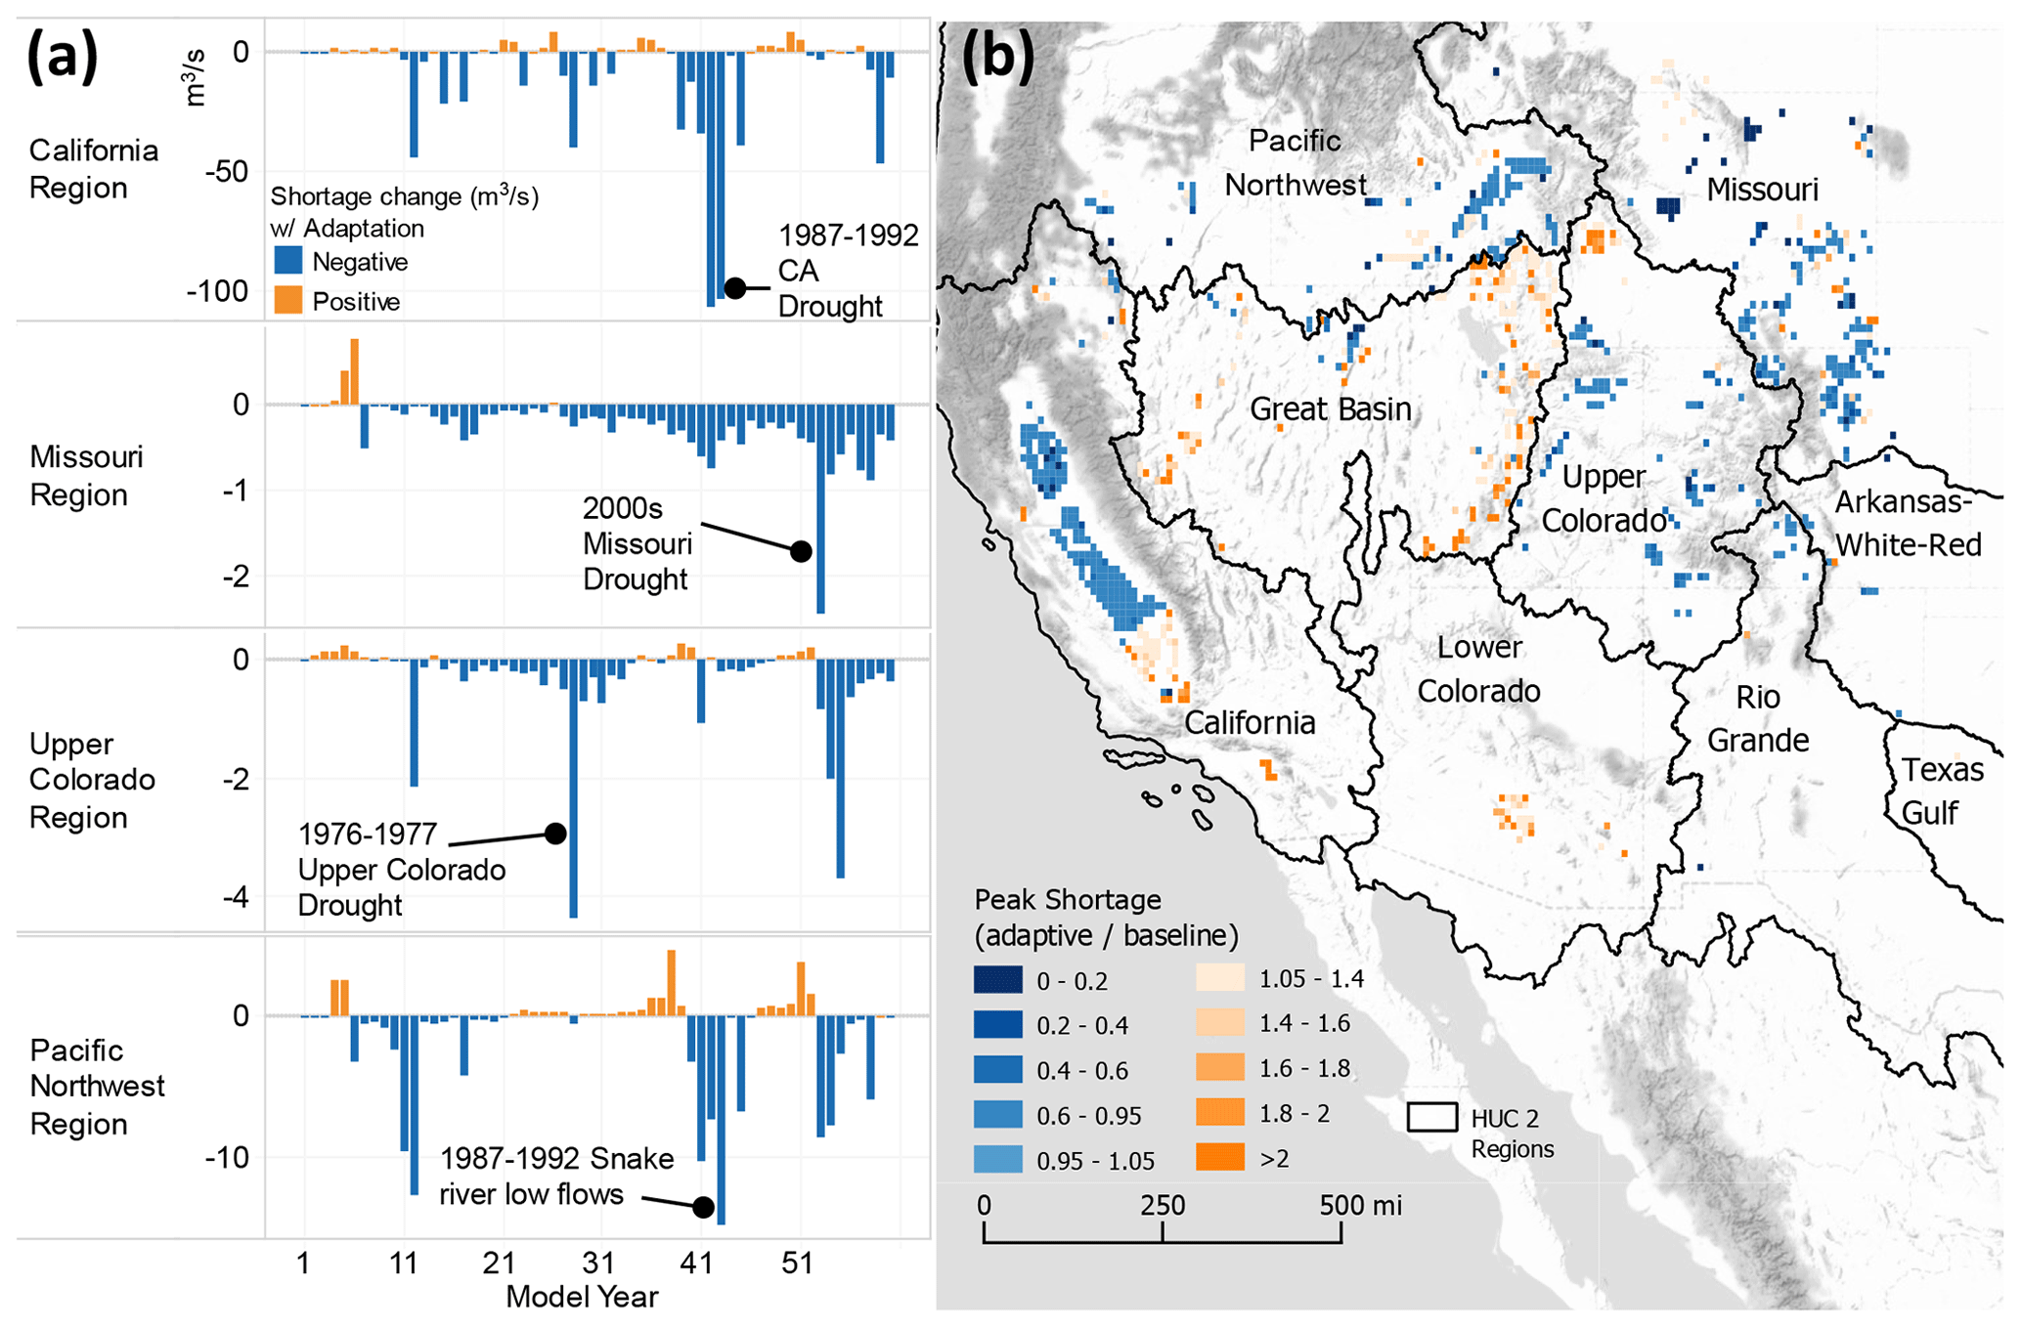
Exploring the Impact of Farm Cropping Adaptation on Water Scarcity
Objective
Explore the impact of modeling dynamic farmer irrigation decisions on water shortage outcomes in large-scale hydrological models.
Approach
Integrate an agent-based model (ABM) adopting a positive mathematical programming (PMP) approach with a large-scale river-routing water management model (MOSART-WM) to dynamically simulate farmer irrigation decisions based on water availability.
Implement a comparative computational experiment using historical hydrological data (1950–2009) to assess the impact of adaptive farmer behavior on water shortage outcomes, contrasting a baseline non-adaptive scenario with an adaptive scenario where farmer agents adjust irrigated crop areas annually.
Impact
Incorporation of adaptive farmer agents in a large-scale hydrological model reduces US-wide annual water shortages by up to 42%.
Farmer adaptation primarily occurs through the contraction of irrigated crop areas, with crop switching playing a secondary role.
Sensitivity analysis shows that the impact of farmer adaptation on water shortage outcomes is robust across different assumptions.
This figure contrasts water shortages under farmer adaptation versus non-adaptation scenarios. It underscores the role of human behavior in water resource management and demonstrates how farmer decisions can alleviate water scarcity. Panel (a) shows the annual difference in water shortage between the adaptive and non-adaptive models and panel (b) identifies the difference in peak annual water shortage (across all model years) for farm agents across the western United States for both models.
Yoon, J., N. Voisin, C. Klassert, T. Thurber, and W. Xu. "Representing farmer irrigated crop area adaptation in a large-scale hydrological model." Hydrology and Earth System Sciences 28, no. 4 (2024): 899-916. DOI: 10.5194/hess-28-899-2024

