Slide 1
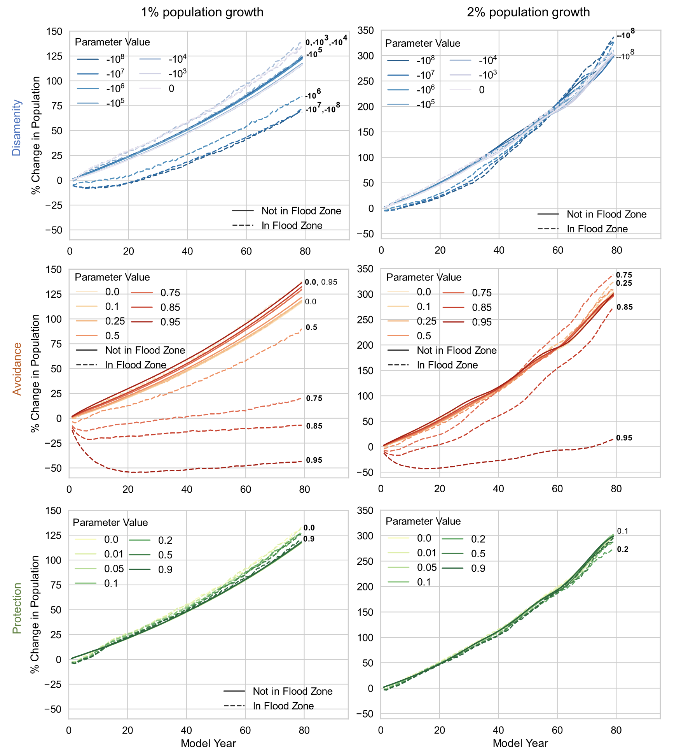
Agent-Based Models Reveal Hidden Dynamics in Flood Risk Analysis
Objective
Introduce an agent-based modeling framework to assess the impact of structural versus parametric choices on flood risk outcomes in a hypothetical urban environment, highlighting the significant influence of structural model choices on the evolution of flood risk and housing market dynamics.
Approach
Deploy three structural variants of the agent-based model, each differing in household interaction with flood hazards: disamenity, avoidance, and protection, to systematically assess the influence of structural choices on flood risk outcomes.
Implement an ensemble of simulations within each structural variant, varying key parameters that control human-flood interactions, to explore the comparative effects of structural versus parametric choices on model outcomes.
Utilize the CHANCE-C model framework, initialized with real-world data but applied to a hypothetical landscape, to simulate urban development and housing market dynamics in response to flood risk, ensuring a controlled environment for evaluating methodological impacts.
Impact
Structural model choices in agent-based simulations significantly influence flood risk outcomes, often overshadowing parametric uncertainty.
The avoidance structural variant results in the most substantial population declines in flood zones while the protection structural variant attracts higher-income households to flood zones, suggesting a unique interaction between flood risk adaptation and socioeconomic dynamics.
The new model framework, CHANCE-C, can be widely adapted for agent-based flood risk analysis.
The structural choice of household flood aversion (disamenity, avoidance, or protection) strongly influences model outcomes of population growth in the flood zone.
Yoon, Jim, Heng Wan, Brent Daniel, Vivek Srikrishnan, and David Judi. 2023. Structural Model Choices Regularly Overshadow Parametric Uncertainty in Agent-Based Simulations of Household Flood Risk Outcomes. *Computers, Environment and Urban Systems* 103: 101979. https://doi.org/10.1016/j.compenvurbsys.2023.101979.
First draft generated using PAIGE, the Pnnl AI assistant for GEnerating publication highlights

