Slide 1
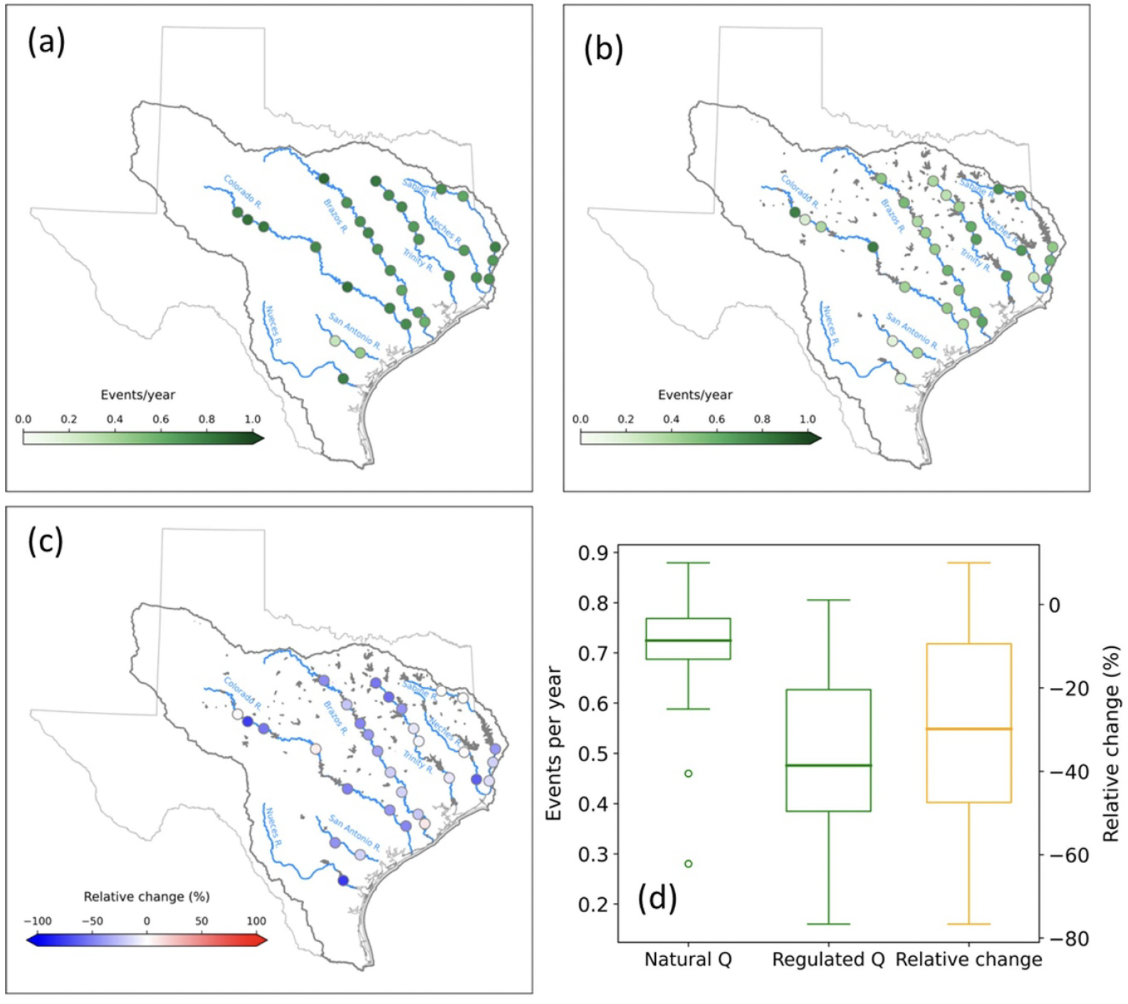
Water Management's Impact on Drought Dynamics in Texas Rivers
Objective
Quantifies the impact of water management on the propagation dynamics and characteristics of hydrological drought in major rivers across Texas.
Approach
Implement an observation-modeling hybrid approach by utilizing naturalized streamflow data from the Texas Commission on Environmental Quality, which adjusts observed streamflow for human influences such as reservoir operations and diversions.
Employ standardized indices, specifically the standardized precipitation index (SPI) and standardized streamflow index (SSI), to identify drought events and quantify drought characteristics under both natural and managed conditions.
Analyze the propagation dynamics by correlating SSI with SPI over various accumulation periods to determine the response time of hydrological drought to meteorological drought, and assess the propagation rate by comparing matched drought events under different management scenarios.
Impact
Water management significantly reduces hydrological drought frequency across Texas' major rivers, decreasing it by 30% on average, while increasing the response time of droughts by a median of 2.5 months.
Despite reducing overall drought frequency, water management increases the average-event duration and severity of droughts, particularly in the Colorado River basin, highlighting complex regional impacts.
Water management's effects on droughts vary seasonally, with attenuation during mid-summer and early fall and intensification during late winter and spring, emphasizing the need for nuanced management strategies.
This figure shows how often hydrologic drought occurs each year at different locations under (a) natural conditions and (b) managed conditions. Part (c) shows how these frequencies change between the two conditions. Part (d) illustrates that most places experienced fewer droughts under managed conditions, with the average frequency decreasing from 0.72 to 0.48 droughts per year—a drop of about 30%.
Yao, Lili, Stephen B. Ferencz, Ning Sun, and Hongxiang Yan. 2024. Assessing the Complex Influences of Water Management on Hydrological Drought Characteristics in Texas. Environmental Research Letters 19 (11): 114034. https://doi.org/10.1088/1748-9326/ad7d23.
First draft generated using PAIGE, the Pnnl AI assistant for GEnerating publication highlights.

