Slide 1
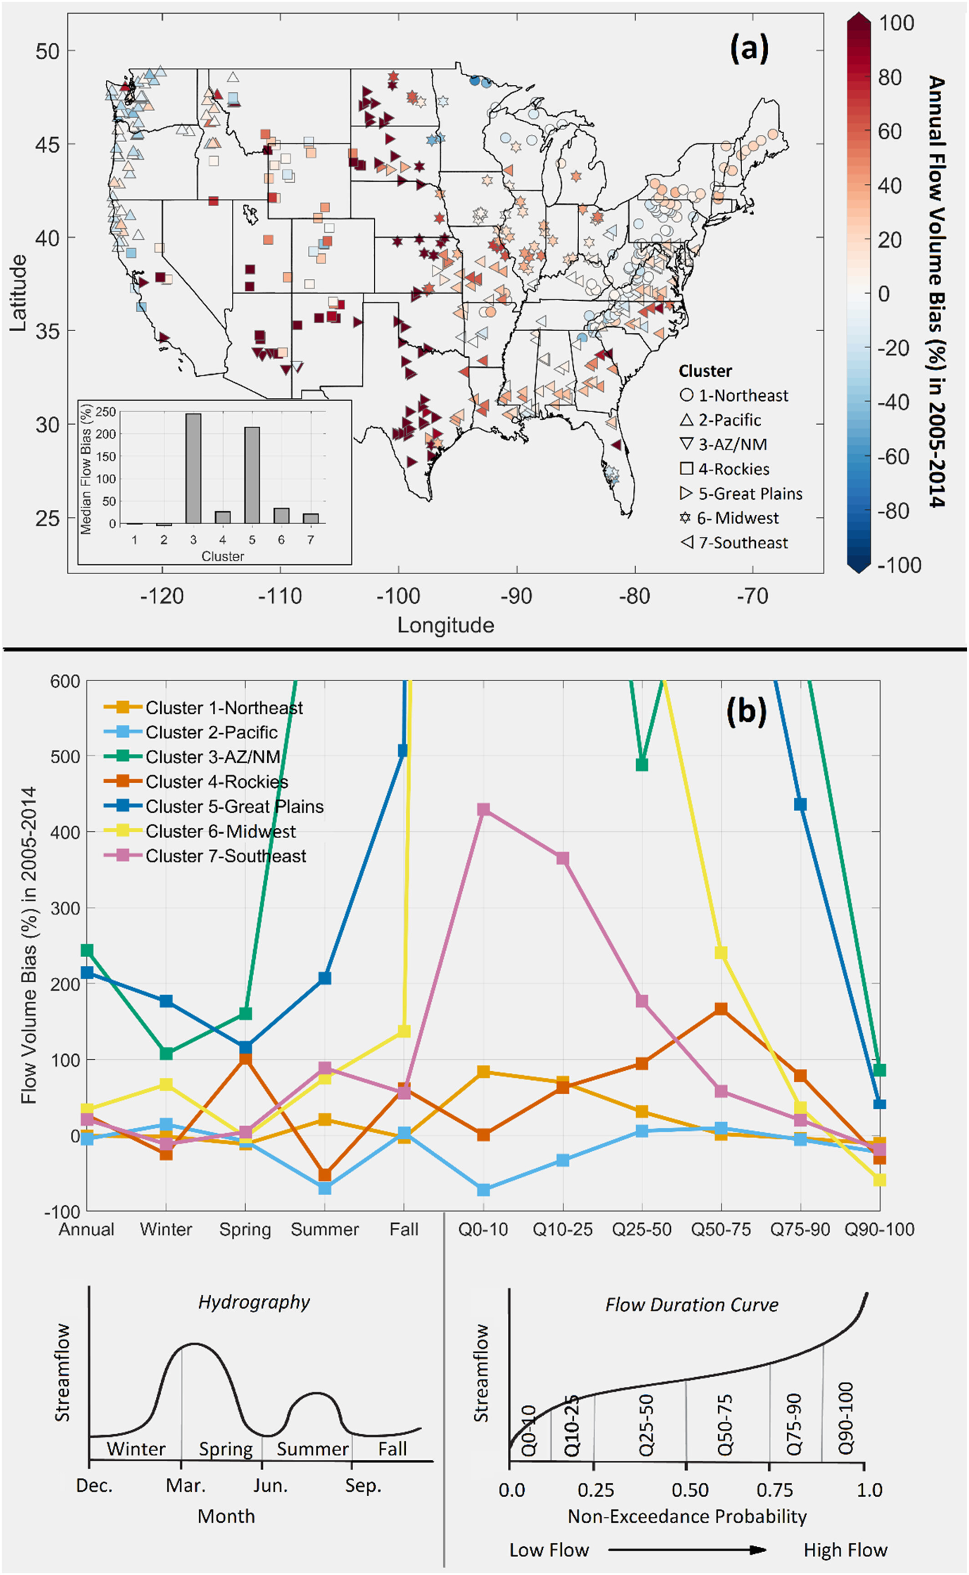
Exploring Hydrologic Predictions and Uncertainty with CLM5 across the United States
Objective
Investigate the effects of parametric uncertainty on the Community Land Model version 5 (CLM5) hydrologic predictions across regions, timescales, and flow regimes in the conterminous United States.
Approach
Conduct a comprehensive diagnostic evaluation and sensitivity analysis of CLM5's streamflow predictions using a large ensemble of hydrologic parameter sets for 464 CAMELS basins across the conterminous United States.
Employ Latin Hypercube Sampling method to sample hydrologic parameter sets and Delta moment-independent sensitivity analysis method to analyze the sensitivity of the parameters to hydrologic predictions.
Impact
This study is the first to examine the effects of parameter uncertainty on CLM5's streamflow predictions across various regions, timescales, and flow regimes.
The results show that CLM5 streamflow predictions using default parameters are vulnerable to poor performance, particularly in the arid Southwest and Central U.S. regions.
Improving the model's accuracy can benefit climate science, hydrology, and environmental management.
(a) Annual flow volume bias (%) using Community Land Model Version 5 (CLM5) default parameters. A positive value indicates that CLM5 overestimated the flow volume in the simulation period 2005–2014. (b) Regional median flow volume bias (%) for 11 error metrics that characterize flow errors at different temporal scales (annual and four seasons) and across flow regimes (e.g., Q0–10: 0%–10% daily flow quantiles) using CLM5 default parameters.
Yan, H., Sun, N., Eldardiry, H., Thurber, T. B., Reed, P. M., Malek, K., Gupta, R., Kennedy, D., Swenson, S. C., Hou, Z., Cheng, Y., and Rice, J.S. 2023. "Large Ensemble Diagnostic Evaluation of Hydrologic Parameter Uncertainty in the Community Land Model Version 5 (CLM5)." Journal of Advances in Modeling Earth Systems 15: e2022MS003312. https://doi.org/10.1029/2022MS003312.

