Slide 1
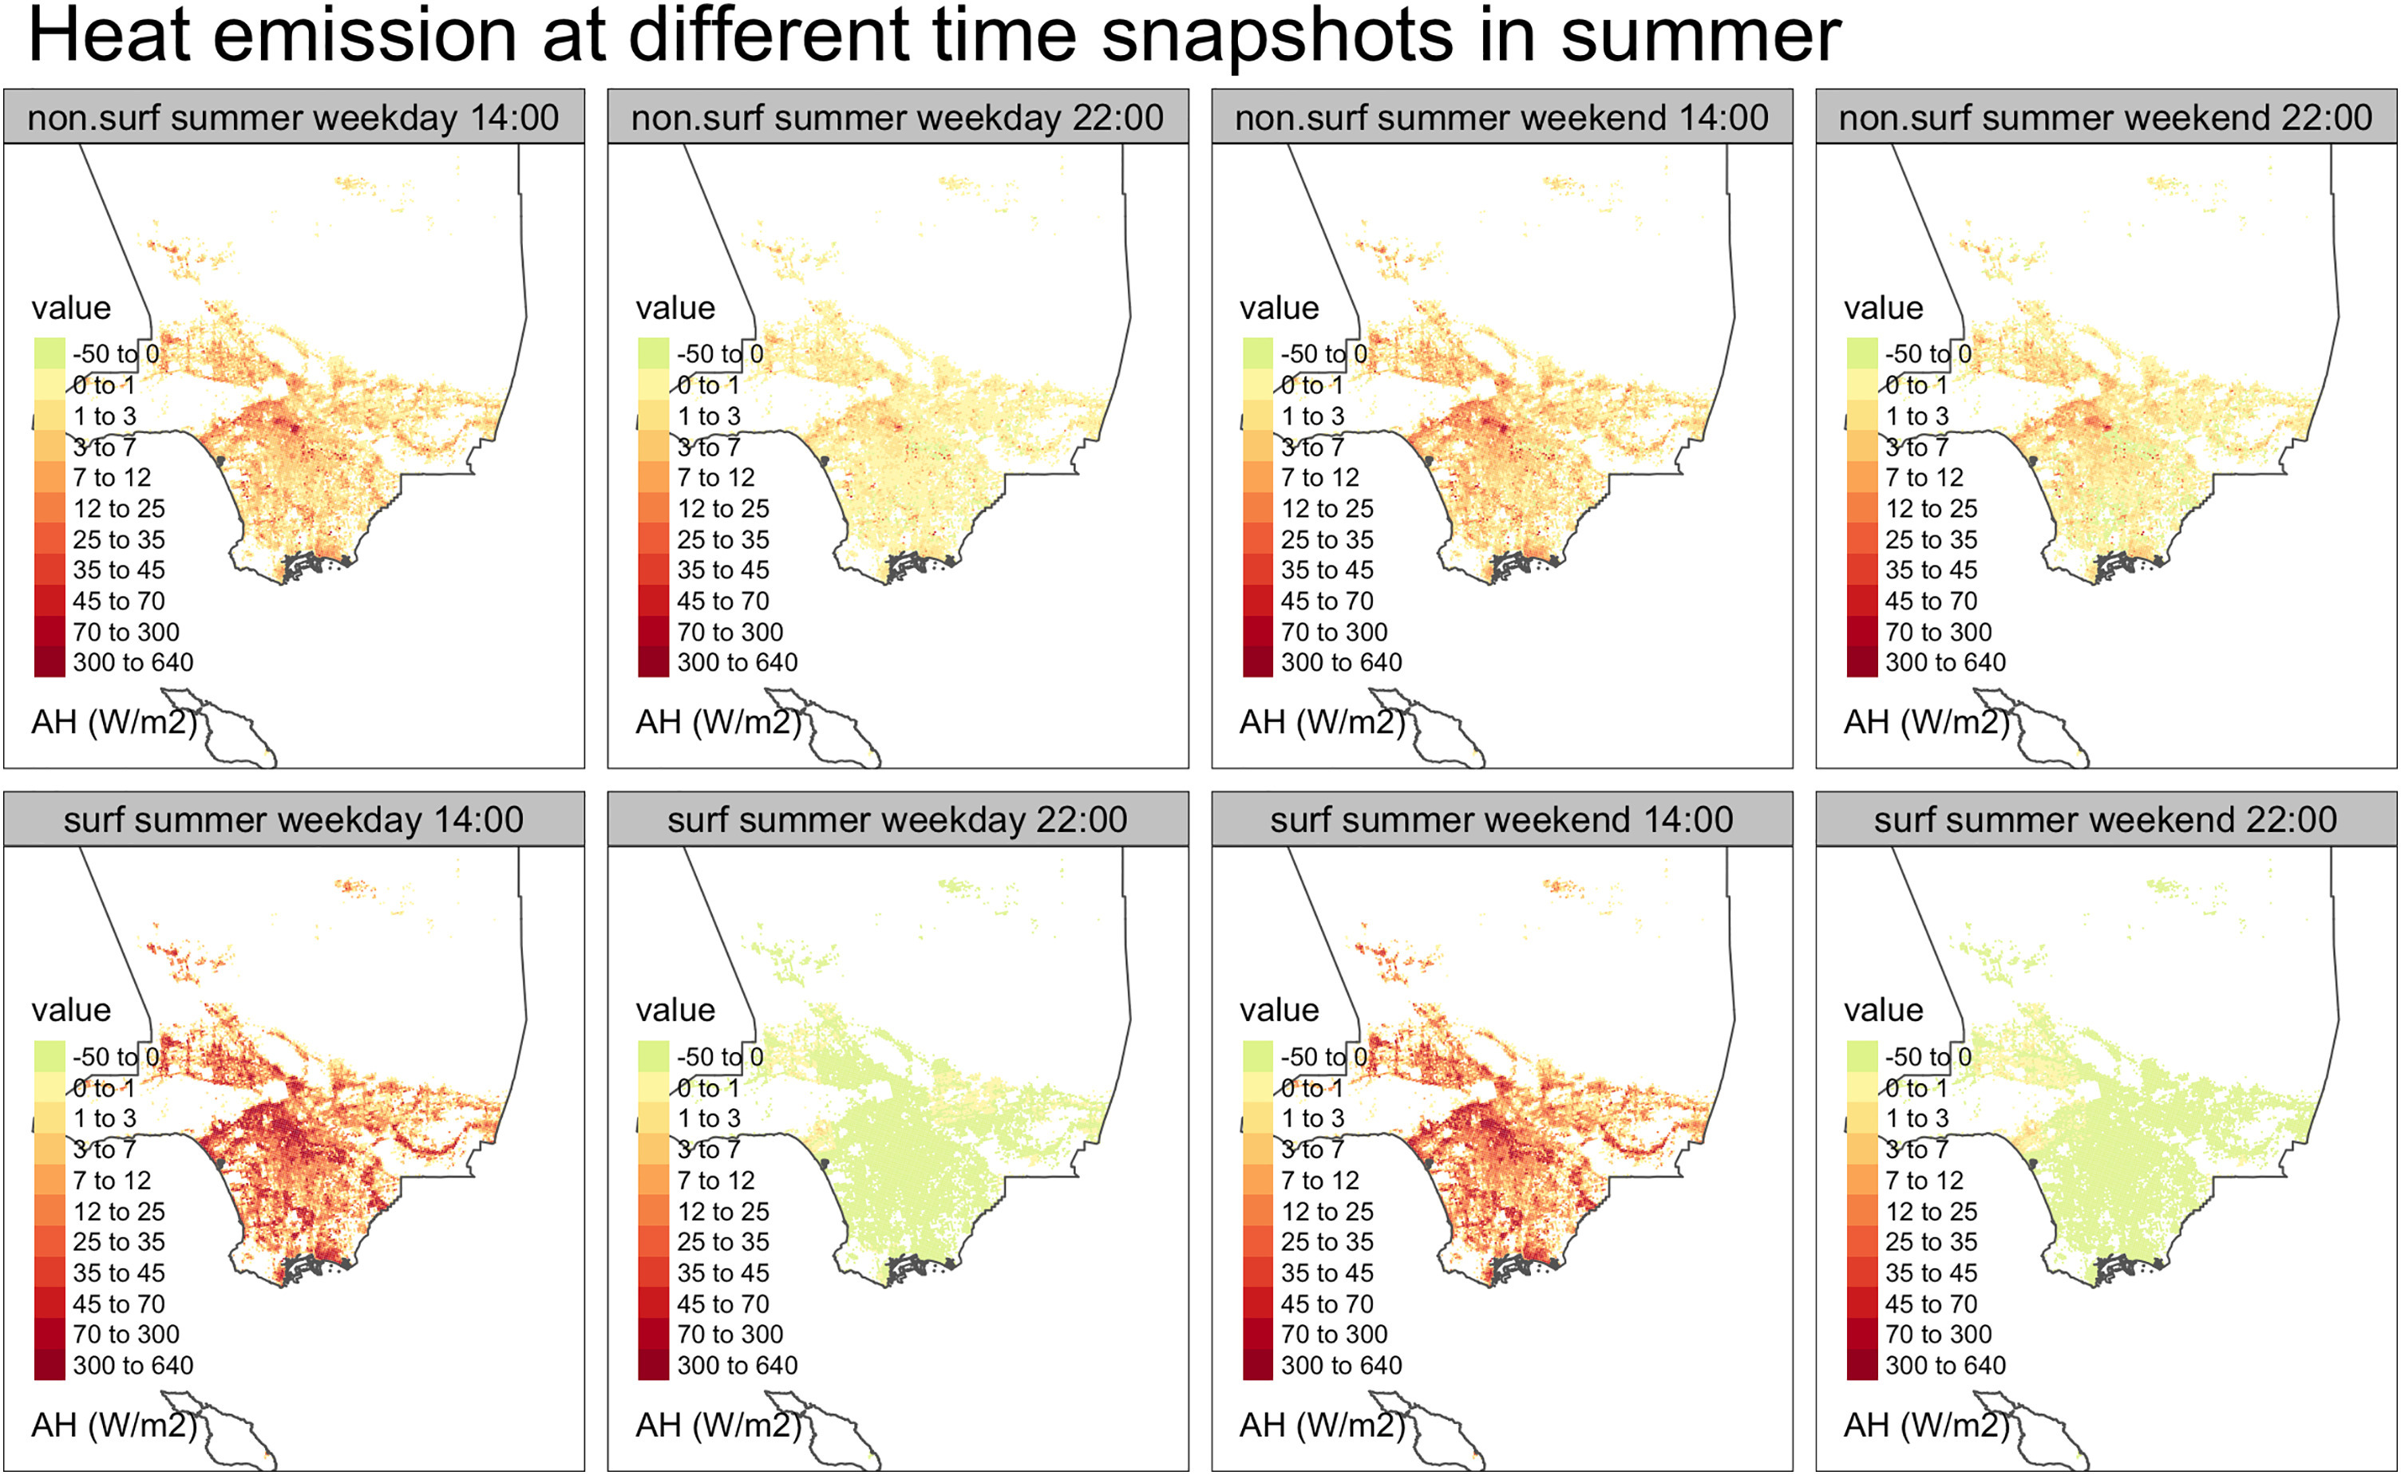
Simulating Building Heat Emissions in Los Angeles County
Objective
Investigates the impact of anthropogenic heat from buildings on urban air temperature in Los Angeles County, highlighting its contribution to the urban heat island effect and the need for mitigation strategies to improve heat resilience.
Approach
Develop a bottom-up simulation framework using EnergyPlus to model annual hourly anthropogenic heat (AH) profiles for 1.7 million buildings in Los Angeles County, incorporating detailed building-physics-based models and local weather data from WRF-UCM simulations.
Aggregate AH data at three spatial resolutions (450 m, 12 km, and census tract) to analyze spatiotemporal characteristics and interactions between building AH and ambient temperature, validated against measured weather station data.
Characterize and analyze AH components (surface convection, HVAC operation, and zone air exchange) across different building types and vintages, identifying seasonal and diurnal patterns and correlations with building characteristics.
Impact
Building anthropogenic heat (AH) in Los Angeles County peaks in May, reaching up to 878 W/m², with surface convection being the largest AH component, accounting for 78% of the total AH.
During the July 2018 heatwave, HVAC-induced building AH (excluding surface convection) increases daily maximum ambient temperatures by up to 0.6°C and daily minimum temperatures by up to 2.9°C, with nighttime temperature increases being more significant.
Higher AH is linked to areas with dense building populations, a high percentage of industrial buildings, and older building stock, suggesting targeted interventions in these areas could mitigate urban overheating.
This figure shows how building heat in Los Angeles varies by time and day, with four maps: noon and night on a weekday and weekend. Some areas consistently produce more heat due to building types and locations. Heat from building surfaces changes significantly between day and night. On weekend nights, areas like Beverly Hills and West Hollywood show more heat, likely due to increased human activity.
Xu, Yujie, Pouya Vahmani, Andrew Jones, and Tianzhen Hong. "Anthropogenic heat from buildings in Los Angeles County: A simulation framework and assessment." Sustainable Cities and Society 107 (2024): 105468. https://doi.org/10.1016/j.scs.2024.105468
First draft generated using PAIGE, the Pnnl AI assistant for GEnerating publication highlights.

