Slide 1
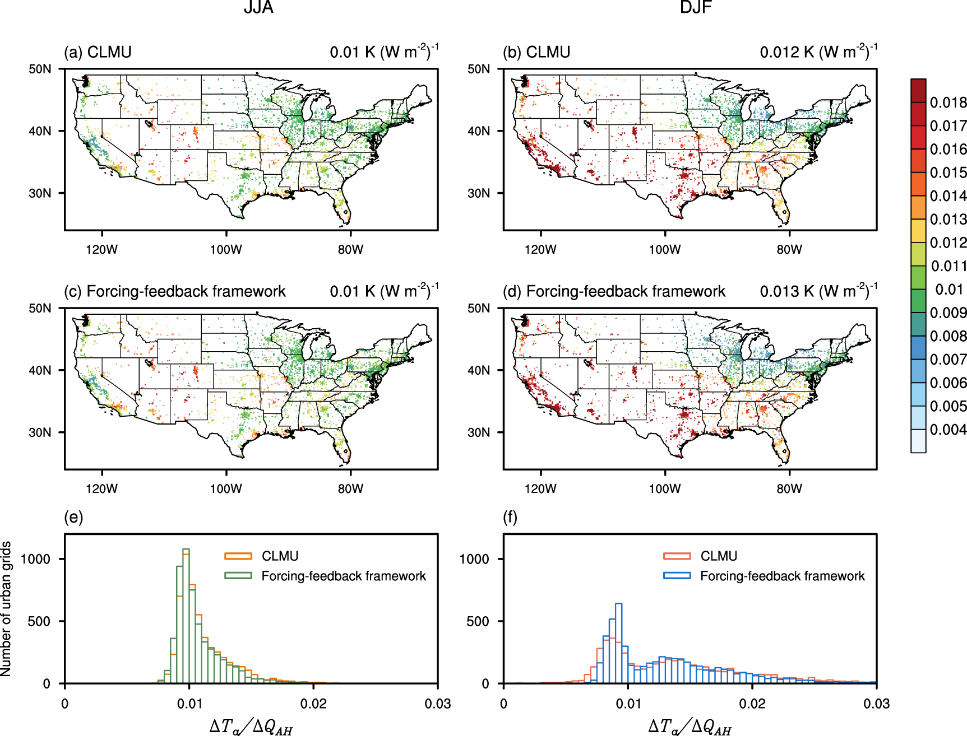
Understanding the Key Drivers of Anthropogenic Heat Impacts on Urban Temperatures
Objective
Investigate the sensitivity of urban canopy air temperature to anthropogenic heat flux across different cities and seasons, highlighting the role of atmosphere-canopy air heat conductance in controlling temperature responses.
Approach
Implement a forcing-feedback framework based on the energy budget of air within the urban canopy layer to diagnose the sensitivity of urban canopy air temperature to anthropogenic heat flux.
Apply the Community Land Model Urban (CLMU) to simulate urban canopy air temperature responses to varying levels of anthropogenic heat flux, using prescribed increments to assess the direct effect and feedback mechanisms.
Impact
Urban canopy air temperature sensitivity to anthropogenic heat flux is approximately 0.01 K(W m⁻²)⁻¹ in summer and 20% higher in winter across the contiguous United States (CONUS).
Feedback mechanisms through changes in surface temperature and atmosphere-canopy air heat conductance nearly cancel each other out in summer, while in winter, weakened negative feedback from conductance leads to a higher urban canopy air sensitivity to anthropogenic heat flux .
The sensitivity of urban canopy air temperature to anthropogenic heat flux shows strong spatial and temporal variability, largely controlled by the variability of atmosphere-canopy air heat conductance.
This figure depicts summer (JJA) and winter (DJF) urban temperature sensitivity to anthropogenic heat flux (∆Ta/∆QAH) across the US, modeled by CLMU in (a) and (b), and calculated via a forcing-feedback framework in (c) and (d), with histograms (e) and (f) showing the distribution of these changes. The total sensitivity diagnosed from the framework matches very well with the directly computed results from CLMU (spatial correlation coefficients larger than 0.99).
Wang, L., T. Sun, W. Zhou, M. Liu, and D. Li. "Deciphering the sensitivity of urban canopy air temperature to anthropogenic heat flux with a forcing-feedback framework." Environmental research letters 18, no. 9 (2023): 094005. DOI: 10.1088/1748-9326/ace7e0

