Slide 1
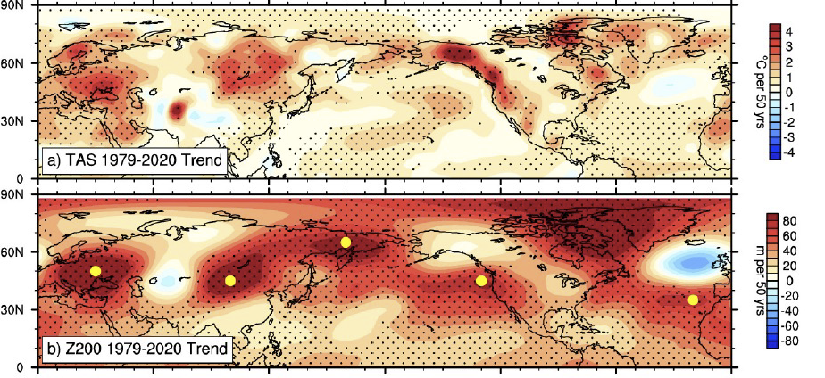
Recognizing a Contributor to Scorching Heat in the Midlatitudes
The top figure shows the linear trend of summer seasonal mean surface air temperature (TAS) from 1979–2020. The stippling represents the 90% confidence level with a Student’s t test. The yellow dots in the bottom figure highlight the centers of the trend in the midlatitudes at 200 hPa geopotential height.
Impact
This is the first paper demonstrating that the upper tropospheric wave train circulation trend observed in summers from 1979–2020 is associated with multidecadal modes of variability in the Pacific and Atlantic Oceans.
A linear planetary wave model indicates that interactions of weather events with the jet streams, especially in the North Atlantic sector, play an important role in the formation of the wave train.
This study suggests that both anthropogenic forcing and natural variability played a role in the warming hot spots observed during the last four decades.
Objective
Understand both the observed circulation trend and the related zonally asymmetric warming pattern during summers from 1979–2020 in the midlatitudes.
Approach
Analyze CMIP6 DECK (AMIP, historical, pre-industrial control) experiments.
Perform idealized CESM1 prescribed soil moisture experiments.
Use a linear planetary wave model to identify the circulation trend.
Teng, H., R. Leung, G. Branstator, J. Lu, and Q. Ding. “Warming pattern over the Northern Hemisphere midlatitudes in boreal summer 1979-2020.” Journal of Climate 35, 3479–3493, (2022). [DOI: 10.1175/JCLI-D-21-0437.1]
Notes:
http://www.pnnl.gov/science/highlights/highlights.asp?division=749

