Slide 1
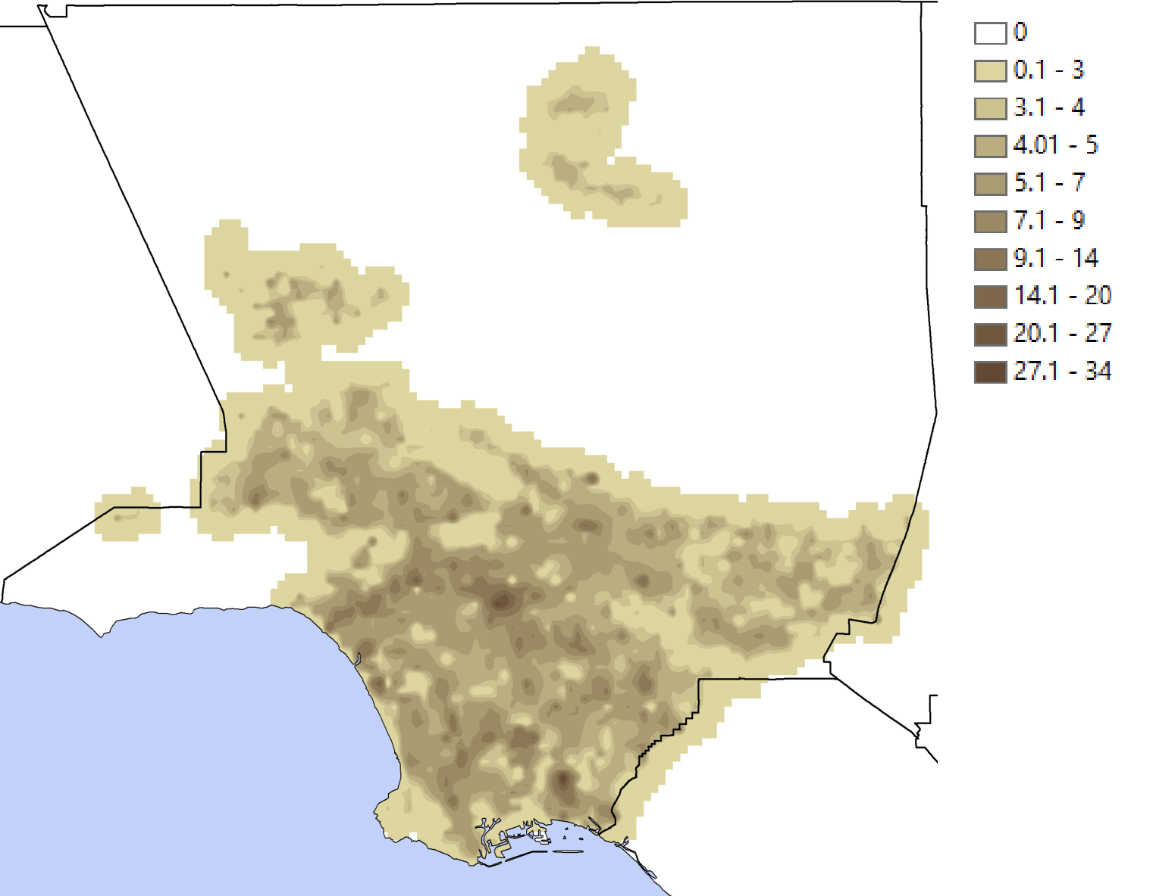
Enhancing Urban Climate Models with NATURF's High-Resolution Data
Objective
Develop open-source software to generate high-resolution urban parameters for input into weather models, enhancing the understanding of building morphology effects on urban microclimates.
Approach
Implement state of the art geospatial and workflow approaches to calculate 132 building parameters from geographic data containing building footprint and height information, facilitating high-resolution urban parameter generation.
Utilize the Hamilton software for workflow organization and visualization, enabling the scoping of function dependencies, a robust test suite, easier troubleshooting, and a deployable and scalable directed acyclic graph (DAG).
Employ the GeoPandas software to handle geospatial calculations efficiently, allowing for the computation of urban parameters based on building geometry and neighborhood interactions.
Impact
NATURF calculates urban parameters, like average building height in Los Angeles with a 100 m resolution as pictured above, to enhance understanding of the influence of urban structures on local weather patterns.
NATURF generates high-resolution urban parameters from building-level data, enabling detailed microclimate modeling at sub-kilometer scales.
Simulations using NATURF demonstrate that urban developments significantly impact temperature and energy use in both new and existing neighborhoods.
NATURF provides high resolution outputs making it suitable for complex urban analyses scaleable on high-performance computing systems.
Sweet-Breu, Levi T., Em Rexer, Chris R. Vernon, Melissa R. Allen-Dumas, and Stefan Krawczyk. 2024. naturf: A Package for Generating Urban Parameters for Numerical Weather Modeling. Journal of Open Source Software 9, no. 98: 6712. https://doi.org/10.21105/joss.06712.
First draft generated using PAIGE, the Pnnl AI assistant for GEnerating publication highlights

