Slide 1
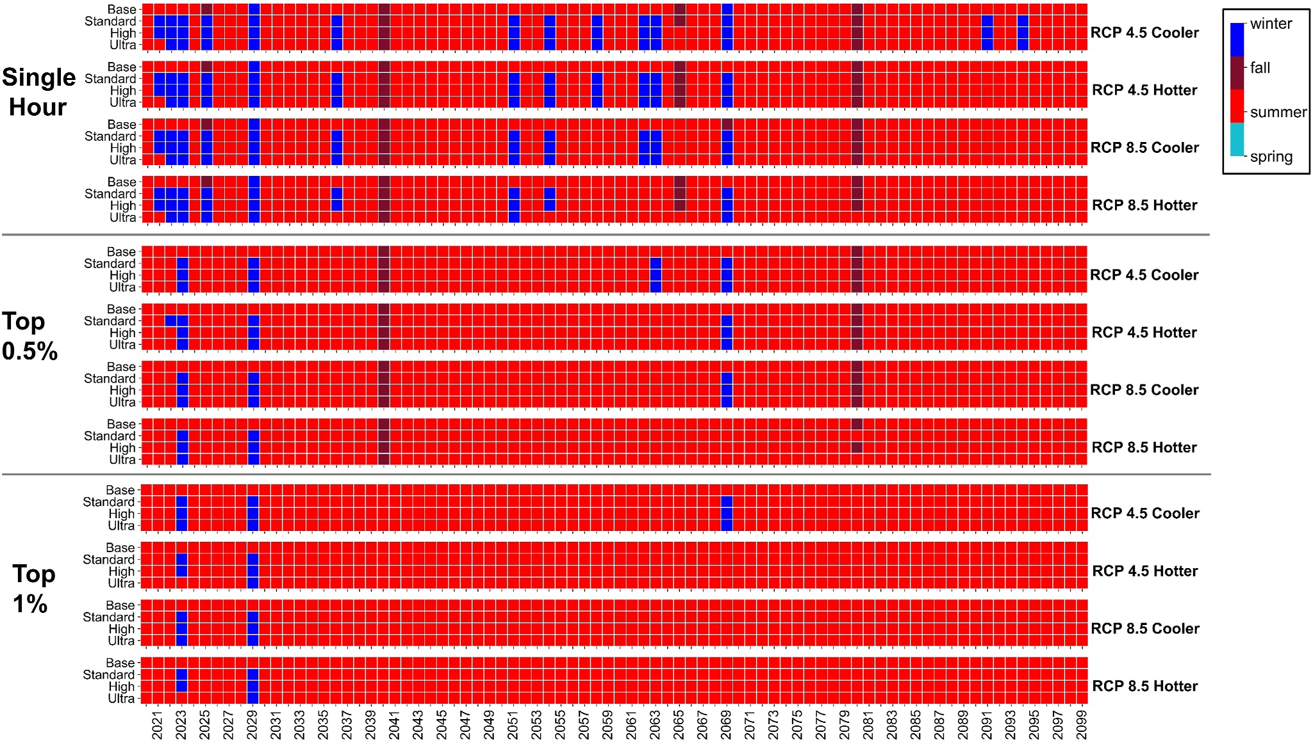
Texas Grid Faces New Challenges with Heat Pump Adoption
Objective
Investigate the combined impacts of space heating electrification and climate change on peak load behavior and grid capacity requirements in Texas, highlighting the potential for increased uncertainty in seasonal peaking patterns and grid reliability.
Approach
Develop machine learning models trained on hourly residential and non-residential load data to predict electricity demand under various heating electrification scenarios and climate change projections.
Implement a direct current optimal power flow (DCOPF) model to simulate the operational impacts on the ERCOT grid, assessing grid reliability and load shedding under different future scenarios.
Integrate climate change data with shared socioeconomic pathways to evaluate the influence of climate and technology adoption on peak load behavior and grid capacity requirements.
The above figure communicates the complex interaction between technology adoption and climate scenarios and that peak electricity demand season in Texas could move from summer to winter with increased heat pump use and climate change, underscoring potential challenges for grid reliability and planning. We examine four different space heating electrification scenarios (base case, and HP adoption under the Standard Efficiency, High Efficiency, and Ultra-High Efficiency HP technologies) and three definitions of peak load (single hour, top 0.5%, and top 1.0%). The color of each cell indicates the season of the year with the highest hourly load occurrence.
Impact
Full electrification of residential space heating with high-efficiency heat pumps improves grid reliability under hotter climate scenarios by reducing summer cooling demand.
Adoption of less efficient heat pumps increases the risk of severe winter peaking events, potentially leading to higher peak loads and increased probability of outages.
System planners must balance the risk of greater resource adequacy challenges due to shifts in seasonal peaking behavior with the benefits of improved efficiency and emissions reductions.
Ssembatya, Henry, Jordan D. Kern, Konstantinos Oikonomou, Nathalie Voisin, Casey D. Burleyson, and Kerem Ziya Akdemir. 2024. Dual Impacts of Space Heating Electrification and Climate Change Increase Uncertainties in Peak Load Behavior and Grid Capacity Requirements in Texas. Earth's Future 12: e2024EF004443. https://doi.org/10.1029/2024EF004443.
First draft generated using PAIGE, the Pnnl AI assistant for GEnerating publication highlights

