Slide 1
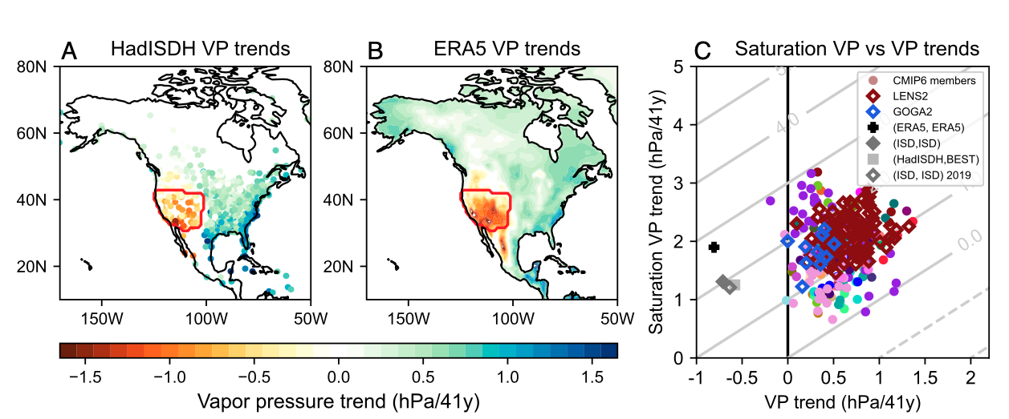
Observed humidity trends in dry regions contradict climate models
Simpson, I. R., K. A. McKinnon, D. Kennedy, D. M. Lawrence, F. Lehner, R. Seager:
Proceedings of the National Academy of Sciences (2023) doi: 10.1073/pnas.2302480120
OBJECTIVE
To report what we know and do not know about the striking discrepancy between observed and simulated vapor pressure (VP) trends over dry regions.
APPROACH
Comparing a range of observations and model simulations, we show robust evidence for a discrepancy in VP trends. By controlling for possible drivers like SSTs or precipitation, we isolate the issue to be most likely related to the land surface component of climate models.
Part of Fig. 1 from Simpson et al. (2023), showing the strong negative vapor pressure (VP) trend, which is not reproduced by any climate model simulation, coupled or uncoupled.
IMPACT
The discrepancy indicates a major gap in our understanding and modeling capabilities which could have severe implications for hydroclimate projections, including fire hazard, moving forward. Resolving this discrepancy is an urgent priority.

