Slide 1
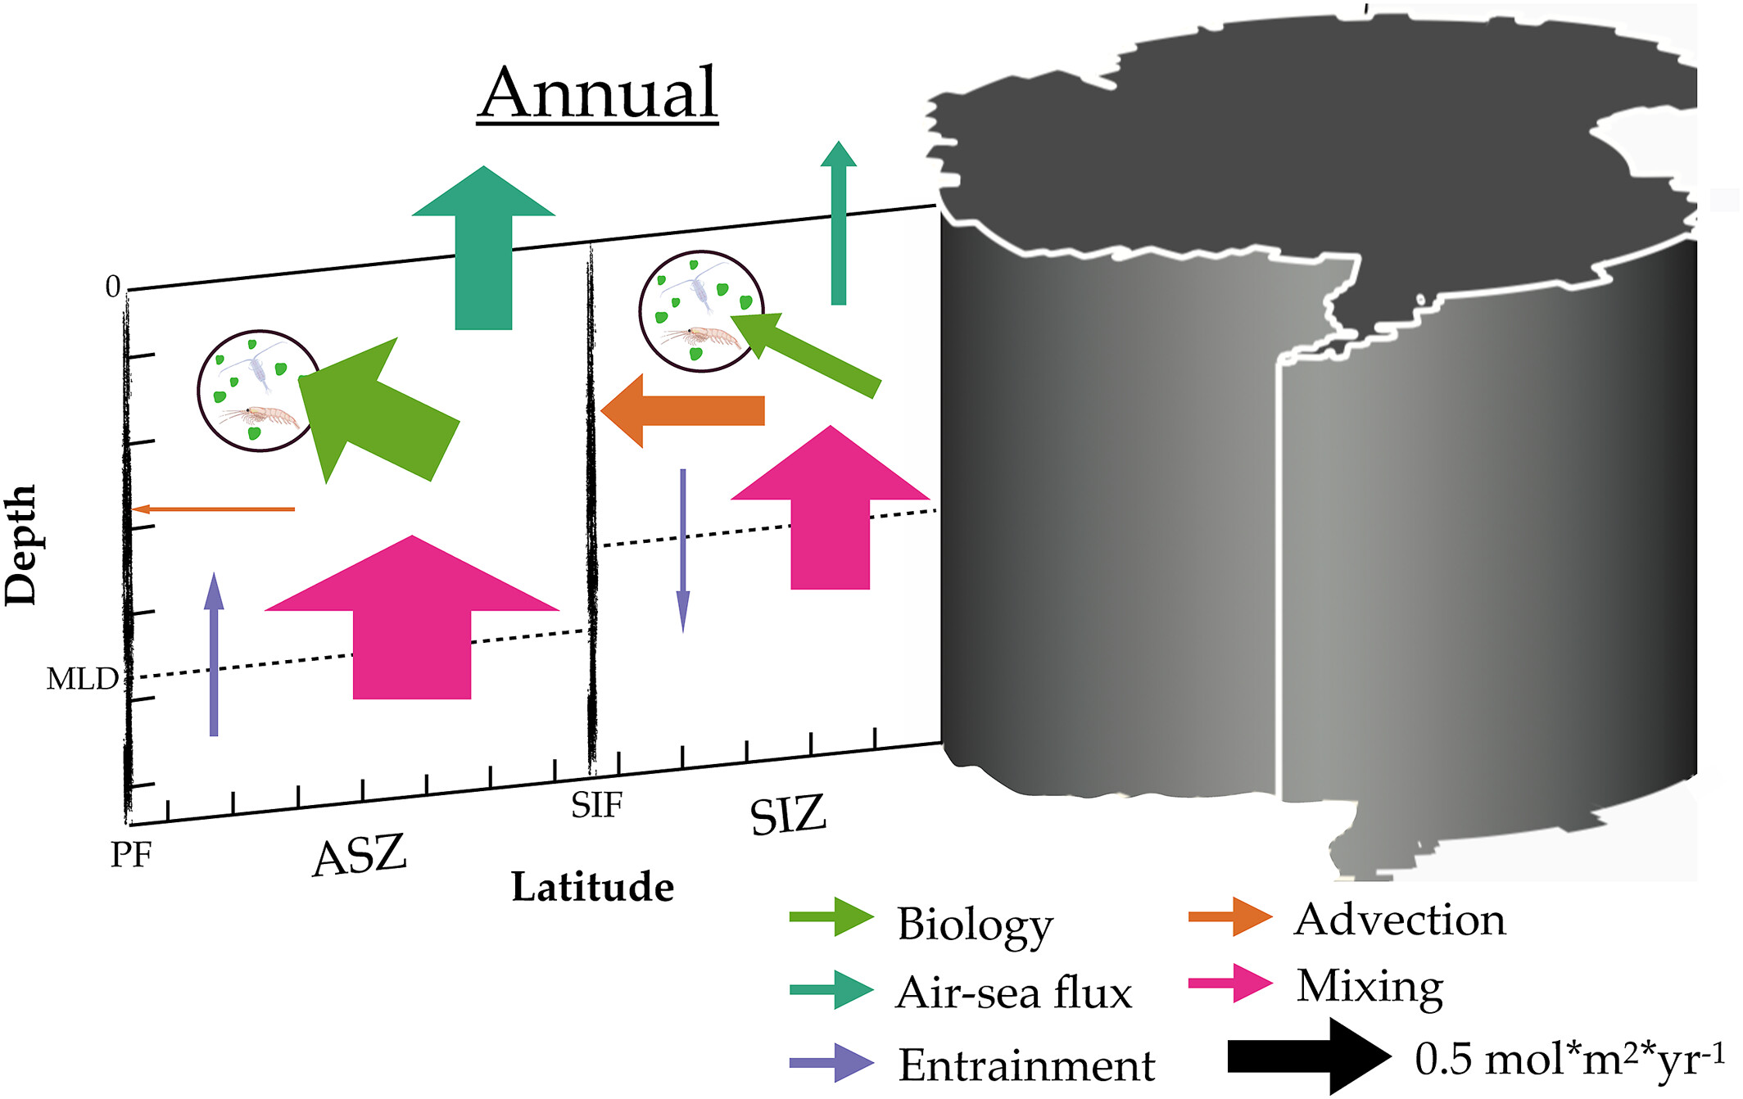
Lateral transport supports Southern Ocean carbon dioxide outgassing
Objective
Build a Southern Ocean observation-based mixed layer inorganic carbon budget with circumpolar coverage and a full seasonal cycle.
Approach
Use data collected on biogeochemical-Argo floats in the Southern Ocean.
Perform an analysis of these data to quantify the main sources and sinks of carbon in the Southern Ocean.
Impact
Biological activity and circulation dominate the seasonal variations in mixed layer dissolved inorganic carbon
Wind-driven transport from the seasonal sea ice zone contributes to carbon outgassing in the Antarctic Circumpolar Current
We provide a useful observation-based product with which to compare to global Earth system model simulations.
Schematic of the annually integrated fluxes of carbon in the Southern Ocean mixed layer.
J. Sauvé, A. Gray, C. Prend, S. Bushinsky, and S. Riser. ”Carbon outgassing in the Antarctic Circumpolar Current is supported by Ekman transport from the sea ice zone in an observation-based seasonal mixed-layer budget.” Journal of Geophysical Research: Oceans, 128, e2023JC019815, (2023). [DOI: 10.1029/2023JC019815]

