Slide 1
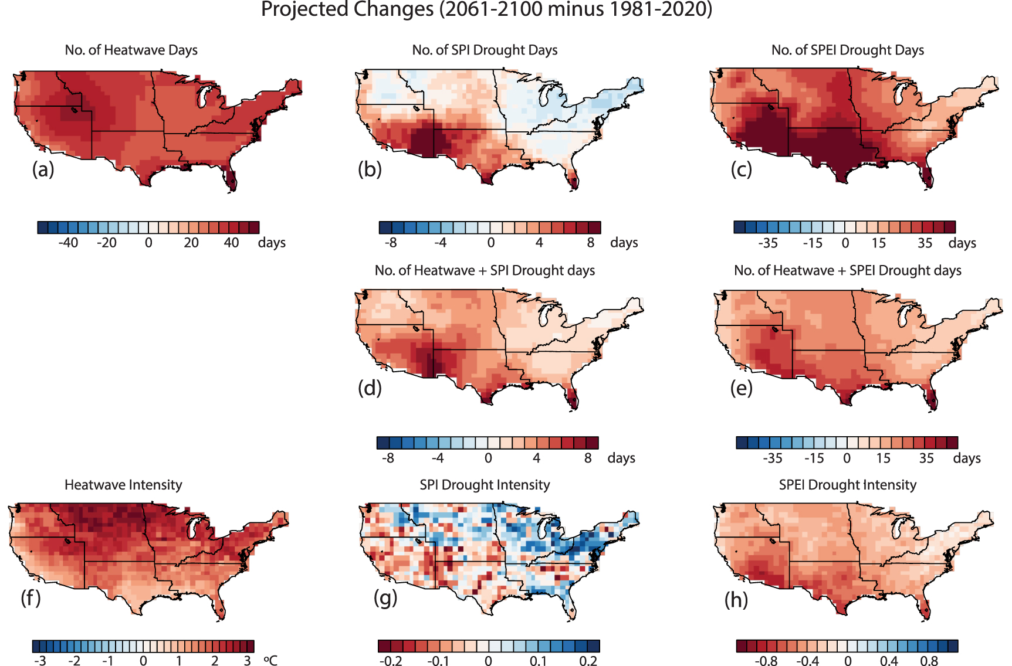
Projected Compound Heatwave and Drought Extremes in the United States
Objective
Evaluate the historical performance and future projections of compound heatwave and drought (CHD) extremes across the contiguous United States using CMIP6 global climate models, providing insights for regional adaptation strategies in response to climate change.
Approach
Analyze the performance of 23 CMIP6 global climate models against observational and reanalysis datasets, focusing on the simulation of historical heatwave and drought characteristics, including biases in frequency and intensity.
Assess future changes in heatwave and drought extremes, as well as compound heatwave-drought events, by examining model projections under the Shared Socioeconomic Pathway 585 scenario and explore regional differences and the impact of drought index choice on these projections.
SPI: Standard Precipitation Index
SPEI: Standard Precipitation-Evapotranspiration Index
Impact
CMIP6 models show substantial biases in simulating heatwaves, droughts, and compound heatwave-drought events compared to reference datasets, with variability in bias magnitude among models.
Future projections indicate an increase in the area affected by compound heatwave-drought events, with intensity and frequency of heatwaves and droughts rising across the majority of the CONUS, especially when using SPEI-based drought indices.
There are significant inter-model differences in projected changes, with variations based on the region, individual GCM projections, and the choice of drought index (SPI or SPEI), highlighting the importance of model selection for regional impact assessments.
Projected end-century changes in the multi-model mean for the (a) number of heatwave days, (b) number of SPI-based drought days, (c) number of SPEI-based drought days, (d) number of SPI-based CHD days, (e) number of SPEI-based CHD days, (f) heatwave intensity for SPI-based (g) drought intensity for SPI-based, and (h) drought intensity for SPEI-based CHD days. The end-century changes are calculated as the average differences during the summer months between 2061–2100 and the 1981–2020 period.
Rastogi, D., J. Trok, N. Depsky, E. Monier, and A. Jones. "Historical evaluation and future projections of compound heatwave and drought extremes over the conterminous United States in CMIP6." Environmental Research Letters 19, no. 1 (2023): 014039.DOI:10.1088/1748-9326/ad0efe

