Slide 1
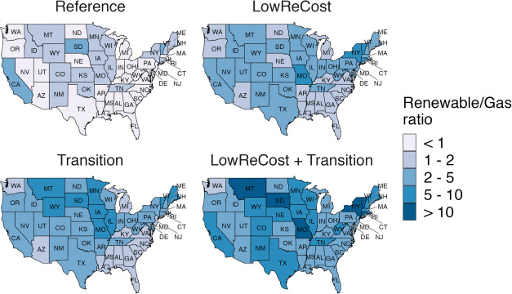
Enhancing Modeled Capacity Expansion Pathways with Improved Power-Sector Dynamics
Objective
Understand the scale and type of electric capacity requirements needed in the U.S. under alternative future transition and technology cost scenarios.
Approach
Incorporate enhanced representations of capacity markets, economic retirements, and power-plant age structure within the capacity expansion module of a multi-sector model (GCAM-USA).
Explore four electric capacity expansion pathways that vary in their assumptions about renewable cost reduction rates and economy―wide low-carbon transitions.
Impact
The enhanced model includes operational flexibility that allows the modelled capacity market to better capture responses to short- and long-term demand changes without overly drastic shifts in near-term capacity.
The ratio of cumulative (2016–2050) new capacity investments in renewables to gas. “Gas” includes gas and gas CCS plants, while “renewable” includes solar PV, solar CSP, and wind. Under a combination of rapid renewable cost reductions and economy-wide low-carbon transitions (LowReCost+Transition), capacity investments in renewable technologies increase substantially. Investments in fossil capacity (coal, gas, and refined liquids) reduce substantially.
Ou, Y., Binsted, M., Iyer, G., Patel, P. and Wise, M. "US state-level capacity expansion pathways with improved modeling of the power sector dynamics within a multisector model." Energy Strategy Reviews, 38, 100739, (2021),
[DOI: 10.1016/j.esr.2021.100739]

