Slide 1
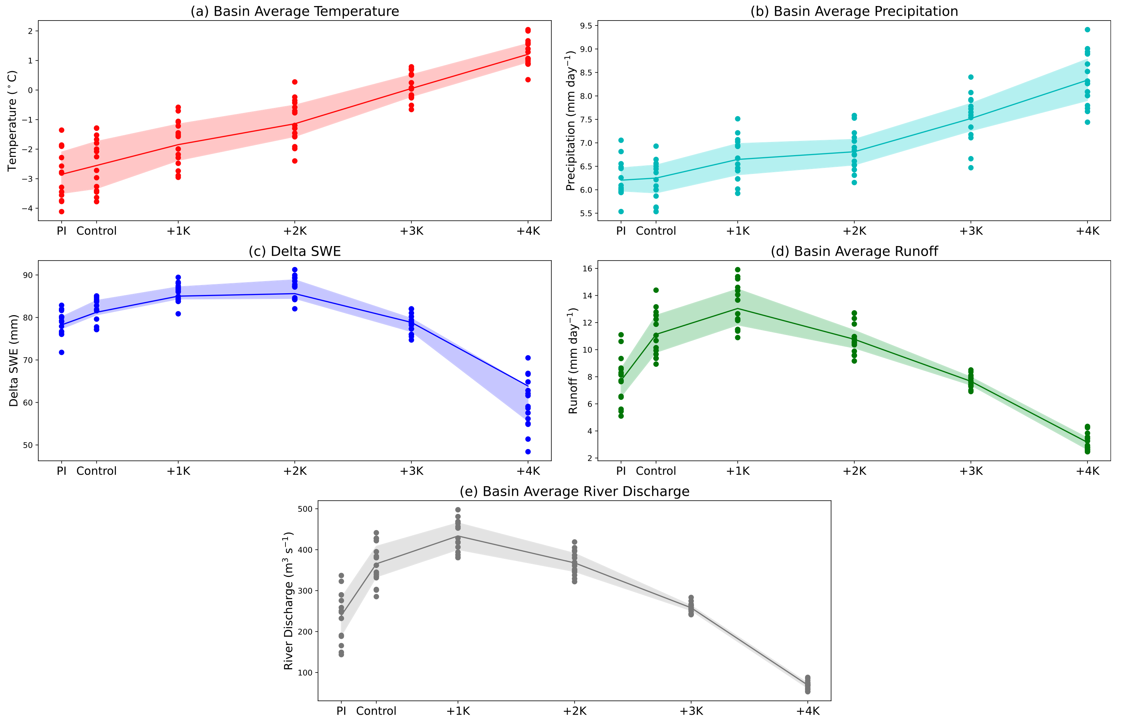
The 1996 Mid-Atlantic Winter Flood: Exploring Climate Risk through
a Storyline Approach
Objective
Evaluate how a compound rain-on-snow flood event in the northeastern United States might plausibly evolve under different future climate warming levels
Approach
Use Betacast in conjunction with 14km E3SM to perform an ensemble reforecast of the January 1996 Mid-Atlantic rain-on-snow flood event over the Susquehanna River Basin.
Warming level "deltas" are derived from the Community Earth System Model Large Ensemble and applied to the initial fields to simulate the flood's evolution in different future climates
Impact
A nonlinear response in simulated surface runoff and streamflow as a function of atmospheric warming is observed due to changing contributions of liquid water input from a shallower initial snowpack (decreased snowmelt), increased surface temperatures and rainfall rates, and increased soil water storage.
Flooding associated with this event peaks from around +1 to +2 K of global average surface warming and decreases with additional warming beyond this.
The timing of the peak runoff and streamflow shifts earlier with warming, leading to changes in the flashiness of the event.
Changes in (a) temperature, (b) precipitation, (c) snow loss, (d) surface runoff, and (e) river discharge averaged over the Susquehanna River Basin for the Jan. 1996 rain-on-snow flood under different warming levels (y-axis). Dots indicate the basin-averaged quantities for an individual E3SM simulation, with the shading representing the 25th-75th percentile spread. Note the monotonic response (increase with warming) of temperature and precipitation, but the non-linear response of snowmelt, surface runoff, and streamflow with warming.
Pettett, A., and C. M. Zarzycki, 2023: The 1996 Mid-Atlantic Winter Flood: Exploring Climate Risk through a Storyline Approach. J. Hydrometeor., 24, 2259–2280, https://doi.org/10.1175/JHM-D-22-0146.1. 4

