Slide 1
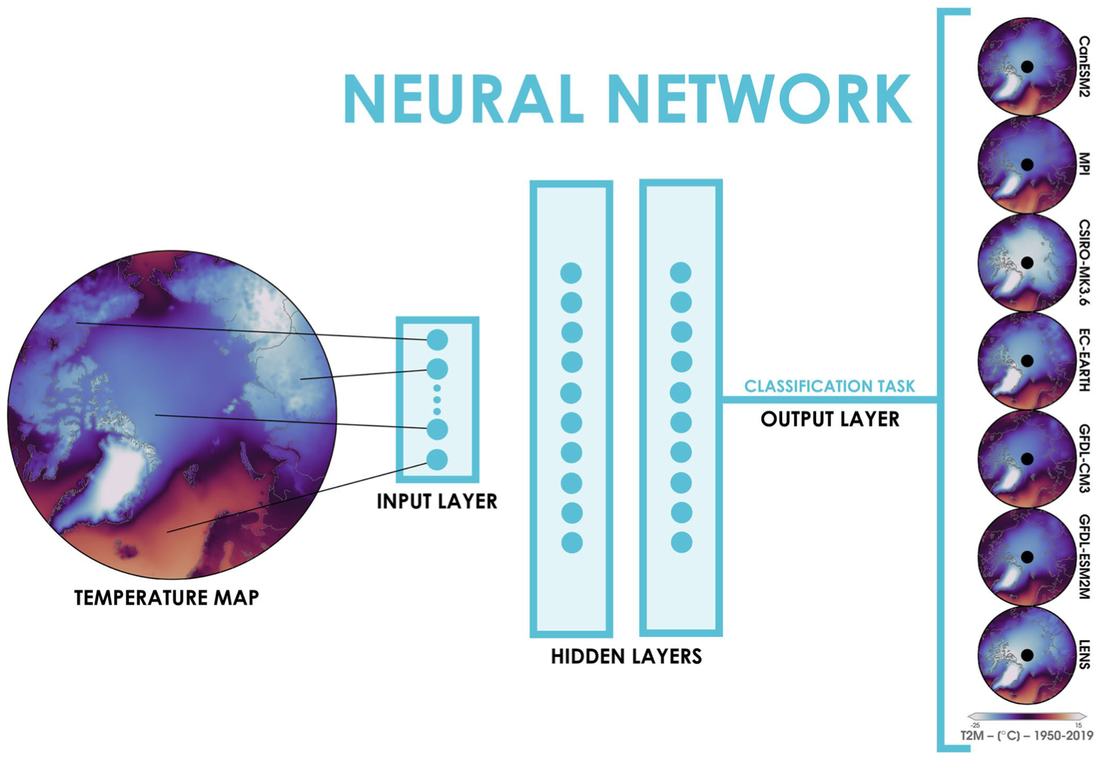
Comparison of Climate Model Large Ensembles With Observations in the Arctic Using Simple Neural Networks
Objective
To leverage machine learning and explainable AI for comparisons of climate models with observations over the Arctic.
Approach
While there are other existing statistical methods for assessing simulations between different climate models, Collaborator Prof. Elizabeth Barnes (Colorado State University) and co-author Dr. Zack Labe (CSU, now GFDLCollaborator Prof. Elizabeth Barnes (Colorado State University) and co-author Dr. Zack Labe (CSU, now at GFDL) trained neural networks to identify the climate model given a map of annual Arctic climate. Once trained, explainable AI techniques (XAI) were then used to extract robust differences in the Arctic across climate models. Reanalysis fields of the Arctic were also put into the network to determine which climate model the network predicted was most similar.
Impact
Overall, we find that the ANN is leveraging regional patterns of temperatures, and not just overall warm and cold biases, in order to make its climate model and observation predictions. Thus, this approach could be useful for understanding climate model differences and biases beyond the regional mean.
(top) Neural network task and architecture. (bottom) (a–g) Composite heatmap XAI for correct testing data predictions averaged over the 1950–2019 period (h) Composite of differences in T2M between CanESM2 minus the multi-model mean ensemble averaged over 1950–2019. (i–n) as in (h), but for the other models.
Labe, Z. M., & Barnes, E. A. (2022). Comparison of climate model large ensembles with observations in the Arctic using simple neural networks. Earth and Space Science, 9, e2022EA002348. https://doi.org/10.1029/2022EA002348

