Slide 1
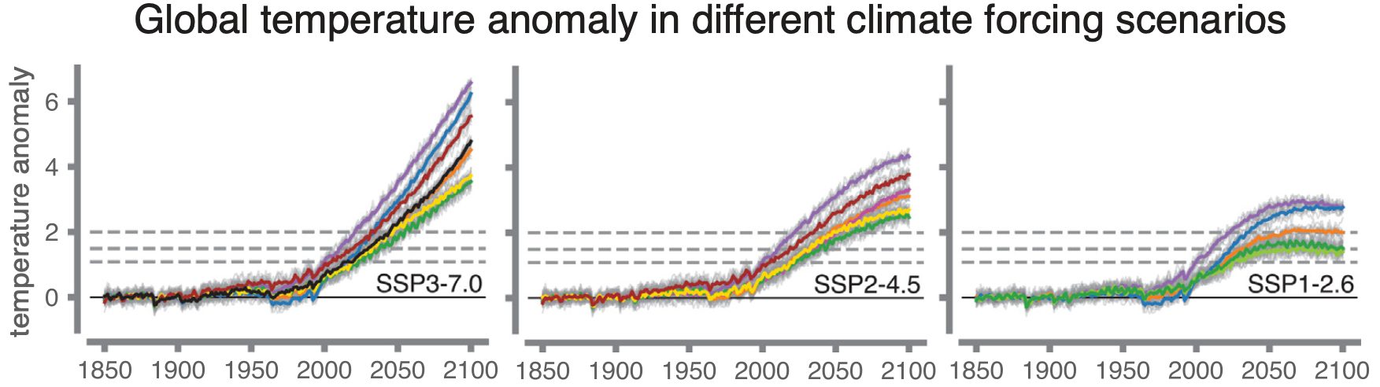
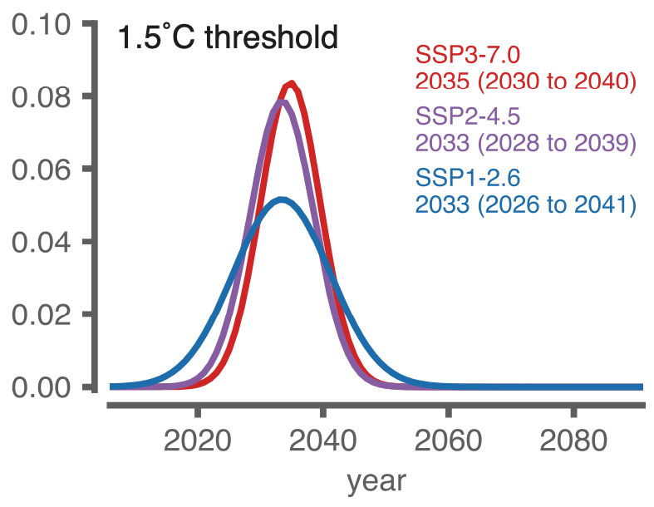
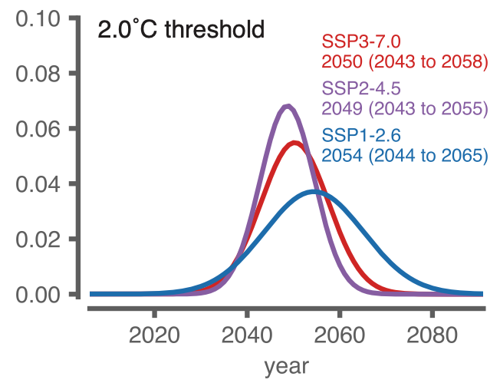
Data-Driven Predictions of the Time Remaining until Critical Global Warming Thresholds Are Reached
Objective
Use data-driven, machine learning methods to leverage climate model simulations to constrain the time remaining (with uncertainties) until critical global warming thresholds (e.g. 2 degrees C above preindustrial) will be reached in the real world.
Approach
Collaborator Prof. Elizabeth Barnes (Colorado State University) and co-author Prof. Noah Diffenbaugh (Stanford University) train neural networks using a suite of climate model data as input, and after training is complete, they input observed warming patterns. In this way, the trained neural networks act in a way to merge a range of disparate climate model simulations with the real world to provide estimates (with their uncertainty) of 21st Century climate change.
Impact
Results provide a central estimate for the 1.5°C global warming threshold between 2033 and 2035 under SSP2-4.5 climate forcing scenario, consistent with previous assessments. However, the observational results suggest a higher likelihood of reaching 2°C in the Low (SSP1-2.6) scenario than indicated in some previous assessments—although the possibility it could be avoided is not ruled out.
(top) Global temperature anomalies under different climate forcing scenarios and across different climate models. (bottom) Neural network predictions of the year (with uncertainties) when the global mean temperature will reach 1.5C and 2C above preindustrial under different climate scenarios.
Diffenbaugh, Noah S., and Elizabeth A. Barnes. 2023. “Data-Driven Predictions of the Time Remaining until Critical Global Warming Thresholds Are Reached.” Proceedings of the National Academy of Sciences 120 (6): e2207183120. https://doi.org/10.1073/pnas.2207183120.

