Slide 1
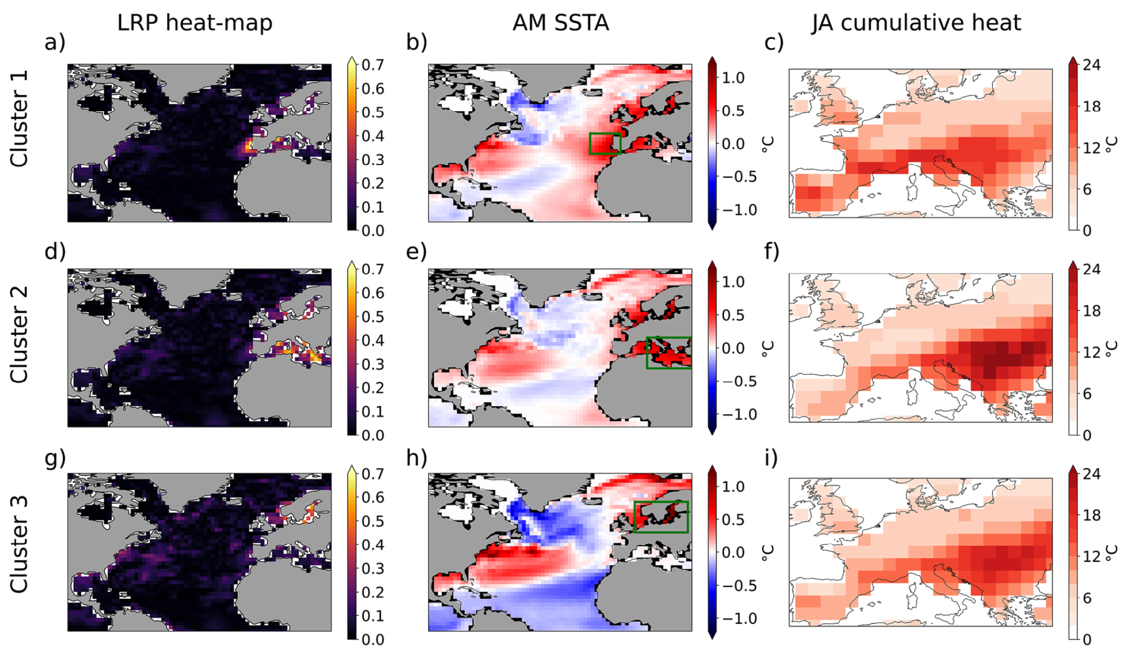
Spring Regional Sea Surface Temperatures as a Precursor of European Summer Heatwaves
Objective
Diagnose springtime precursors of summer European heatwaves using explainable machine learning.
Approach
Collaborator Prof. Elizabeth Barnes (Colorado State University) and co-authors train neural networks to predict the occurrence of European summer heatwaves and use explainable machine learning algorithms to diagnose their springtime sea-surface temperature precursors using 100 historical simulations of the MPI Grand Ensemble. A neural network is tasked to predict whether a summer will occur, given sea-surface temperature maps in spring. The network correctly classifies approximately 70% of all heatwaves/non-heatwave seasons.
Impact
Although the machine learning algorithms are trained to predict heatwaves in the coming months, the main focus of the article is on heatwave precursors which are identified via explainable machine learning algorithms. Results show three “flavors” of European heatwave, each with different regional sea-surface temperature anomalies that act as precursors. In this way, the work demonstrates an approach to predicting (and understanding) the lead-up to dangerous heatwaves.
K-means clustering of explainable machine learning heat-maps for correctly classified European summer heatwave years with model confidence above 60%. Cluster composites of; (a, d, g) heat-maps; (b, e, h) April and May mean sea surface temperature anomalies; (c, f, i) July and August heatwave intensity expressed as cumulative heat. Cluster one contains 1,103 samples, cluster two 814 samples and cluster three 903 samples.
Beobide-Arsuaga, Goratz, André Düsterhus, Wolfgang A. Müller, Elizabeth A. Barnes, and Johanna Baehr. 2023. “Spring Regional Sea Surface Temperatures as a Precursor of European Summer Heatwaves.” Geophysical Research Letters 50 (2). https://doi.org/10.1029/2022gl100727.

