Slide 1
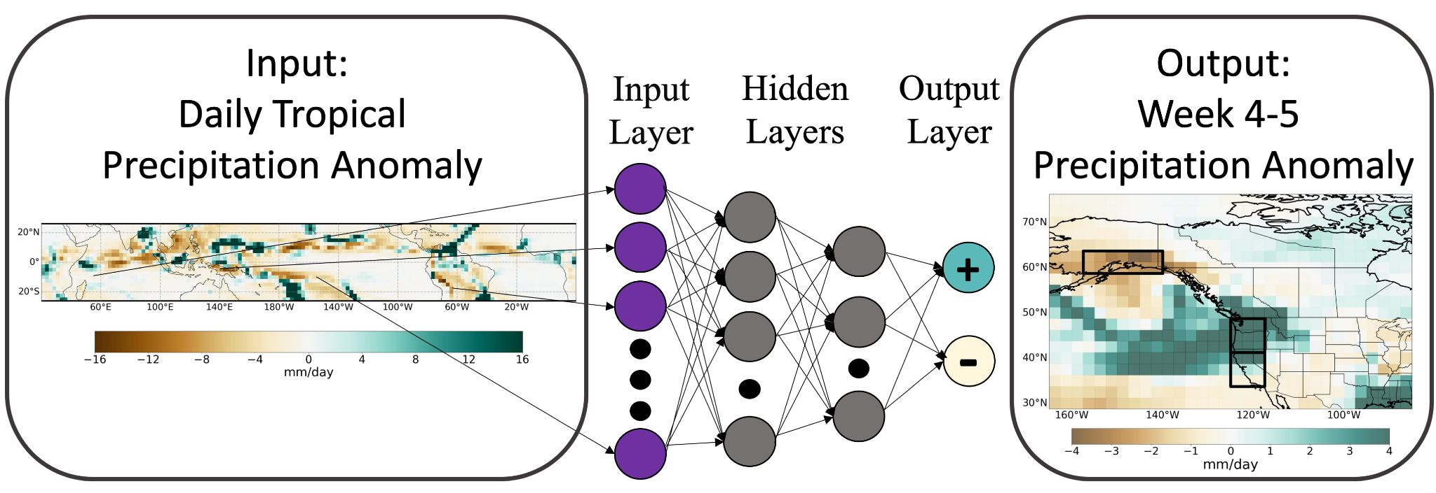
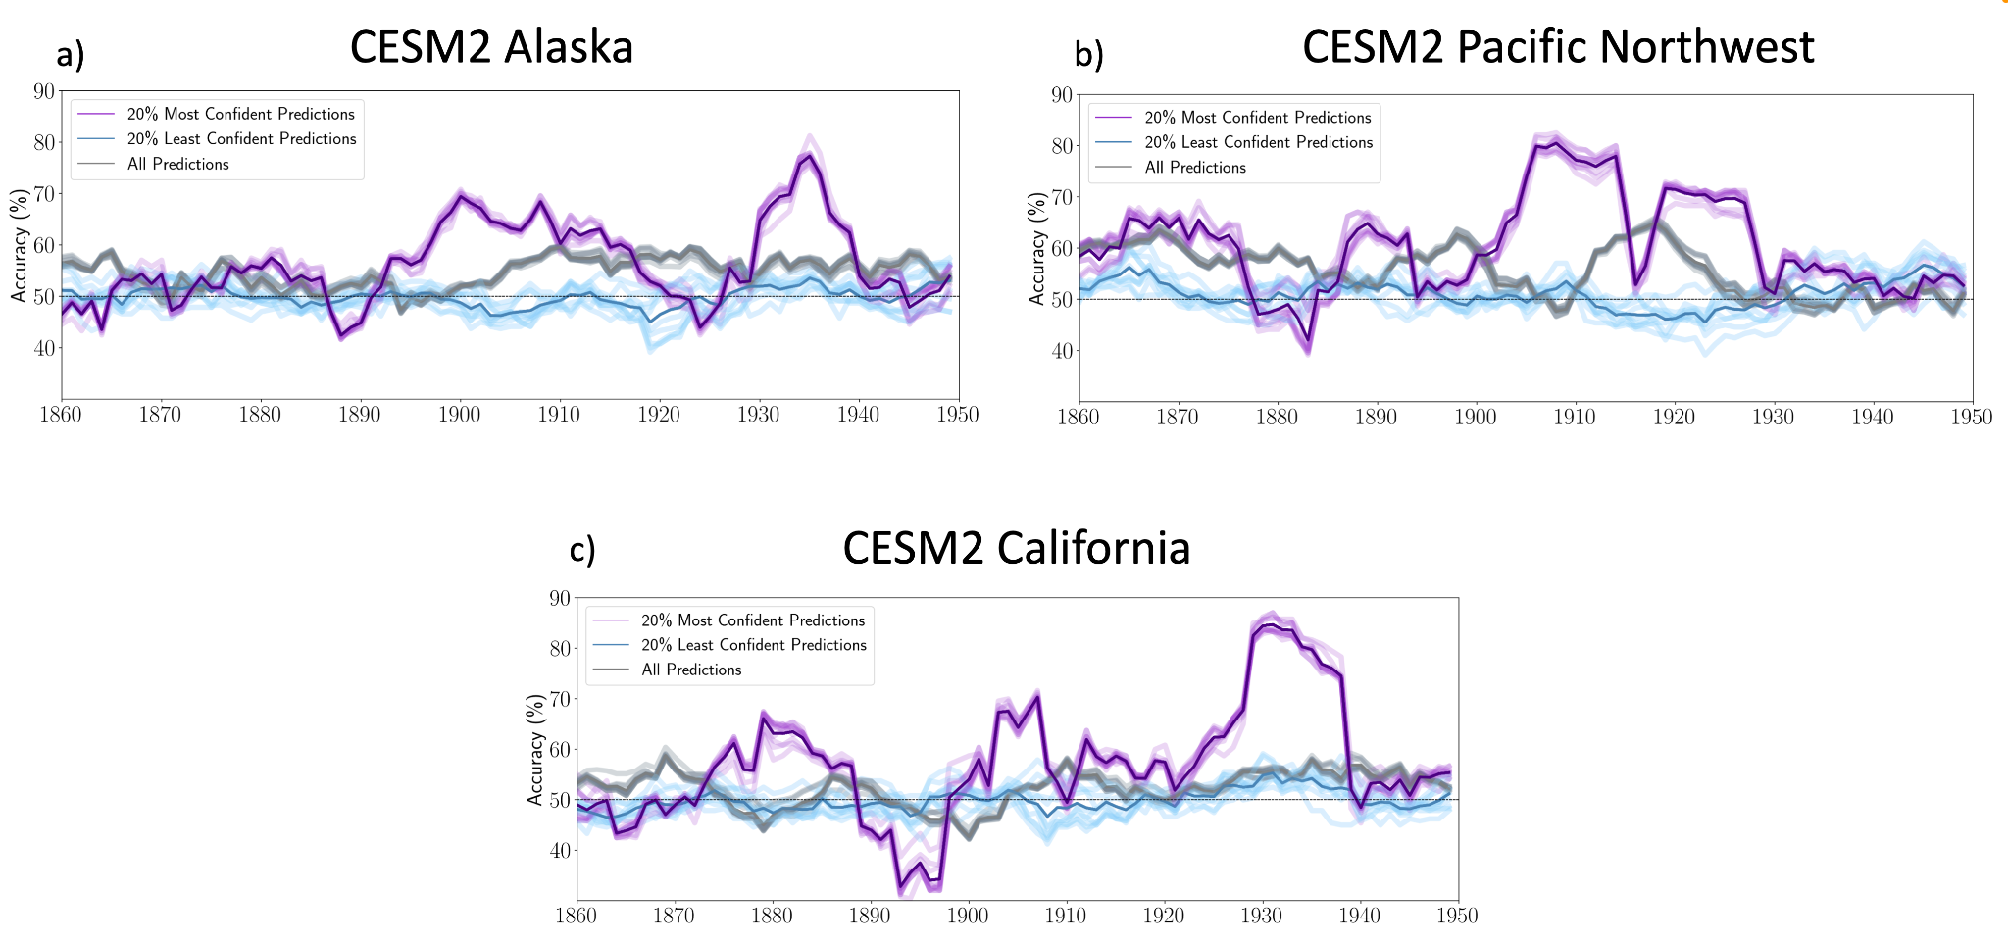
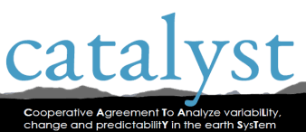
Assessing Decadal Variability of Subseasonal Forecasts of Opportunity Using Explainable AI
Objective
To identify and explore decadal variability in midlatitude subseasonal forecasts of opportunity provided by the tropics using explainable AI.
Approach
Dr. Marybeth Arcodia (Colorado State University), Dr. Elizabeth Barnes (CSU) and co-authors use neural networks to investigate if subseasonal forecasts of opportunity for U.S. West Coast precipitation provided by tropical precipitation vary on decadal timescales. Explainable artificial intelligence (XAI) methods are used to explore sources of predictability. By calculating a 10-year running mean across confident network predictions throughout the CESM2-LE historical simulation, we extract lower frequency variability in subseasonal predictability during forecasts of opportunity. Analysis is extended to ECMWF Reanalysis v5 data to reveal that the relationships learned within the CESM2-LE holds in modern reanalysis data.
Impact
We find that tropically-driven subseasonal predictability varies on decadal timescales during forecasts of opportunity. These results further indicate that the neural networks are capable of identifying predictable decadal states of the climate system within CESM2 that are useful for making confident, accurate subseasonal precipitation predictions in the real world.
(top) Neural network task and architecture. (bottom) (a–c) Ten year moving windows of accuracy shifted forward by one year for ten random seeds of one CESM2 test ensemble member for all predictions (gray), the 20% most confident predictions (purple), and the 20% least confident predictions (blue) for (a) Alaska, (b) Pacific Northwest, and (c) California. Darker lines represent the average of the ten random seeds.
Arcodia, Marybeth C., et al. (2023). Assessing decadal variability of subseasonal forecasts of opportunity using explainable AI. Environmental Research: Climate, 2 045002. https://doi.org/10.1088/2752-5295/aced60.

