Slide 1
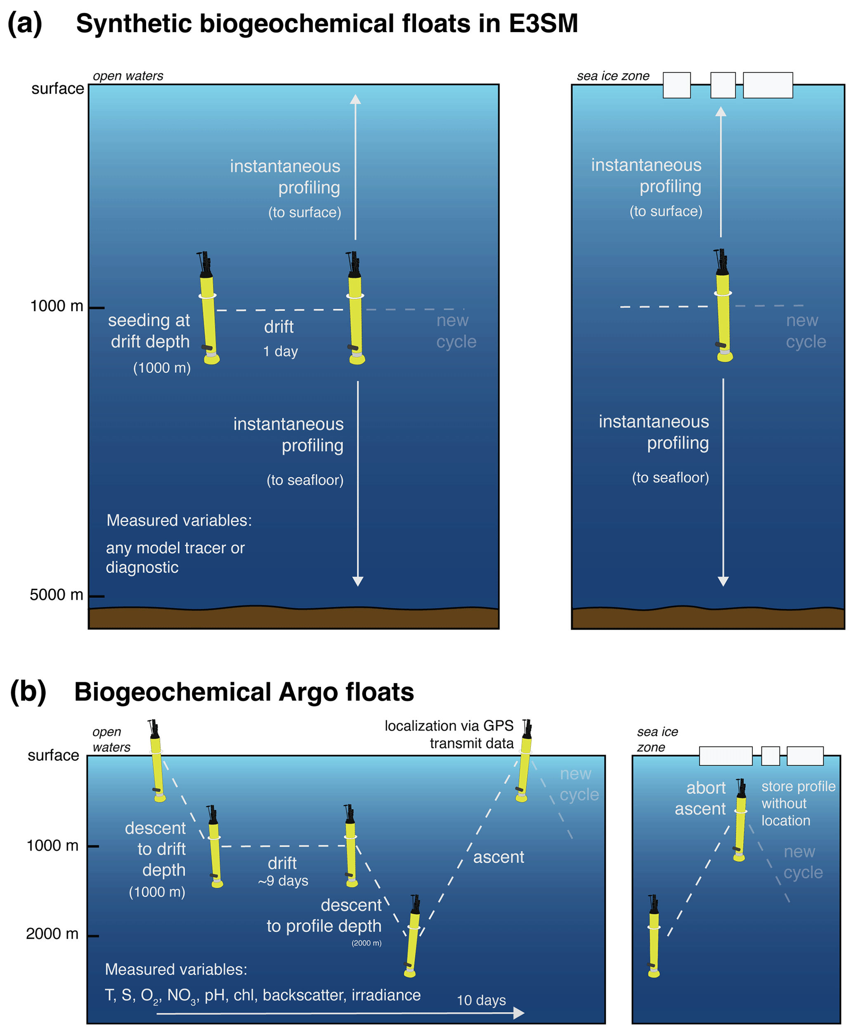
Synthetic Biogeochemical Argo Floats in E3SM
Objective
Determine whether Argo float sampling frequency and density captures the true spatiotemporal variability in ocean physical and biogeochemical properties.
Approach
Develop synthetic Argo float capabilities in E3SMv2 and conduct a test simulation with this new tool.
Impact
This paper introduces and describes a novel tool for the DOE E3SM: synthetic floats that drift with simulated ocean currents and sample their physical and biogeochemical properties online at model runtime.
This new tool has the potential to transform our approach to oceanographic observational system simulation.
Schematic illustration of synthetic and real-world biogeochemical Argo floats.
C. Nissen, N. Lovenduski, M. Maltrud, A. Gray, Y. Takano, K. Falcinelli, J. Sauvé, and K. Smith. ”LIGHT-bgcArgo-1.0: using synthetic float capabilities in E3SMv2 to assess spatiotemporal variability in ocean physics and biogeochemistry.” Geoscientific Model Development, 17, 6415-6435, (2024). [DOI: 10.5194/gmd-17-6415-2024]

