Slide 1
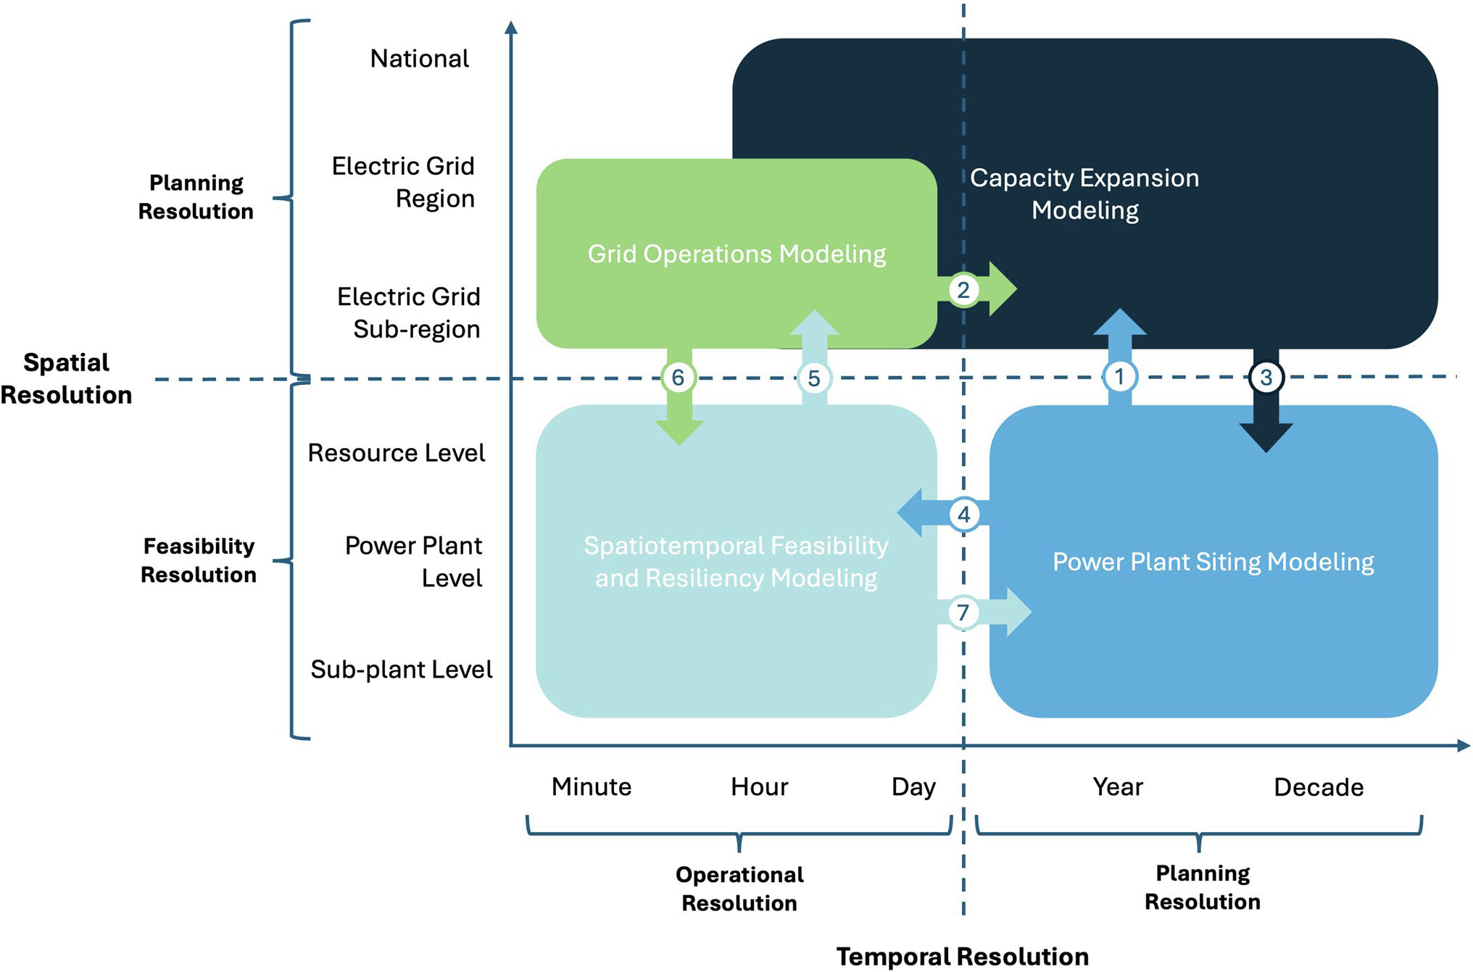
Innovative Frameworks for Future-Proof Energy Capacity Planning
Objective
Highlight the development of an integrated and iterative multiscale modeling framework to enhance the robustness of electricity system capacity expansion planning in the face of evolving uncertainties in climate, technology, and policy.
Approach
Develop an integrated workflow that links capacity expansion models with high-resolution production cost and transmission planning models to simulate grid operations under varying conditions.
Implement a spatial disaggregation approach using high-resolution geospatial data to determine feasible siting locations and create realistic resource supply curves for capacity expansion models.
Establish an iterative feedback loop where high-resolution downstream models conduct stress tests on capacity expansion plans, providing critical signals for model updates to enhance system resiliency.
Impact
Integration of high-resolution temporal and spatial models with capacity expansion frameworks enhances the realism and robustness of energy planning under climate and policy uncertainties.
Iterative workflows that incorporate feedback loops between capacity expansion, grid operations, and power plant siting models improve system resilience by dynamically adjusting to extreme weather and demand fluctuations.
High spatial resolution modeling identifies feasible power plant locations, reducing overestimation of resource availability and providing insights into local land-use impacts and socioeconomic tradeoffs.
The above figure illustrates how different models coordinate to improve energy capacity expansion planning. It shows the flow of information between models that simulate power plant siting, grid operations, and capacity expansion, ensuring that plans are both feasible and resilient.
Mongird, Kendall, and Jennie Rice. 2024. An Integrated and Iterative Multiscale Modeling Framework for Robust Capacity Expansion Planning. Current Sustainable/Renewable Energy Reports. https://doi.org/10.1007/s40518-024-00238-5.
First draft generated using PAIGE, the Pnnl AI assistant for GEnerating publication highlights

