Slide 1
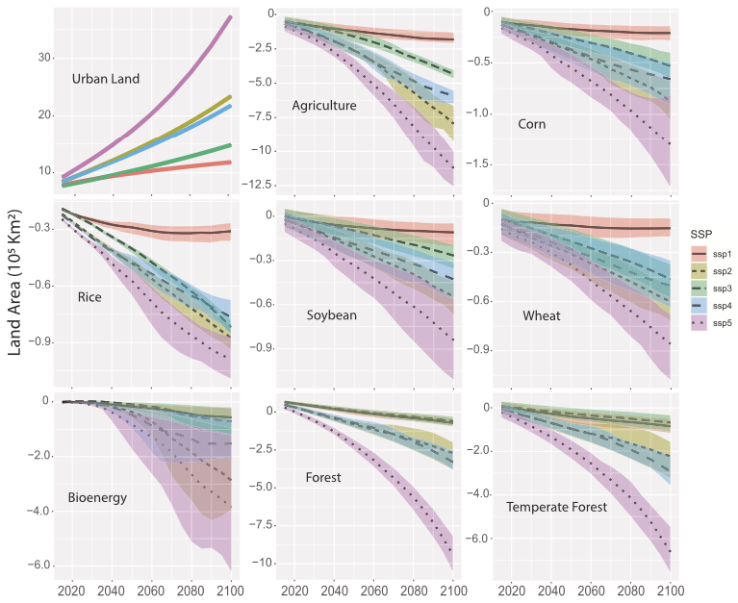
Urban Expansion Poses a Dual Threat to Food Security and Climate Stability
Global land area adjustments from dynamic urbanization
Objective
Investigate the consequences of dynamic urban land expansion on the land system, crop production, and net primary production (NPP) to understand potential negative impacts on food security and carbon sequestration.
Approach
Integrate high-resolution urban land projections from the SELECT model with dynamic non-urban land projections from the GCAM-Demeter model to quantify the displacement of agricultural and forest lands due to urban expansion.
Calculate the changes in crop yields and net primary production (NPP) by applying region- and basin-specific average crop yield rates and a range of NPP estimates to the areas of land lost to urbanization, providing a conservative estimate of the impact on land-carbon equilibrium.
Impact
Urban land expansion by 2100 could displace up to 1.4 million km² of agricultural lands, compromising significant quantities of staple crop production.
Projected urbanization may reduce global net primary production by 0.24 to 2.24 Gt C yr⁻¹, potentially increasing land CO₂ emissions by 1.19 to 6.59 Gt CO₂ yr⁻¹.
The study highlights that not accounting for dynamic urban land changes in models can lead to underestimations of urbanization's impact on land-carbon equilibria.
This figure highlights the significant impact of urban growth on key land types, such as agricultural and forested areas, vital for food production and carbon sequestration. The results are shown for the five Shared Socioeconomic Pathways (SSP1-5) and the ranges in values for each SSP represent different scenarios based on a range of Global Circulation Models, Representative Concentration Pathways, and the land harmonization procedure.
McManamay, R.A., C.R. Vernon, M. Chen, I. Thompson, Z. Khan, & K.B. Narayan. 2024. "Dynamic urban land extensification is projected to lead to imbalances in the global land-carbon equilibrium." Communications Earth & Environment 5.1 (2024): 70. DOI: 10.1038/s43247-024-01231-y

