Slide 1
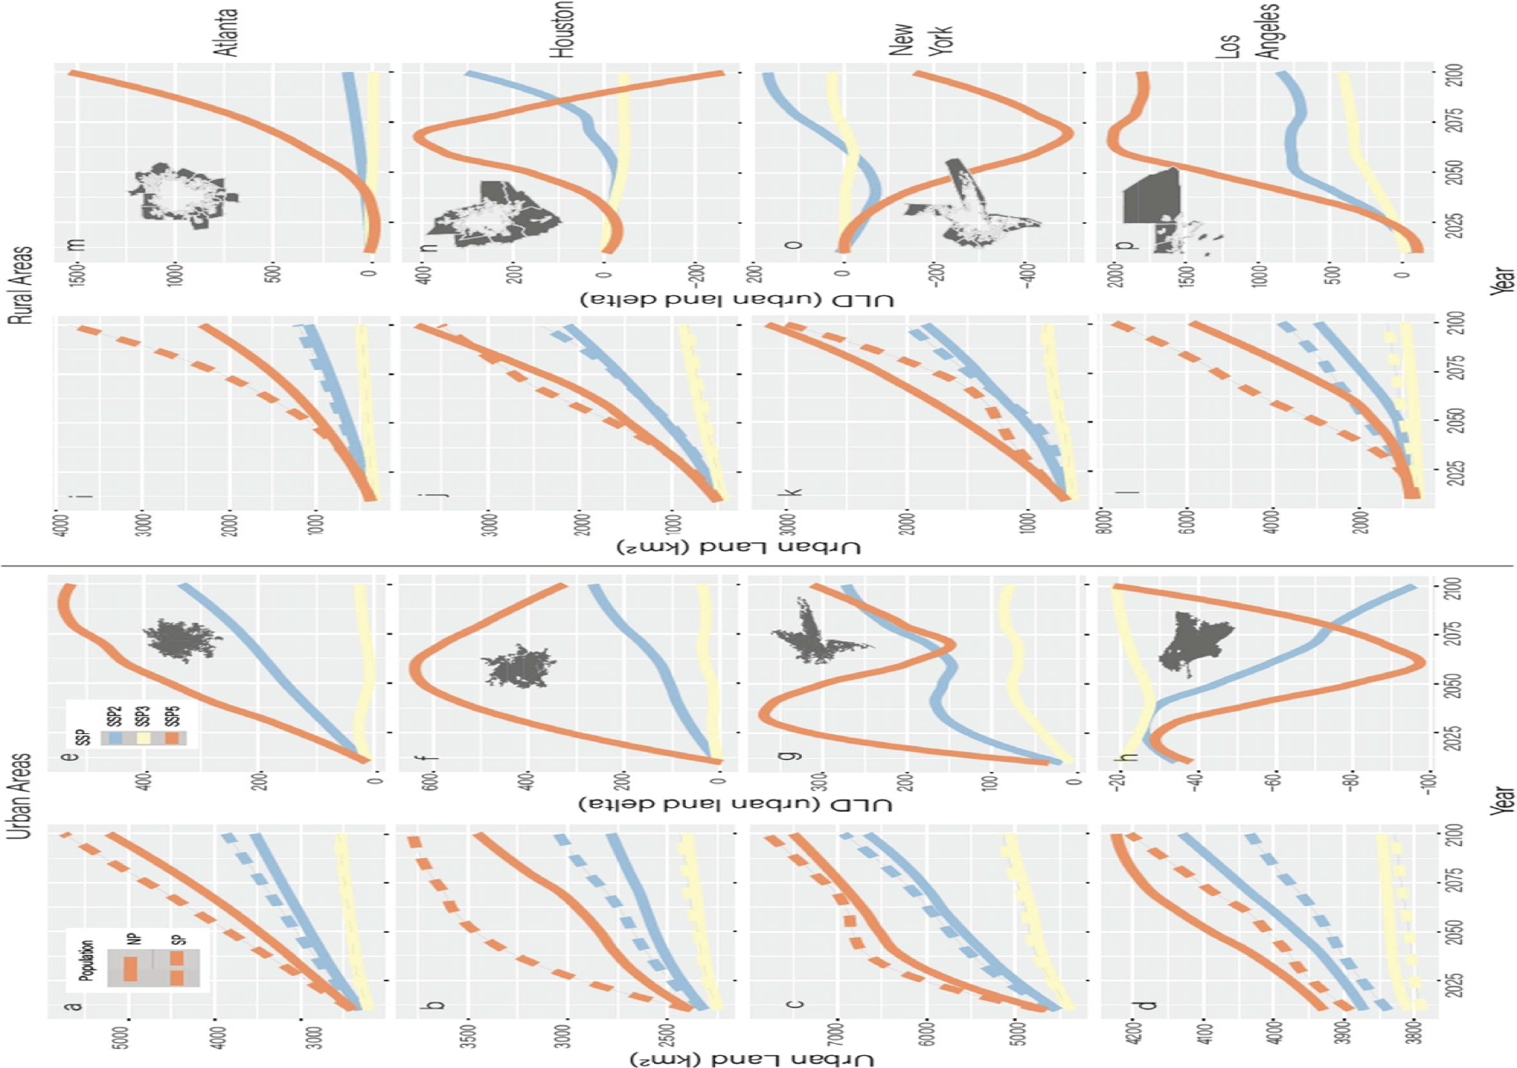
Exploring Urban Land Changes with Varying Population Projections
Objective
Examine how alternative population projections within the Shared Socioeconomic Pathways influence divergent urban land trajectories, highlighting the complex interactions between population dynamics and urbanization processes.
Approach
Implement a high-resolution spatial modeling experiment using the SELECT model to simulate urban land dynamics under different population projections, incorporating spatially explicit demographic patterns and migration data.
Integrate state-specific and national-level population projections into the SELECT model to assess their impact on urban land trajectories, ensuring the model accounts for local variations in urbanization processes.
Utilize a clustering analysis to identify temporal patterns in urban land changes, allowing for the examination of spatial heterogeneity and the influence of population inputs on urban intensification and extensification.
Impact
This figure shows how urban land area and the difference in urban land area (urban land delta, ULD) between state-specific and national population projections change from 2010 to 2100 for various cities (a)–(h) and their surrounding rural areas (i)–(p) under different future socioeconomic scenarios. The largest differences in ULD are seen in SSP5, followed by SSP2. Cities like Atlanta, Houston, and New York show increasing ULD values in urban areas, while rural areas around these cities vary widely. Los Angeles stands out, with decreasing ULD in urban areas and increasing ULD in rural areas.
Alternative population projections under the same SSPs lead to significant differences in urban land outcomes, with some areas experiencing up to 14-fold increases or 100% decreases in urban land area.
Urban land expansion is more pronounced in rural areas under state-specific population projections, suggesting a trend towards more extreme urban sprawl than previously anticipated.
Urbanization patterns are not linearly related to population changes, highlighting the complex interplay between demographic inputs and urban land development processes.
McManamay, Ryan A., Alen Raad, Chris R. Vernon, Travis Thurber, Jing Gao, Stephen Powers, and Brian O’Neill. 2024. Divergent Urban Land Trajectories under Alternative Population Projections within the Shared Socioeconomic Pathways. Environmental Research Letters 19 (4): 044025. https://doi.org/10.1088/1748-9326/ad2eec.
First draft generated using PAIGE, the Pnnl AI assistant for GEnerating publication highlights

