Slide 1
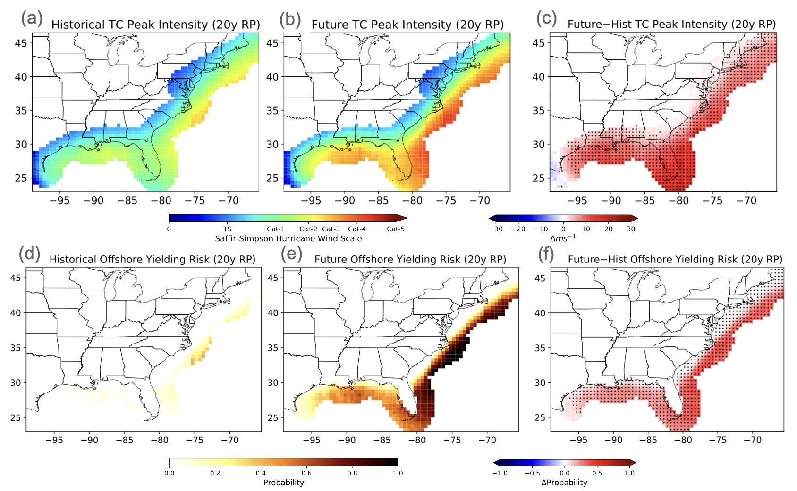
Tropical Cyclones Pose Growing Risk to Offshore Wind Energy
Objective
Assess the evolving risk to U.S. offshore wind turbines from Atlantic tropical cyclones (TCs) in future climate to inform future wind farm development and enhance turbine resilience.
Approach
Integrate the Risk Analysis Framework for Tropical Cyclones (RAFT) with climate model simulations to generate large ensembles of synthetic TCs consistent with historical and future climate scenarios.
Utilize turbine fragility curves to simulate the structural response of fixed-bottom 5 megawatt offshore wind turbines to TC-induced wind and wave loadings, focusing on the U.S. Atlantic and Gulf Coasts.
Conduct subregional analyses and state-level assessments to evaluate spatial variability in TC behavior and impacts, ensuring a comprehensive risk assessment framework for offshore wind turbine resilience in a non-stationary climate.
Impact
This figure shows the likelihood of offshore wind turbine towers beginning to yield due to TCs. It compares historical and future peak TC winds and turbine damage probabilities corresponding to a 20-yr return period event, highlighting increased damage risks in a changing climate with strong agreement among CMIP6 models. Regions with at least 8/9 CMIP6 model agreement on the sign of change are denoted with black markers in panels (c) and (f).
Projected future climate increases the frequency and intensity of TCs impacting U.S. offshore wind energy areas. Historical 20-year storms are expected to occur every 12.7 years and escalate to Category 2 or 3, while 50-year storms reach Category 4, significantly elevating risk to offshore wind turbines.
The probability of turbine yielding and buckling due to TCs is projected to increase by approximately 37% and 13%, respectively, with regional increases reaching up to 51%.
Lipari, Serena, Karthik Balaguru, Julian Rice, Sha Feng, Wenwei Xu, Larry Berg, and David Judi. 2023. Amplified Threat of Tropical Cyclones to U.S. Offshore Wind Energy in a Changing Climate. Nature Communications Earth & Environment. https://doi.org/10.1038/s43247-024-01887-6
First draft generated using PAIGE, the Pnnl AI assistant for GEnerating publication highlights

