Slide 1
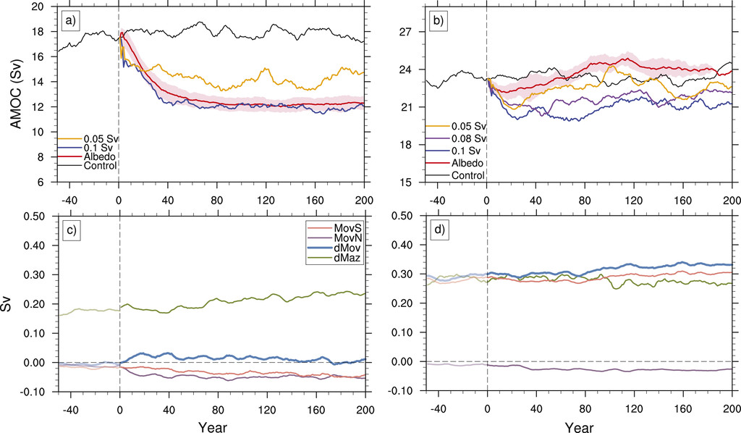
AMOC Stability and Diverging Response to Arctic Sea Ice Decline in Two Climate Models
Li, H., Fedorov, A., & Liu, W. (2021):
Journal of Climate, 34(13), 5443-5460. 10.1175/JCLI-D-20-0572.1
AMOC strength (Sv) in the (a) low-res and (b) high-res simulations as a function of time. Black curves show the respective control, and red curves show AMOC responses to sea ice decline. Also shown is the ensemble mean time series of the AMOC stability indicator (steel blue) in the (c) low-res and (d) high-res sea ice perturbed simulations.
OBJECTIVE
To understand the diverging responses of the Atlantic meridional overturning circulation (AMOC) to Arctic sea ice decline in two configurations of the CESM with different horizontal resolution.
APPROACH
We performed a suite of model experiments where we impose radiative imbalance at the ice surface, replicating a loss of sea ice cover comparable to that observed during 1979–2014, and we compare the AMOC response between the two models.
IMPACT
Variations in the AMOC are critical for global and regional climate.
The decreasing Arctic sea ice can contribute to the AMOC slowdown by inducing warm and fresh surface anomalies that could spread into the subpolar region on multidecadal time scales. This study shows the AMOC response to transient buoyancy forcing induced by Arctic sea ice decline in two CESM models and investigate how the different behaviors can be related to the AMOC stability properties. Our results demonstrate that the AMOC stability indicator is indeed useful for evaluating AMOC sensitivity to perturbations. We emphasize that, despite the differences in the long-term adjustment, both models simulate a multidecadal AMOC weakening caused by Arctic sea ice decline, relevant to climate change.

