Slide 1
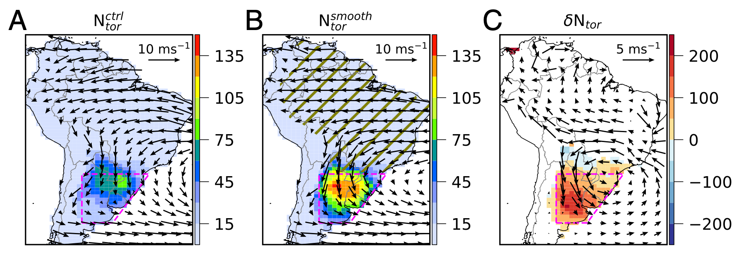
Upstream surface roughness and terrain are a strong driver of contrast in tornado potential North and South America
Funing Li, Daniel R. Chavas, Brian Medeiros, Kevin A. Reed, Kristen L. Rasmussen
Proceedings of the National Academy of Sciences (2024) doi: 10.1073/pnas.2315425121
OBJECTIVE
Provide an explanation for why North America has more tornado activity than South America.
APPROACH
Severe storm environments are diagnosed using thresholds for CAPE and wind shear from the surface to 6km. Tornado potential is assess based on severe storm environments that also have storm relative helicity beyond a threshold. Numerical experiments show that artificially smoothing the upstream region of South America induces much more tornado activity. Idealized experiments show this is a general result.
Color shading in A & B shows potential for tornado activity (hours/year) with 850 hPa wind vectors overlaid. A shows the control simulation, B shows an experiment with a smooth, flat ocean-like upstream land surface (hatched area). C shows the relative change.
IMPACT
This study questions the canonical view of North America’s “tornado alley” by comparing with South America. The results show that the surface conditions upstream from severe storm hotspots affect the lower atmosphere and the potential for tornadic activity.

