Slide 1
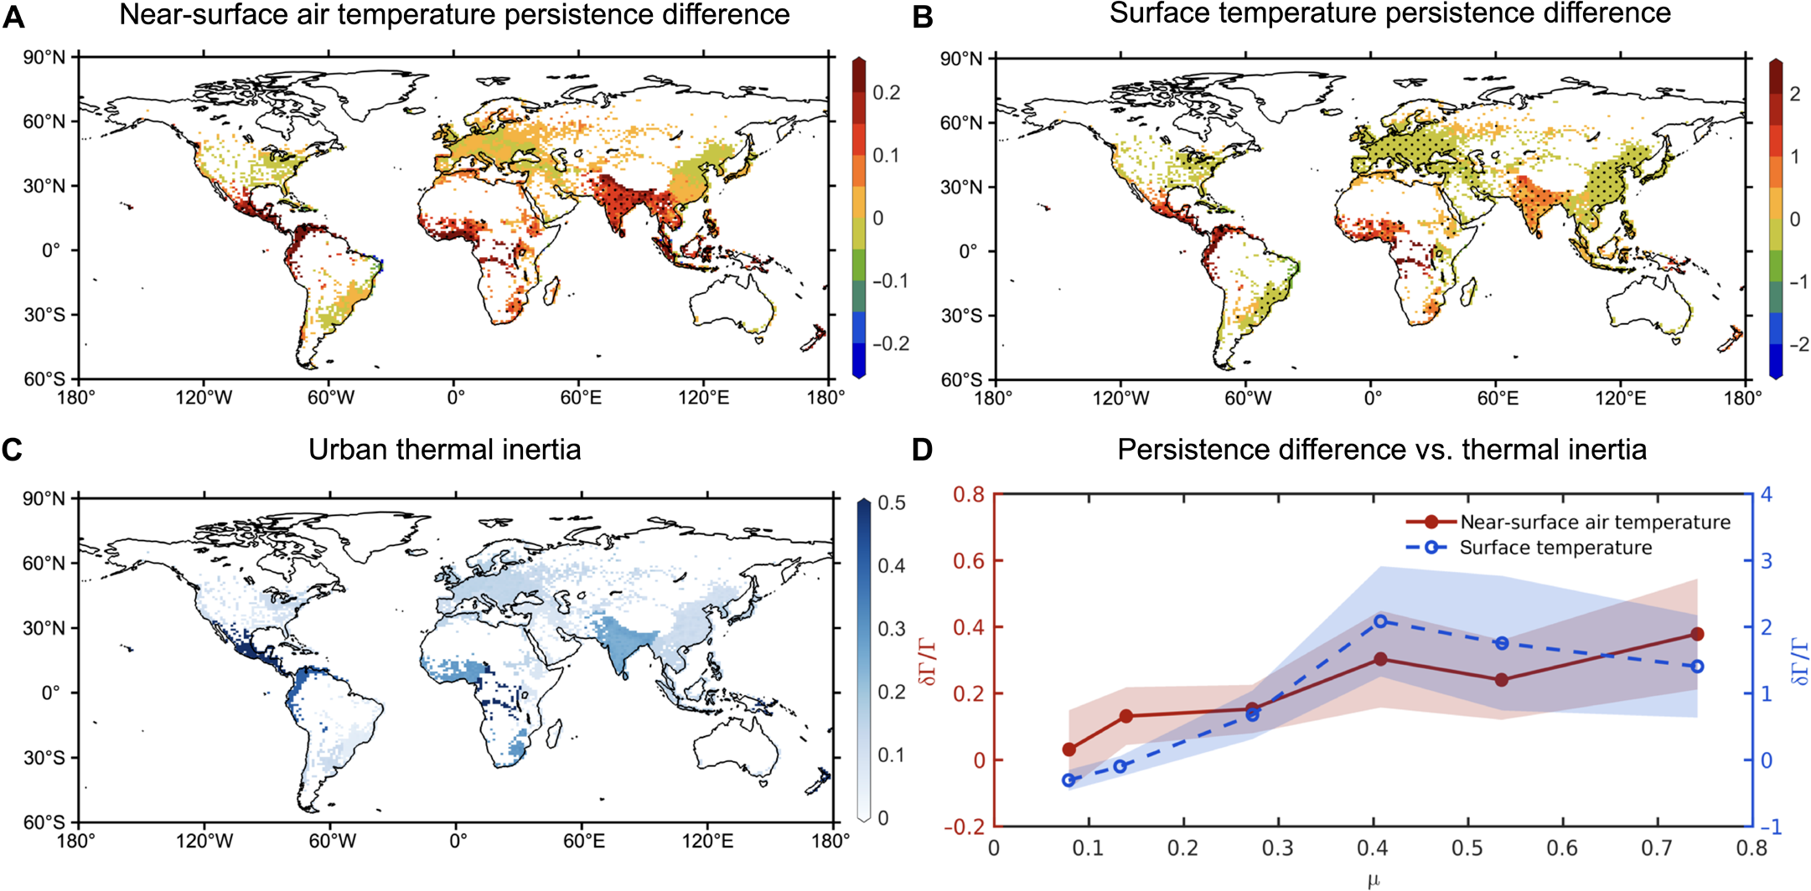
Persistent Urban Heat: Understanding Temperature Anomalies in Cities
Objective
Demonstrate that urban surface and near-surface air temperatures exhibit significantly greater persistence than rural temperatures, particularly in cities with impervious materials of high thermal inertia, and highlight mitigation strategies to address the enhanced urban temperature persistence.
Approach
Integrate numerical simulations from the Community Earth System Model (CESM) with a surface energy balance theory to analyze urban and rural temperature persistence.
Apply autocorrelation and spectral analyses to quantify temperature persistence, removing long-term trends and mean annual cycles to focus on daily temperature anomalies.
Compute the fractional difference in persistence timescales between urban and rural areas using the thermal inertia of urban impervious materials, supported by a surface energy balance model to elucidate the role of thermal inertia in temperature persistence.
This figure shows the differences between urban and rural areas in how long air and surface temperatures stay the same (persistence) and how this is related to urban heat storage (thermal inertia). (A) Shows how air temperature persistence differs between urban and rural areas, with stippled areas highlighting where the difference is statistically significant. (B) Shows the same for surface temperatures. (C) Displays the thermal inertia of urban materials, which is how much heat they can store. (D) Illustrates the relationship between temperature persistence and thermal inertia, where larger dots represent the average difference in persistence, and shading shows the variation.
Impact
Urban surface and near-surface air temperatures exhibit significantly higher persistence than rural temperatures, particularly in cities with impervious materials of high thermal inertia.
Urban temperature persistence is most pronounced in tropical regions like Central America, West Africa, and India, where impervious materials such as corrugated metal roofs are prevalent.
Increasing urban thermal inertia, due to ongoing urbanization, is projected to further enhance temperature persistence, with tropical cities being especially vulnerable to prolonged heat events.
Li, Dan, Linying Wang, Weilin Liao, Ting Sun, Gabriel Katul, Elie Bou-Zeid, and Björn Maronga. 2024. Persistent Urban Heat. *Science Advances* 10 (April): eadj7398. https://doi.org/10.1126/sciadv.adj7398.
First draft generated using PAIGE, the Pnnl AI assistant for GEnerating publication highlights

