Slide 1
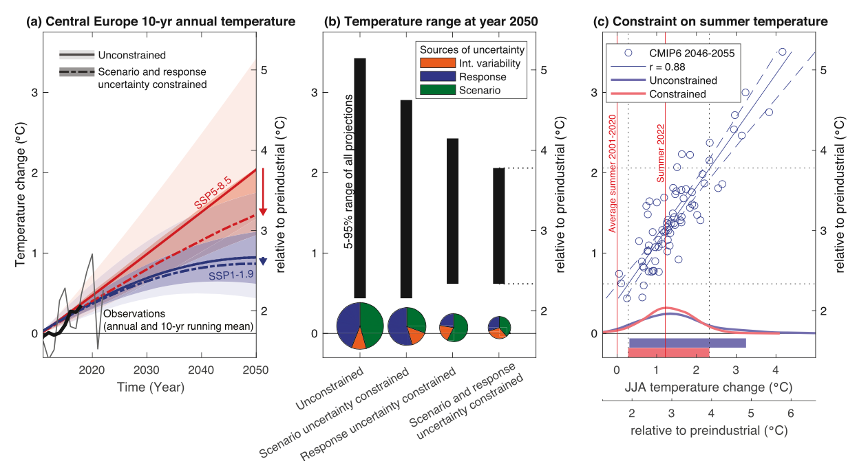
New Potential to Reduce Uncertainty in Regional Climate Projections by Combining Physical and Socio-Economic Constraints
Lehner, F., E. Hawkins, R. Sutton, A. G. Pendergrass, F. C. Moore:
AGU Advances (2023) doi: 10.1029/2023AV000887
OBJECTIVE
Regional climate projections still diverge strongly due to uncertainties in emissions scenarios and associated climate model responses. The goal is to reduce these uncertainties via a combined framework.
APPROACH
We combine recently published constraints on climate sensitivity and socio-economic trajectories in a probabilistic framework to reduce uncertainties in regional temperature projections.
IMPACT
The combined constraints reduce regional climate projection uncertainty significantly, more than either constraint individually. Reduced uncertainties can aid in adaptation planning. This framework can potentially be extended to other variables, though it requires a link of those variables to global temperatures.
Fig. 1 from Lehner et al. (2023), showing the step-wise reduction of uncertainty in regional temperature projections from combining constraints on global and regional climate sensitivity with constraints on socio-economic scenarios. The upshot is that uncertainties are reduced by up to 50% relative to the full uncertainty as assessed from unconstrained CMIP6.

