Slide 1
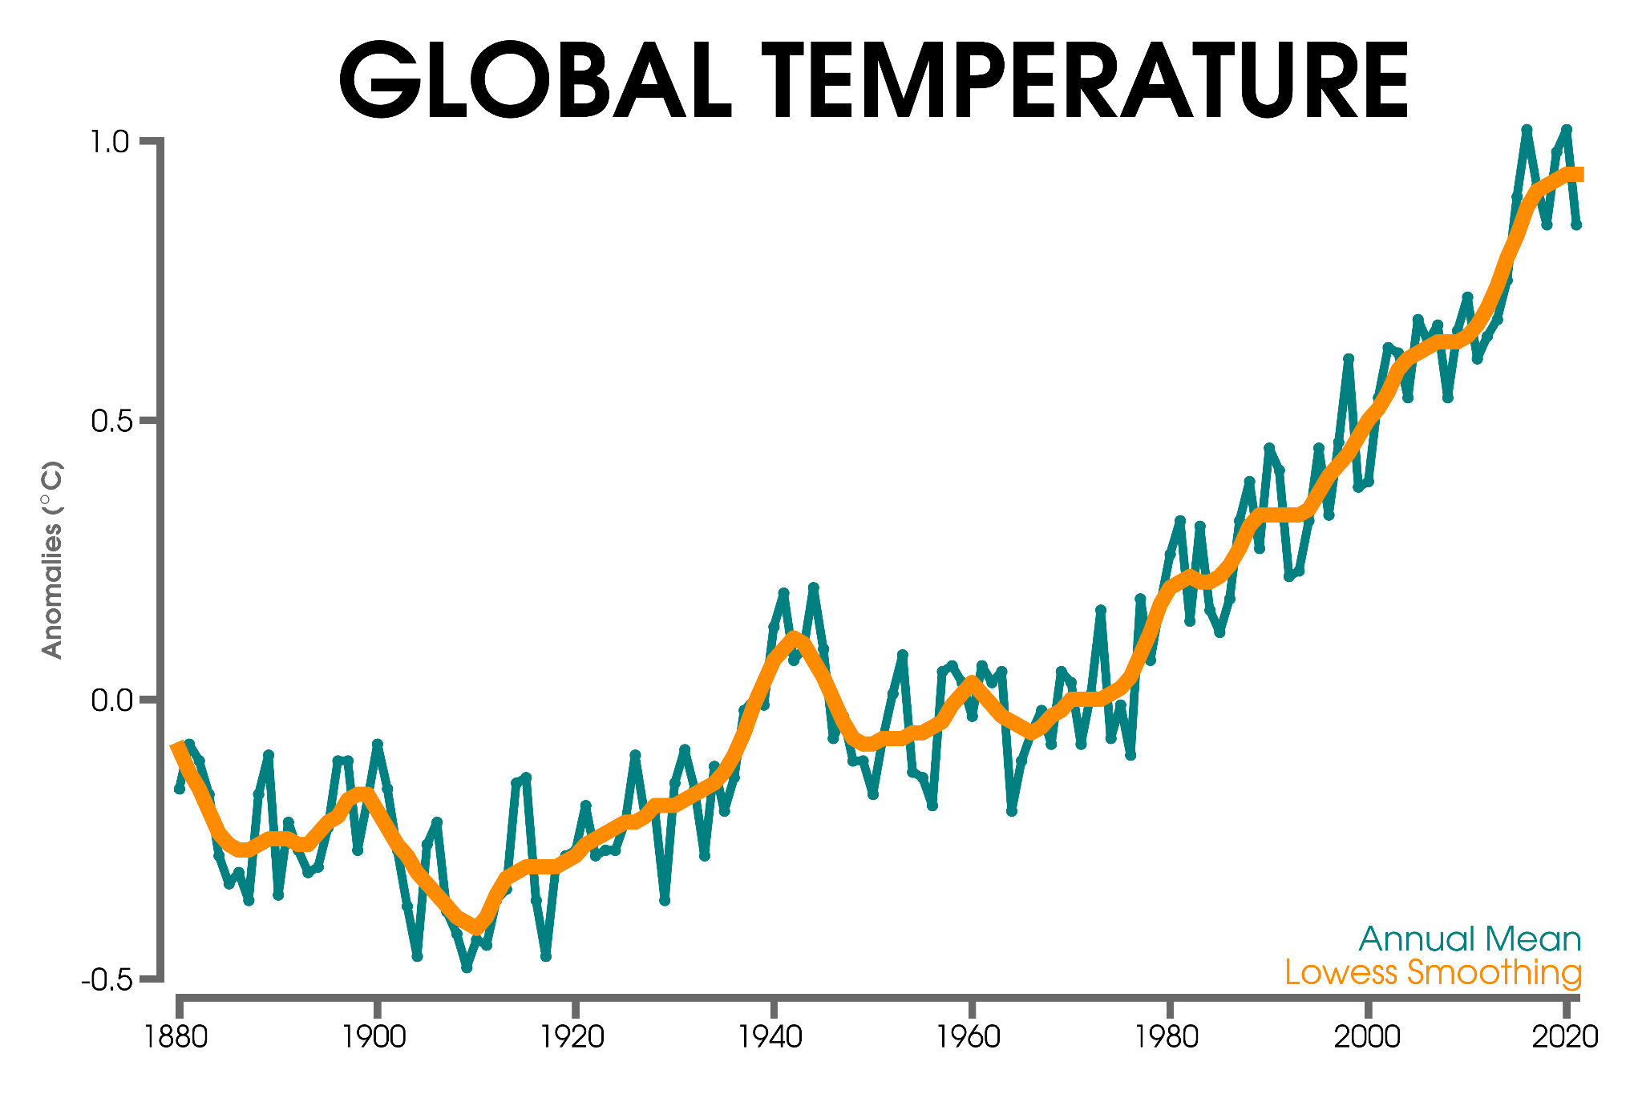
Predicting Slowdowns in Decadal Climate Warming Trends With Explainable Neural Networks
SCIENTIFIC ACHIEVEMENT
We demonstrated that an artificial neural network (ANN) trained with CESM2 Large Ensemble maps of ocean heat content can skillfully predict simulated onsets of decadal slowdowns in global-mean temperature, as well as the warming slowdown observed in the early 2000s. These events are often triggered by transitions in oceanic low-frequency variability - as identified via explainable AI [XAI] methods.
warming slowdown
SIGNIFICANCE AND IMPACT Although the ANN is trained only on climate model data from one climate model, we find that it also produces skillful predictions of the early 2000s warming slowdown in observational data. This work shows that temporary warming slowdowns may have some predictability from Pacific climate variability and highlights the promising future for using machine learning tools in a wide variety of decadal climate prediction problems.
XAI
Labe, Zachary M., and Elizabeth A. Barnes. 2022. “Predicting Slowdowns in Decadal Climate Warming Trends with Explainable Neural Networks.” Geophysical Research Letters 49 (9). https://doi.org/10.1029/2022gl098173.

