Slide 1
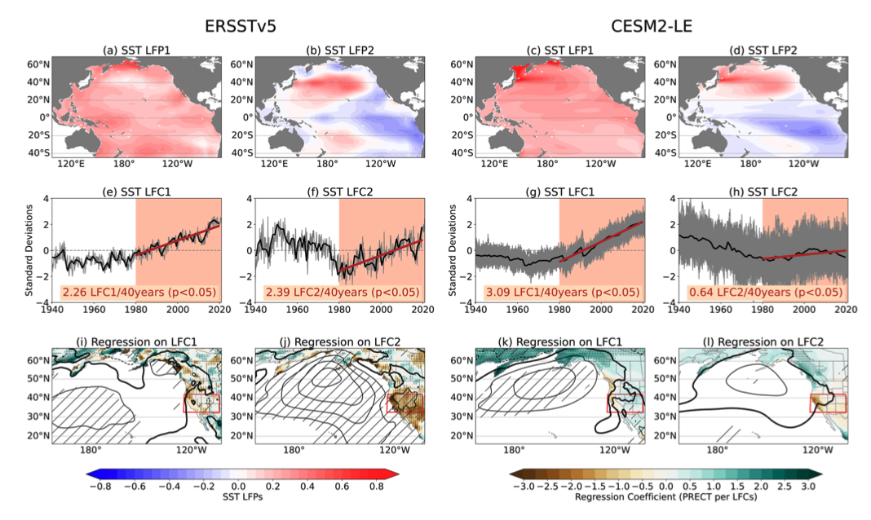
Anthropogenic Aerosols Contribute to the Recent Decline in
Precipitation Over the U.S. Southwest
Kuo, Y.-N., Kim, H., Lehner, F.:
Geophysical Research Letters (2023) doi: 10.1029/2023GL105389
OBJECTIVE
Regional precipitation trends are still poorly understood. Here, we attempt to better understand what caused the recent precipitation decline over the Southwestern U.S.
APPROACH
We use a Low Frequency Component Analysis and single forcing large ensemble simulations to build evidence for aerosols having contributed to the precipitation decline via their influence on Pacific SSTs.
IMPACT
If aerosols can meaningfully influence regional precipitation trends, then important questions like future drought trajectories need to contend with this often overlooked forcing. However, more work is needed to understand whether models are depicting the aerosol influence correctly.
Fig. 2 from Kuo et al. (2023), showing the similarity between observed and simulated modes of low-frequency SST variability in the Pacific and their imprint on circulation and precipitation. Subsequent figures illustrate the role of aerosols via single-forcing simulations.

