Slide 1
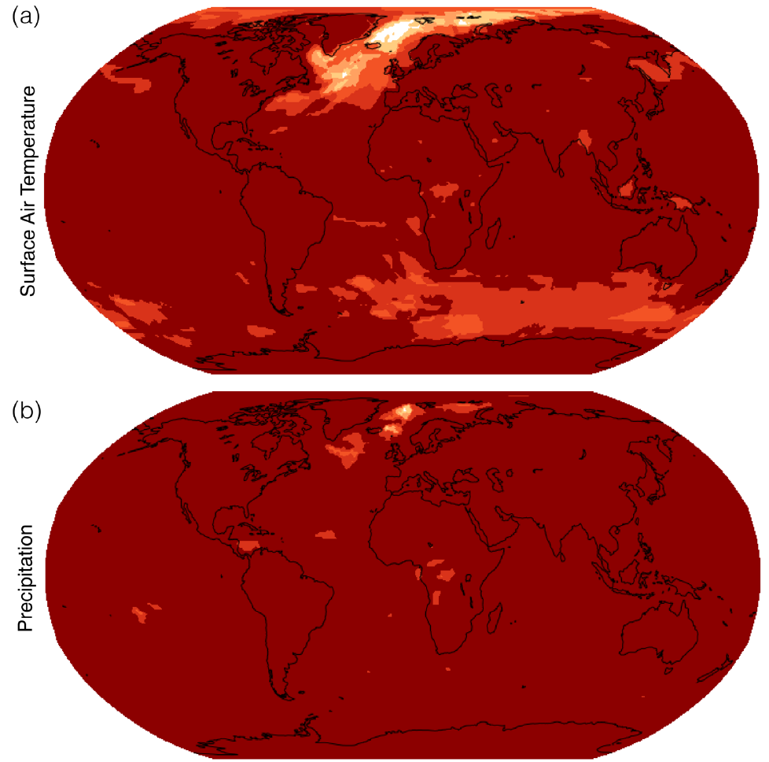
Updating available patterns of mean field behavior for CMIP6 models
Objective
Create and validate a library of average global-to-local relationships for each of the 38 Coupled Model Intercomparison Project Phase 6 (CMIP6)-participating models, updating available libraries of the Coupled Model Intercomparison Project Phase 5 (CMIP5) model results and extending to new output variables and time scales.
Approach
Use established linear pattern scaling methods to update existing libraries of CMIP5 mean field behaviors and extend to new variables and time scales.
Streamline this generation process by relying on cloud-hosted CMIP6 data, resulting in faster generation of these patterns with less labor and computing memory required.
Impact
Pangeo-Enabled Earth ESM Pattern Scaling (PEEPS) provides a data set of spatial patterns for temperature, precipitation, and relative humidity on annual and monthly timescales, for each of 38 models under 6 different scenarios (where data is available).
PEEPS patterns facilitate rapid spatial visualization of long-term average outcomes for future scenarios, such as is done in hectorUI, the graphical user interface for the HECTOR simple climate model.
Average global-to-local relationships like these spatial patterns may improve the understanding of differences among long term outcomes from CMIP6 models, so that multisectoral modelers can use these outcomes intentionally.
The approach can be used for more rapid calculation of these spatial patterns in future eras of model runs, providing earlier insight and plotting capabilities.
This figure illustrates the PEEPS dataset's success (dark red) in emulating climate patterns, This figure shows for each grid point the number of scenarios among the 6 total for which the value (percent of models within one standard deviation of baseline) is at least 90%.
Kravitz, B. and Snyder, A. (2023). Pangeo-Enabled ESM Pattern Scaling (PEEPS): A customizable dataset of emulated Earth System Model output. PLOS Clim, 2(12), e0000159. https://doi.org/10.1371/journal.pclm.0000159

