Slide 1
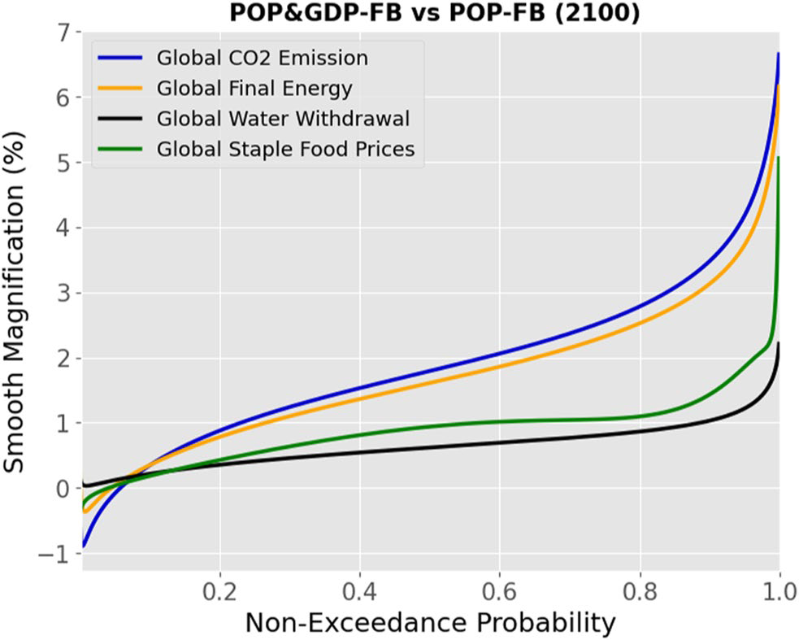
Compounding Uncertainties in Economic and Population Growth Increase Tail Risks for Outcomes Across Sectors
Objective
Investigates the effects of compounded uncertainties in economic and population growth on long-term multisectoral outcomes, using the Global Change Analysis Model (GCAM) to model impacts on energy consumption, water withdrawal, staple food prices, and CO2 emissions across different regions and scenarios.
Approach
Implement stochastic simulations to generate large ensembles of GDP and Population drivers to GCAM with different levels of feedback (FB) between the two, to evaluate the differential impacts across distributions of multisector outcomes.
Calculate magnification curves to isolate the impact of jointly considering GDP and Population uncertainty on each quantile of outcome distributions, mapping how uncertainty propagates through GCAM to alter outcome distributions.
Conduct principal component analysis on the magnification curves across regions and sectors to identify distinct patterns of uncertainty magnifications.
Impact
Uncertainties in GDP and population growth amplify tail risks in energy use, CO2 emissions, and food prices.
Alternative futures that GCAM can model can constrain uncertainties in some sectors (e.g., energy), but this comes with increased uncertainty in other sectors (e.g., food prices and water withdrawals) in addition to higher median values.
Results differ across regions, but Principal Component Analysis (PCA) reveals common types of outcomes regions and sectors may fall into, marking a first step toward classifying deeper regional patterns in GCAM.
This figure illustrates the disproportionate impact on extreme outcomes under a GCAM reference scenario, emphasizing the need for incorporating multiple uncertainties in future planning. Here we see magnification versus non-exceedance probability for global staple food prices, water withdrawals, final energy consumption, and CO2 emissions due to GDP uncertainty under the reference case in 2100.
Kanyako, F., Lamontagne, J., Snyder, A., Morris, J., Iyer, G., Dolan, F., et al. (2024). Compounding uncertainties in economic and population growth increase tail risks for relevant outcomes across sectors. Earth's Future, 12, e2023EF003930. https://doi.org/10.1029/2023EF003930

