Slide 1
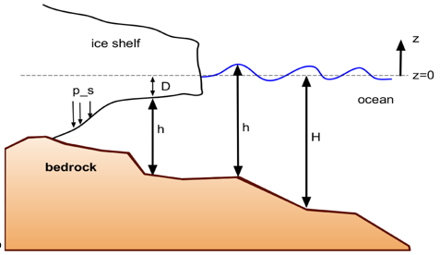
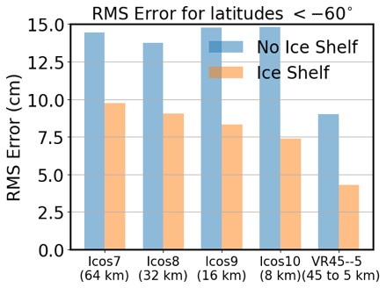
Adding Ice Shelves Improves the Accuracy of Global Tidal Models
Tidal Amplitude and Phase
Objective
Include Antarctic ice shelf cavities in global ocean simulations to improve tidal amplitude and phase results over the whole Earth.
Approach
Extend the ocean model domain into ice shelf cavities, including the pressure induced by overlying ice and the bedrock topography.
Compare global simulations with and without ice shelves, using resolutions from 64 to 5 km grid cells. Analyze results for the amplitude and phase of the five largest tidal constituents.
Impact
Errors compared to satellite observations were reduced by up to 50% near Antarctica and by 5 – 10% globally.
Tidal modeling is important for coastal inundation studies of future climates. Validation against observations and improved accuracy is a critical first step.
Global simulations of tides are much closer to observations when ice shelf cavities are included. Tidal amplitude (colors) and phase (lines) from MPAS-Ocean (top), with a diagram of an ice shelf cross section (bottom left) and the error in simulations compared to observations for different resolutions (bottom right).
Pal, N., et al. “Barotropic tides in MPAS-Ocean (E3SM V2): impact of ice shelf cavities.” Geoscientific Model Development, 16, 1297–1314 (2023). [DOI: 10.5194/gmd-16-1297-2023]
OSTI Identifier: 1960182

