Slide 1
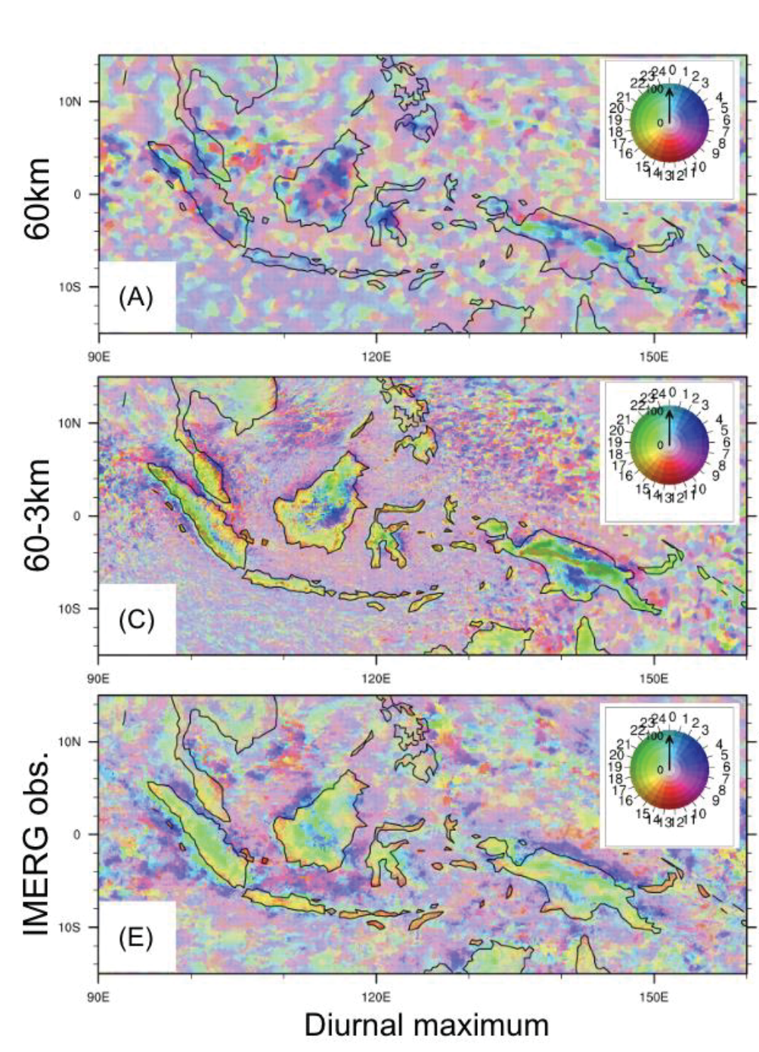
Examining tropical convection features at storm-resolving scales over the Maritime Continent region
Xingying Huang, Andrew Gettelman, Brian Medeiros, and William C. Skamarock
Journal of Geophysical Research - Atmospheres (2024) doi:10.1029/2024JD040976
OBJECTIVE
Describe emergent features of tropical convection in a simulation with regional refinement down to 3 km.
APPROACH
Seasonal simulations are conducted using CESM configured with CAM6 physics and the non-hydrostatic MPAS dynamical core. A uniform 60km mesh is the control, and a regionally refined mesh with 3 km grid spacing in the Maritime Continent provides storm-resolving capability. The mean state, diurnal cycle, and extremes of precipitation are investigated.
IMPACT
The increased resolution provides some clear improvements, including in the diurnal cycle of precipitation, formation and intensity of tropical cyclones, and a more realistic distribution of precipitation intensity.
Notable biases outside the refined region emerge and are at least partly attributable to sensitivity of the convection parameterization to time step. This highlights the need for scale-aware physics in regionally refined simulations.
Phase and amplitude of the daily maximum precipitation for (top) uniform 60km mesh, (middle) mesh refined to 3km, (bottom) satellite observations.

