Slide 1
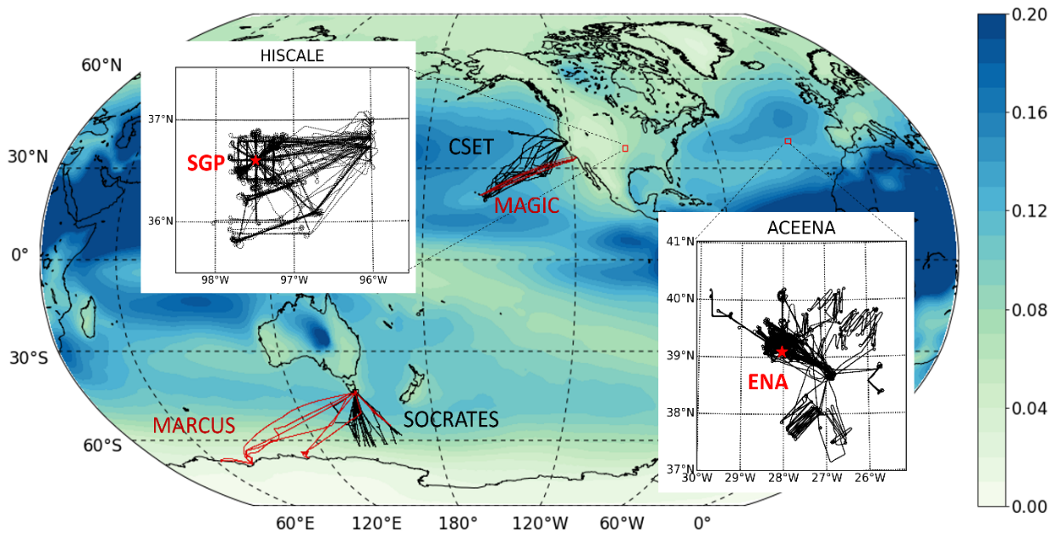
A Diagnostics Package to Evaluate Aerosols in an Earth System Model with Field Campaign Measurements
Objective
Facilitate the evaluation of aerosols, clouds, and aerosol-cloud interactions in Earth System models.
Identify sources of simulation errors, providing insights into model deficiencies that can help guide future model development.
Approach
Develop the Earth system model aerosol-cloud diagnostics (ESMAC Diags) package with a focus on aerosol evaluation using primarily in-situ aircraft, ship, and surface measurements.
Incorporate measurements from six field campaigns in four geographical regions: the Eastern North Atlantic (ENA), Central U.S. (CUS), Northeastern Pacific (NEP), and Southern Ocean (SO).
Impact
ESMAC Diags has been used to evaluate E3SM and guide the development of new parameterizations.
The flexible software design allows for further extension to include more measurements and diagnostics to better understand aerosols, clouds, and aerosol-cloud interactions.
Aircraft (black) and ship (red) tracks for the six field campaigns included in the current version of ESMAC Diags. The red stars in the enlarged map indicate two Atmospheric Radiation Measurement user facility fixed sites where ground-based measurements are available for model diagnostics: the Southern Great Plains and ENA. The map overlay is aerosol optical depth at 550nm averaged from 2014–2018 and simulated by the Energy Exascale Earth System Model.
Tang, S., Fast, J. D., Zhang, K., Hardin, J. C., Varble, A. C., Shilling, J. E., Mei, F., Zawadowicz, M. A., and Ma, P.-L. “Earth System Model Aerosol–Cloud Diagnostics (ESMAC Diags) package, version 1: assessing E3SM aerosol predictions using aircraft, ship, and surface measurements,” Geosci. Model Dev., 15, 4055–4076, (2022). [DOI: 10.5194/gmd-15-4055-2022]
Notes:
http://www.pnnl.gov/science/highlights/highlights.asp?division=749

