Slide 1
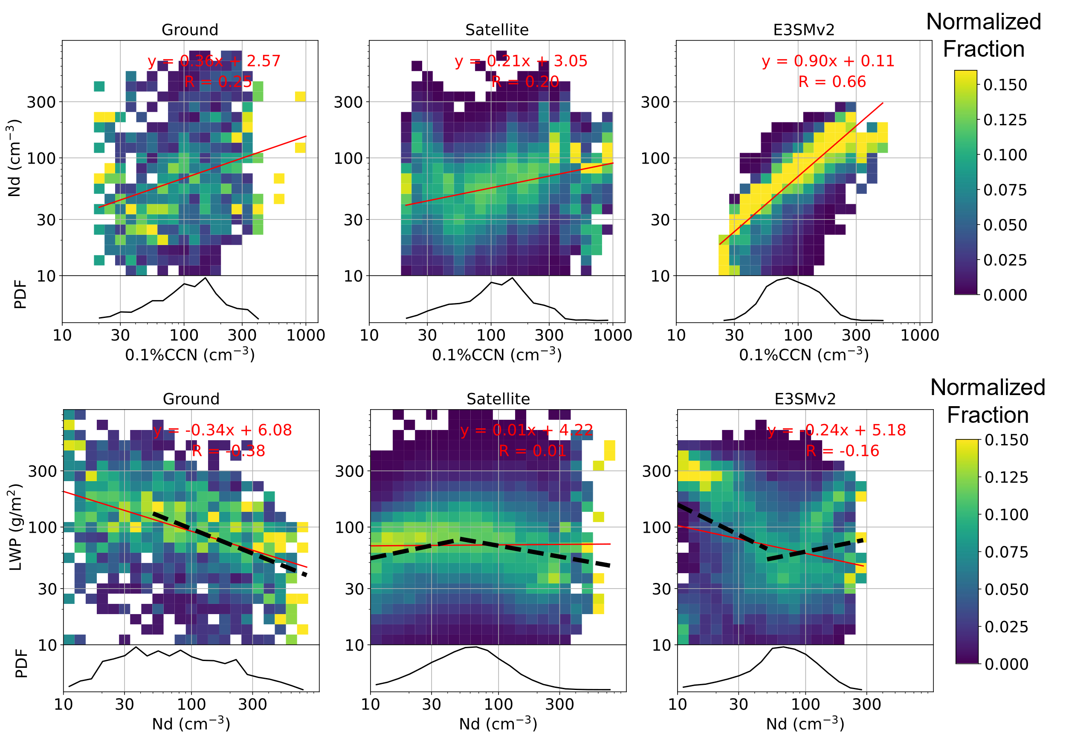
A Diagnostics Package to Evaluate Earth System Model Aerosol–Cloud Interactions with Field Campaign Measurements
Objective
Evaluate how well an Earth system model represents aerosols, clouds, and aerosol–cloud interactions, providing insights into model deficiencies that can help guide future model development.
Approach
Release the second version of the Earth system model aerosol–cloud diagnostics (ESMAC Diags v2) with extended focus on evaluation of aerosols, clouds, and aerosol–cloud interactions.
Add long-term ground and satellite measurements at two fixed-location sites from the Atmospheric Radiation Measurements (ARM) program for more robust model diagnostics.
Impact
ESMAC Diags v2 generates various types of single-variable and multi-variable diagnostics, including percentiles, histograms, joint histograms, and heatmaps, which allow users to examine correlations between variables that are relevant to the study of aerosol–cloud interactions. It is being applied to evaluate the performances of new physical components in E3SM.
Evaluation of Nd-CCN relationship at the ARM ENA site from 2016-2018 shows that E3SMv2 shows more tight and sensitive aerosol activation than satellite observations.
Tang, S., Varble, A. C., Fast, J. D., Zhang, K., Wu, P., Dong, X., Mei, F., Pekour, M., Hardin, J. C., and Ma, P. L.: “Earth System Model Aerosol–Cloud Diagnostics (ESMAC Diags) package, version 2: assessing aerosols, clouds, and aerosol–cloud interactions via field campaign and long-term observations” Geosci. Model Dev., 16, 6355-6376, (2023). [DOI: 10.5194/gmd-16-6355-2023]
Notes:
http://www.pnnl.gov/science/highlights/highlights.asp?division=749

