Slide 1
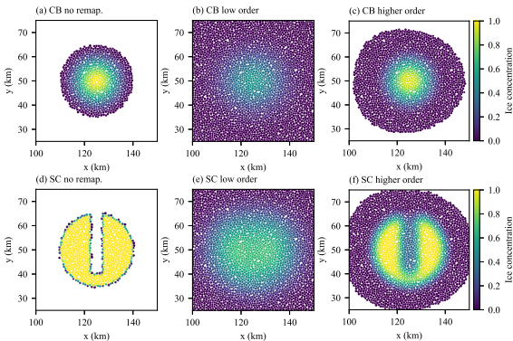
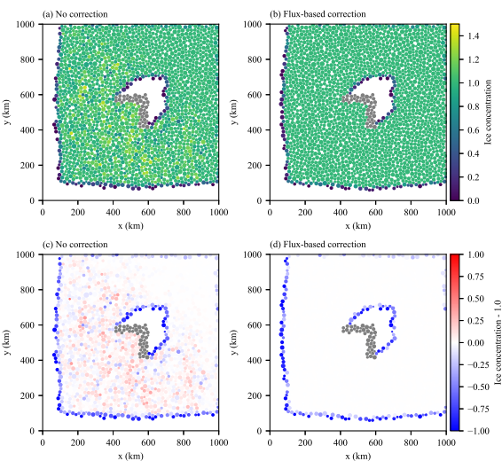
Geometric based remapping in DEMSI
Elements become deformed from sea-ice ridging in discrete element based sea ice model – Limits simulation length
We have developed a technique to remap the deformed particle distribution back to an undeformed one
Each element has a tessellated polygon associated with it that allows disk elements to represent fully covered pack
Uses a geometric remapping based on the incremental remapping sea ice transport code
Higher order representation of tracers within polygon dramatically reduces numerical diffusion (upper right)
Correction scheme based on parallel optimization library permonQP prevents sea ice concentration exceeding realistic bounds (lower right)
Conserves relevant tracer quantities
Implemented in Discrete Element Model for Sea Ice (DEMSI)
Sea ice concentration after 200 remappings of two distributions. Higher order method reduces numerical diffusion
Sea ice concentration after flow around island then remapping. Correction method prevents excessive sea ice concentration

