Slide 1
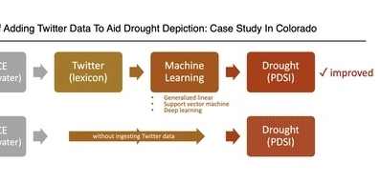
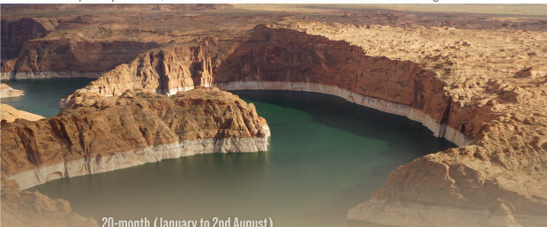
Twitter can help detect drought early, says study
Study based on testing in Colorado shows that Twitter data can be used in conjunction with meteorological records to improve the detection and prediction of drought progression using machine learning techniques, providing valuable insights for early drought warning and response in the American West.
https://www.mdpi.com/2073-4441/14/18/2773

