Slide 1
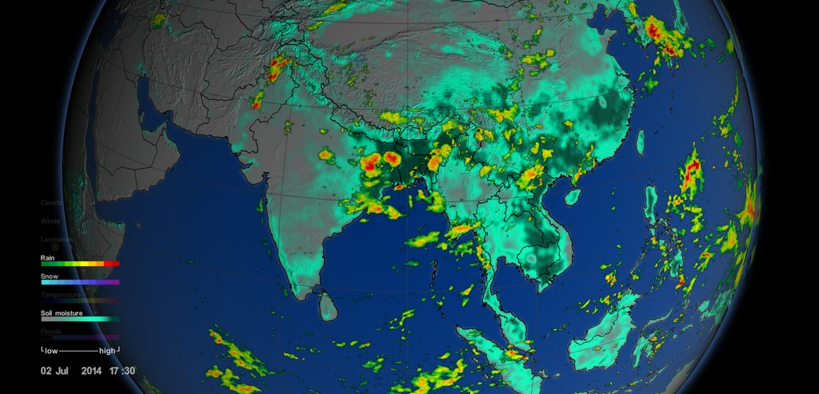
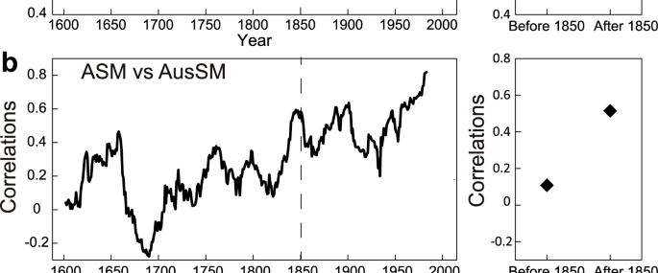
New Study Links Global Warming to Increased Monsoon Extremes
Study That Employed Simulation and Tree-Ring Proxies Finds Enhanced Relationship Between El Niño-Southern Oscillation and Monsoon Precipitation in Asia and Australia Due to Global Warming, Highlighting Urgent Need for Climate Action and Continued Research
https://www.nature.com/articles/s41612-023-00341-2

