Slide 1
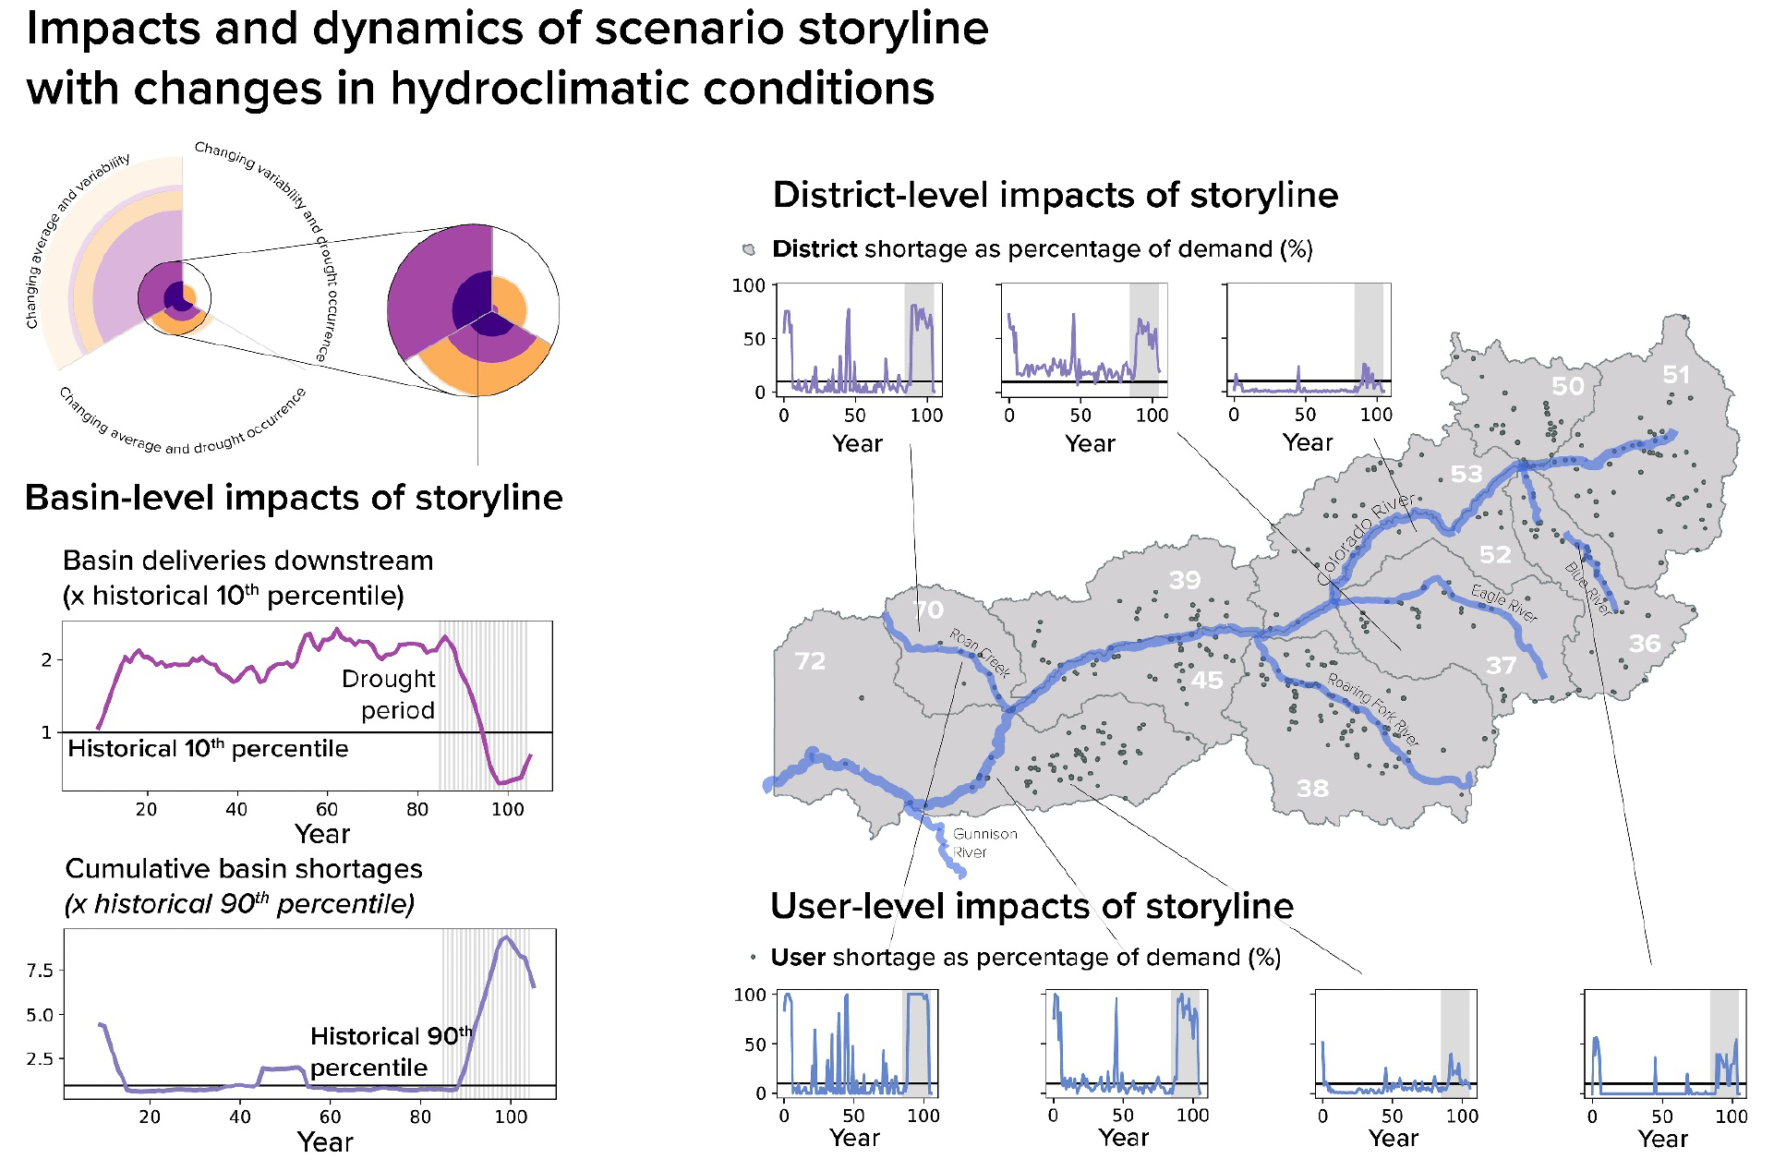
Discovering Drought Scenarios for Future Water Planning in Colorado
Objective
Introduce a framework for discovering scenario storylines that describe diverse stakeholder impacts and consequential dynamics in multi-actor human-natural systems facing change.
Approach
Develop the FRamework for Narrative Storylines and Impact Classification (FRNSIC) to organize and investigate consequential scenarios using hierarchical classification of diverse outcomes across actors, sectors, and scales.
Implement exploratory modeling to generate large ensembles of possible futures, allowing for the identification of scenario storylines that capture key system dynamics and consequential outcomes.
Utilize set theory and hierarchical classification to integrate dynamic properties and robustness performance measures, facilitating the discovery of impactful scenario storylines that inform future adaptation planning.
Impact
FRNSIC classifies dynamic properties and impacts of states of the world (SOWs), highlighting significant effects on water shortages and deliveries.
The study reveals that many SOWs have dynamic properties beyond historical ranges, primarily due to projected climate changes and internal variability, resulting in more frequent and severe droughts.
FRNSIC's exploration of alternative impact thresholds offers flexibility in scenario selection, enabling stakeholders to focus on different plausible futures and impacts, thus enhancing decision-making in complex human-natural systems.
This figure illustrates how a possible drought could impact different parts of a river basin. On the left, it shows the effects on the entire basin. The top right panels (with purple lines) break down the impacts on specific water districts, and the bottom right (with blue lines) shows how individual water users are affected. The highlighted water districts are number 70 (Roan Creek Basin), 37 (Eagle River Basin), and 52 (Piney/Cottonwood Creeks).
Hadjimichael, Antonia, Patrick M. Reed, Julianne D. Quinn, Chris R. Vernon, and Travis Thurber. 2024. Scenario Storyline Discovery for Planning in Multi-Actor Human-Natural Systems Confronting Change. Earth's Future 12: e2023EF004252. https://doi.org/10.1029/2023EF004252.
First draft generated using PAIGE, the Pnnl AI assistant for GEnerating publication highlights.

