Slide 1
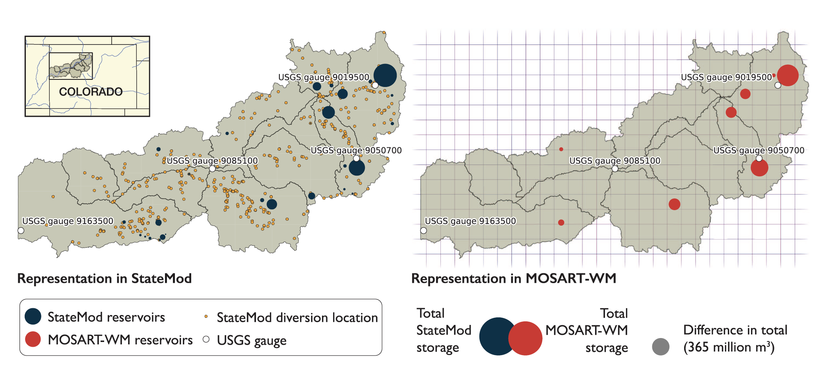
Comparing Water Scarcity Insights from Large-Scale and Basin-Scale Models
Objective
Assesses the consistency of water scarcity insights between large-scale hydrologic models and node-based water system models in the Upper Colorado River Basin, highlighting the limitations and potential improvements for evaluating water scarcity and adaptation strategies.
Approach
Compare a large-scale hydrologic model (MOSART-WM) and a node-based water system model (StateMod) in the Upper Colorado River Basin using various levels of aggregation, state variables, and water shortage metrics.
Analyze the spatial consistency of water shortages across different water districts and assess the limitations of large-scale models in capturing water scarcity variability within the basin.
Impact
The study reveals that MOSART-WM can capture the aggregate effect of water operations in a basin but underestimates subbasin-scale variability in user vulnerabilities.
StateMod simulates a larger variance of scarcity across water users due to its detailed accounting of local water allocation infrastructure and institutional processes.
The research highlights the limitations of large-scale studies in evaluating water scarcity and actionable adaptation strategies, emphasizing the need for integrating basin-scale water systems model information for better water allocation and shortage assessments.
This figure illustrates the representation of the Upper Colorado River Basin by two water management models, StateMod and MOSART-WM. It highlights the differences in reservoir representation, reservoir storage, river gauges, and spatial resolution between the two models. The figure helps to understand why these models provide different results and insights regarding water scarcity vulnerabilities and potential adaptation strategies in the basin.
Hadjimichael, A., J. Yoon, P. Reed, N. Voisin, W. Xu. 2023. “Exploring the Consistency of Water Scarcity Inferences between Large-Scale Hydrologic and Node-Based Water System Model Representations of the Upper Colorado River Basin,” J. Water Resour. Plann. Manage., 149(2): 04022081. DOI: 10.1061/JWRMD5.WRENG-5522

