Slide 1
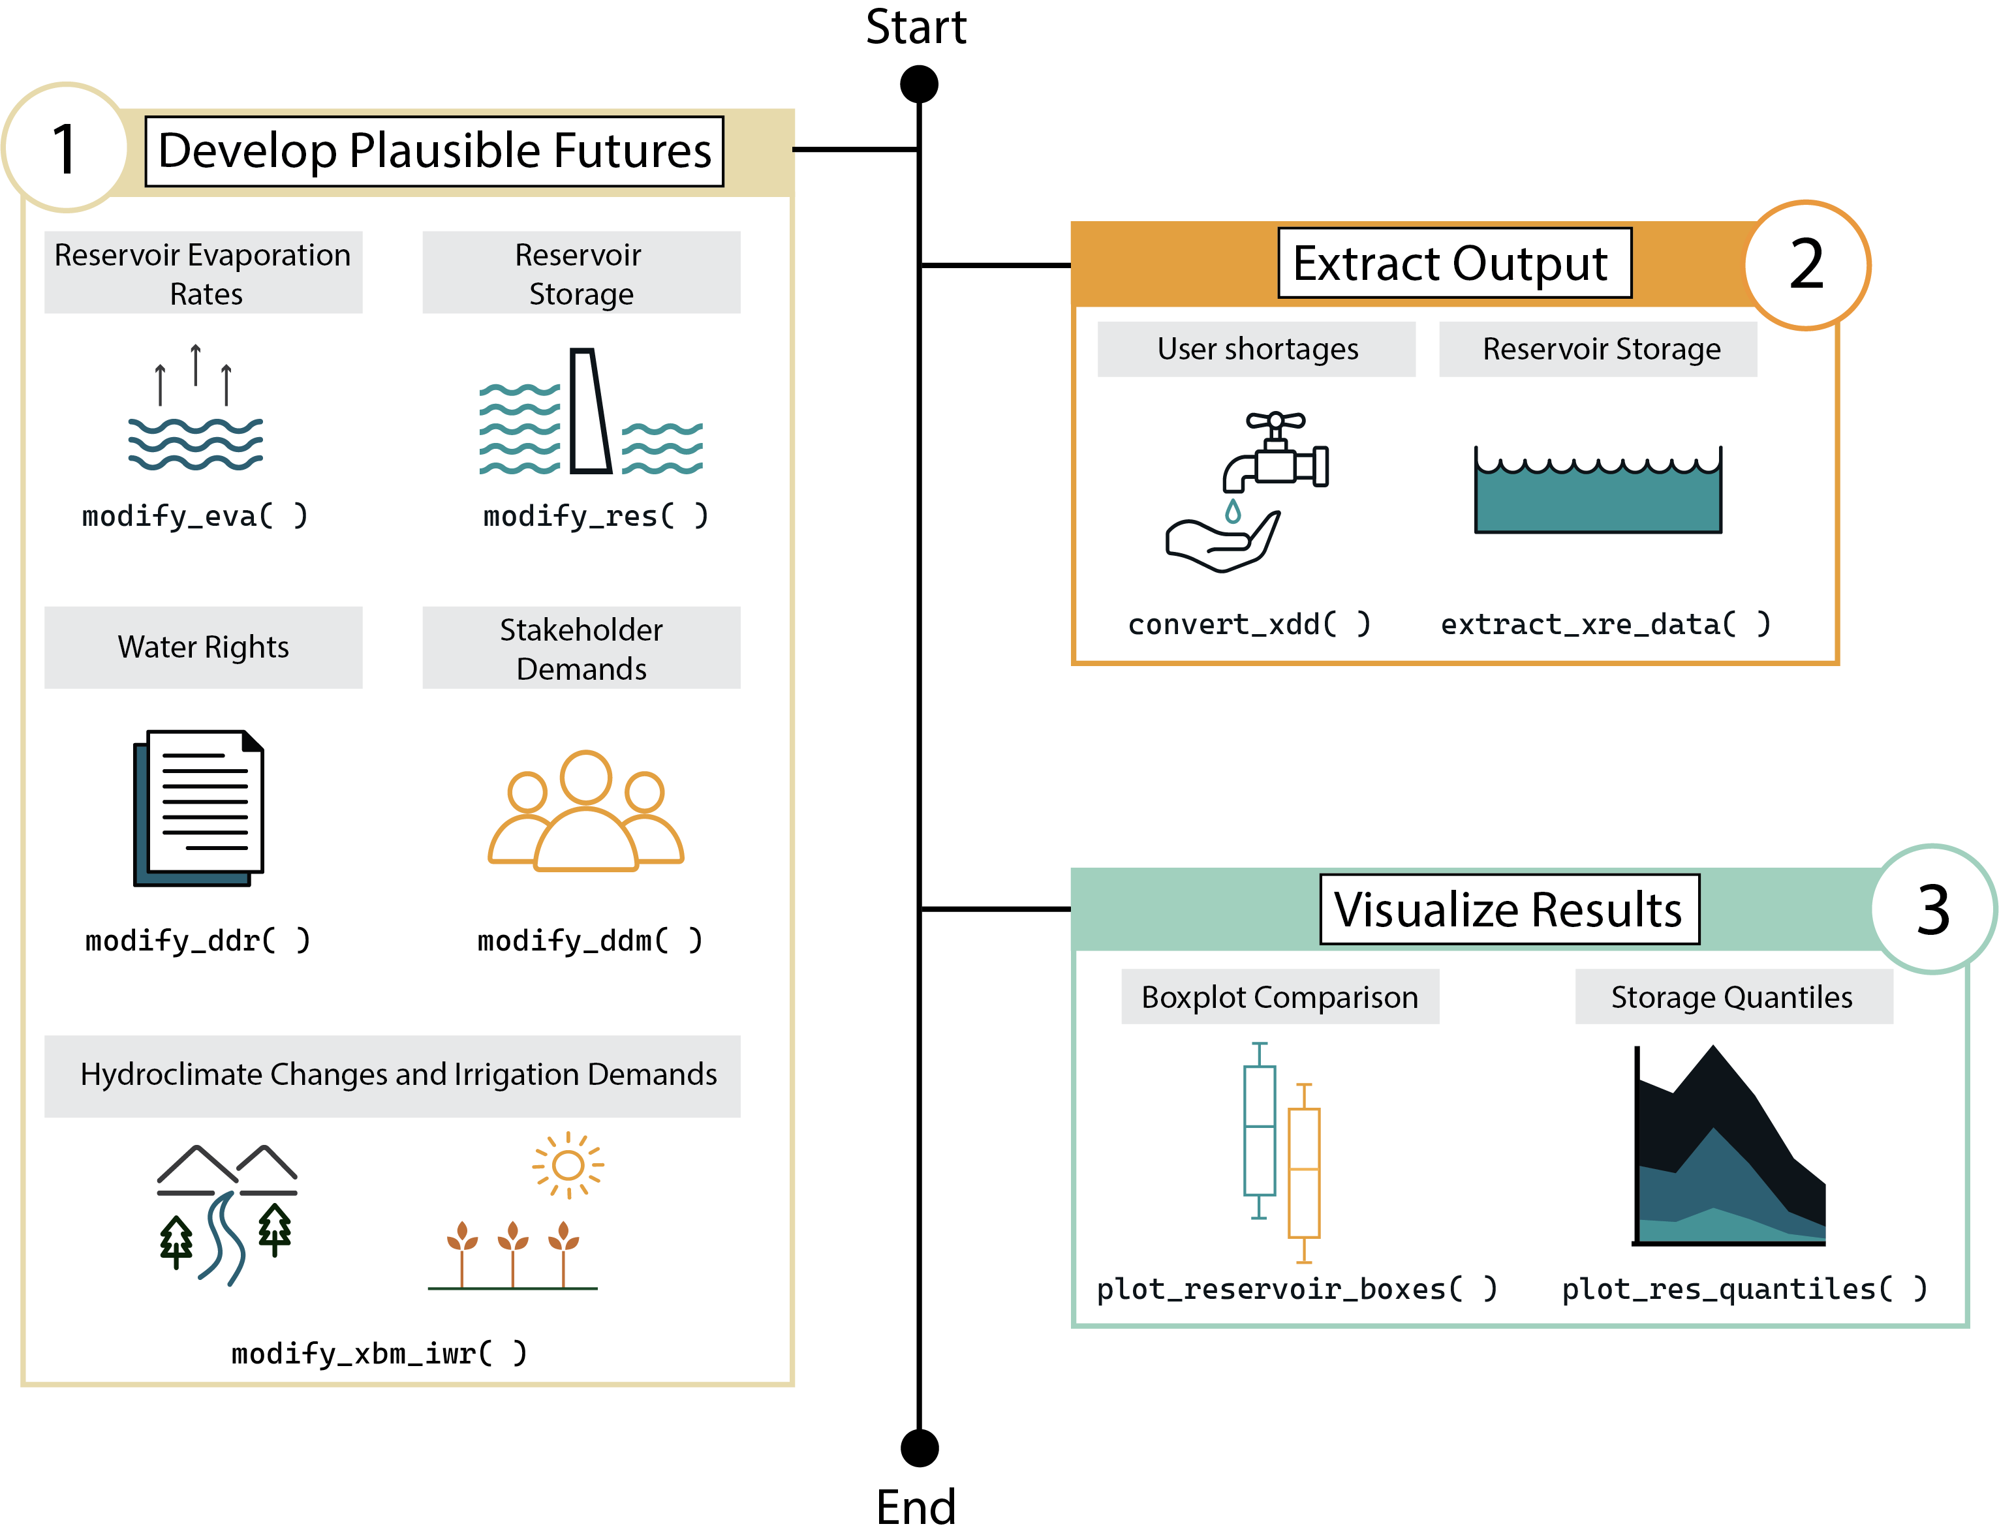
Python Framework Simplifies Drought Vulnerability Modeling in Colorado
Objective
Facilitate accessible exploratory modeling to identify drought vulnerabilities in Colorado's West Slope basins through the development of the Python-based framework used to interact with StateMod.
Approach
Develop the statemodify Python package to enable users to manipulate StateMod input files, allowing for the creation of alternative scenarios related to demand, hydrology, infrastructure, and institutional changes in Colorado's West Slope basins.
Implement methods within statemodify to compress and extract model outputs into easily readable formats, facilitating analysis and visualization through interactive Jupyter notebooks.
Integrate statemodify with containerized environments and cloud platforms to provide broader access to exploratory modeling capabilities, enabling users to conduct analyses without requiring high-performance computing resources.
Impact
statemodify enables users to interact with the StateMod water allocation model using Python, simplifying exploratory modeling for drought vulnerability analysis.
The framework allows for the manipulation of input files to create diverse scenarios, enhancing the ability to assess impacts on water shortages, streamflow, and reservoir levels systematically.
By integrating with Jupyter notebooks and cloud platforms, statemodify broadens access to exploratory modeling, facilitating participation from users lacking high-performance computing resources.
This figure illustrates the step-by-step process of using the statemodify framework, highlighting how users can manipulate water modeling scenarios in Colorado's West Slope basins to explore drought vulnerabilities.
Gupta, Rohini S., Chris R. Vernon, Travis Thurber, David F. Gold, Zachary M. Hirsch, Antonia Hadjimichael, and Patrick M. Reed. 2024. statemodify: A Python Framework to Facilitate Accessible Exploratory Modeling for Discovering Drought Vulnerabilities. Journal of Open Source Software 9 (96): 6325. https://doi.org/10.21105/joss.06325.
First draft generated using PAIGE, the Pnnl AI assistant for GEnerating publication highlights

