Slide 1
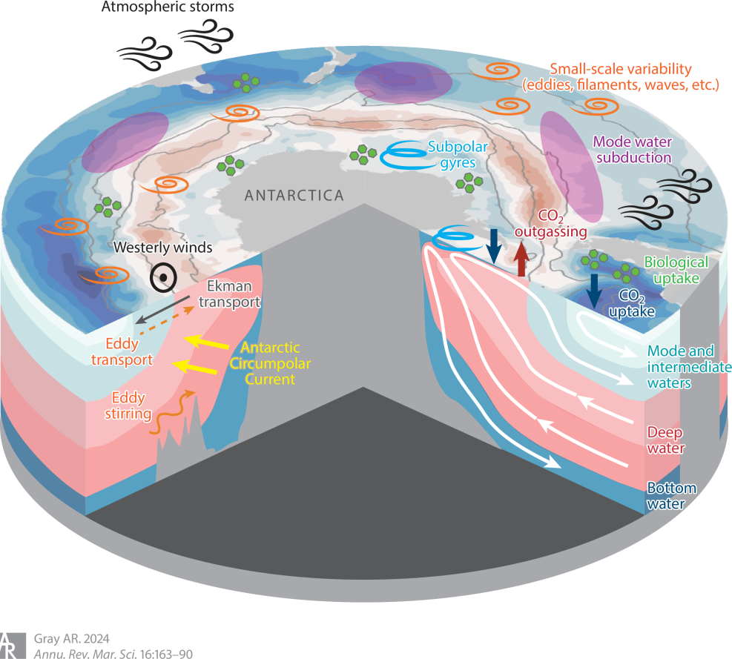
The 4-D Carbon Cycle of the Southern Ocean
Objective
Provide a review of recent literature, highlighting advances in the understanding of Southern Ocean carbon transport and storage.
Approach
Summarize recent literature about Southern Ocean carbon transport, with a particular focus on studies using new biogeochemical-Argo observations.
Impact
Demonstrates that we need to move beyond the zonal mean picture and instead embrace a four-dimensional understanding of the carbon cycle in the Southern Ocean.
Schematic of the primary processes impacting the flow of carbon through the Southern Ocean.
A. Gray. ”The four-dimensional carbon cycle of the Southern Ocean.” Annual Review of Marine Science, 16, 163-190, (2024). [DOI: 10.1146/annurev-marine-041923-104057]

