Slide 1
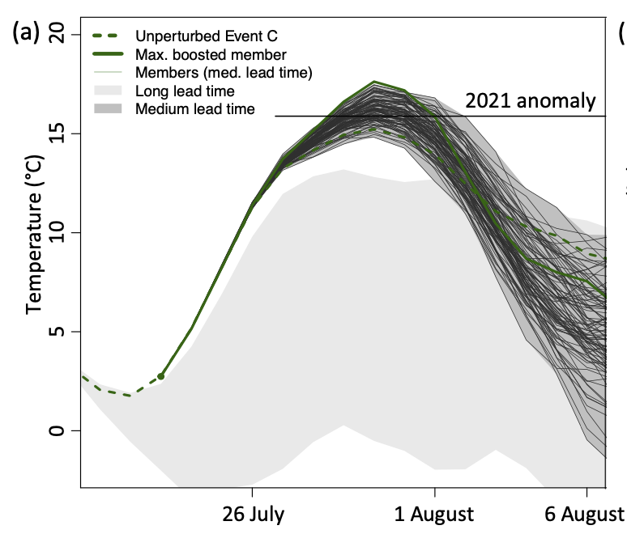
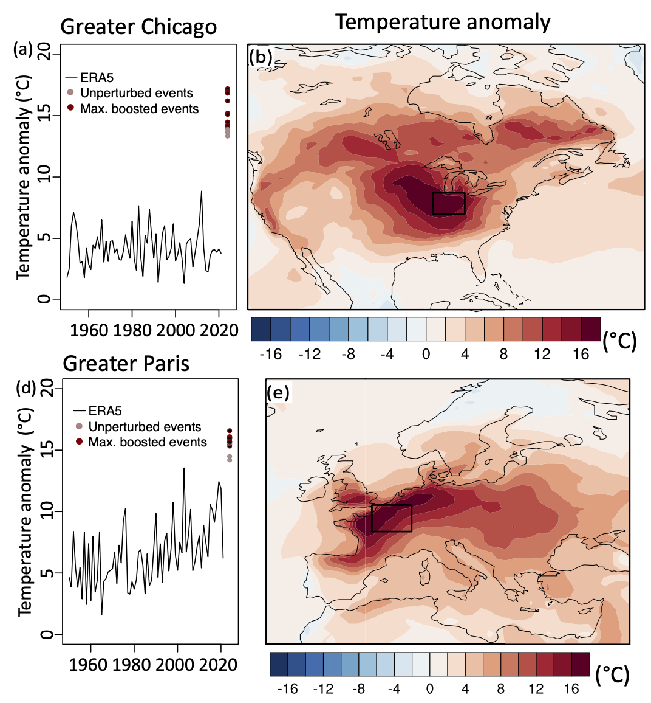
Storylines for unprecedented heatwaves based on ensemble boosting
Fischer, E. M., U. Beyerle, L. Bloin-Wibe, C. Gessner, V. Humphrey, F. Lehner, A. G. Pendergrass, S. Sippel, J. Zeder, R. Knutti:
Nature Communications (2023) doi: 10.1038/s41467-023-40112-4
OBJECTIVE
Recent record-shattering heatwaves such as in the Pacific NW raise the question ‘are climate models able to simulate such events?’ and ‘how much hotter can these events get?’. Using a new modeling technique with CESM1, we attempt to answer these questions.
APPROACH
We use ”ensemble boosting” to reinitialize hundreds of times the hottest heatwaves in a bit-by-bit configuration of CESM1 with round-off changes in initial conditions. This is computationally much more efficient than running thousands of model years to find the most extreme possible event.
2021 Pacific NW heatwave and ensemble boosting results from CESM1, exceeding the event.
IMPACT
Through ensemble boosting, we find even more extreme events than in the normal CESM1 ensemble, some also exceed recently observed events, attesting to the fit-for-purpose of climate models. This methods provides estimates of worst-case heatwaves that allow cities to plan for. . We cannot predict when the heatwaves will occur but show what is physically plausible. We call on the community to scrutinize the new method to strengthen the results and make them actionable.
Worst-case heatwaves for Chicago and Paris based on ensemble boosting.

